Slide 1

Africa Medical Supplies Platform
Vaccine Financing and an overview of the Advance Procurement Commitment

Slide 2
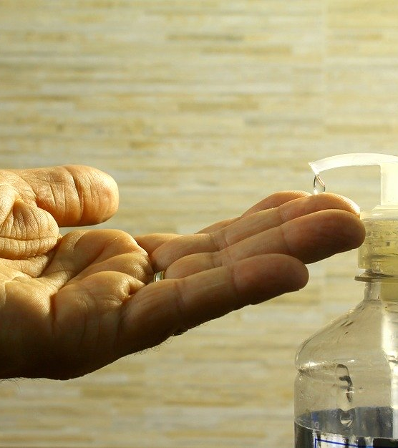
What is the Africa Medical Supplies Platform ?

Slide 3
A marketplace enabling access to critical medical supplies on the African continent
PPEs
(Personal Protective Equipment)
Clinical management devices
Diagnostic kits
Drugs
Vaccines

Slide 4
The platform works in 5 simple steps
Critical medical supplies are sourced
Buyers place orders on the platform
Buyers make payments
Seller prepares shipments
Delivery from seller to countries
Africa CDC platform team and its strategic partners
AU Member States
Authorized Foundations & NGOs
Afreximbank
Manufacturers in Africa & worldwide
Logistics partners (eg.National Airlines, Global Freight Forwarders)

Slide 5
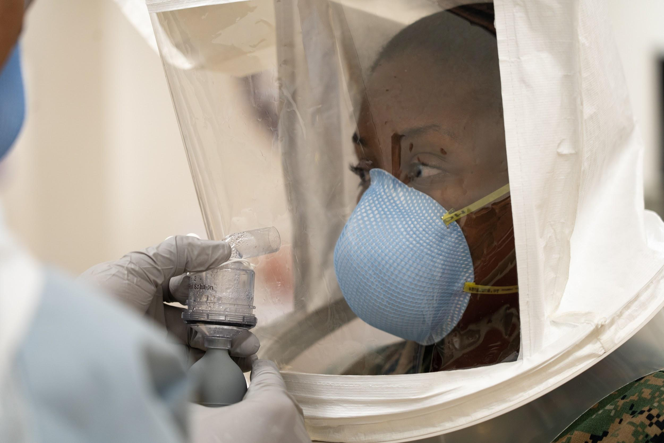
The African Vaccine Acquisition Task Team’s (AVATT) Advance Procurement Commitment (APC)

Slide 6
AVATT’s efforts are concentrated in three areas
Securing adequate amounts of safe & efficacious vaccines
Estimating the funding needs for vaccines procurement & distribution
Creating the financing mechanism required for the vaccine acquisition

Slide 7
Key objectives of the Advance Procurement Commitment (APC) mechanism
01
Member states must be able to access COVID-19 vaccines in a manner that reduces the fiscal burden
on them
GUARANTEE access to vaccines
02
Timely and cost effective availability of vaccine supplies and by so doing, mitigate the protracted financial and socio-economic costs of the COVID-19 pandemic
Equitable ACCESS of COVID-19 vaccines supplies
03
A structure housing a blend of funding/financing mechanisms to support the COVID-19 vaccine procurement requirements
Provision of a CREDIBLE funding platform for all member states

Slide 8
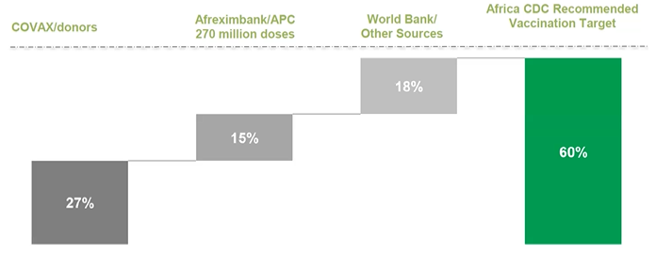
In collaboration with AVATT, Afreximbank has put in place a $2 billion Advance Procurement Commitment (APC) facility for the vaccine acquisition

Slide 9
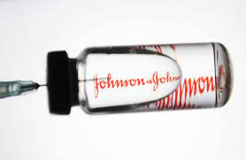
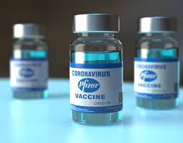
Our achievements include
30 countries on the African continent now opted-in to participate in the APC mechanism

Slide 10
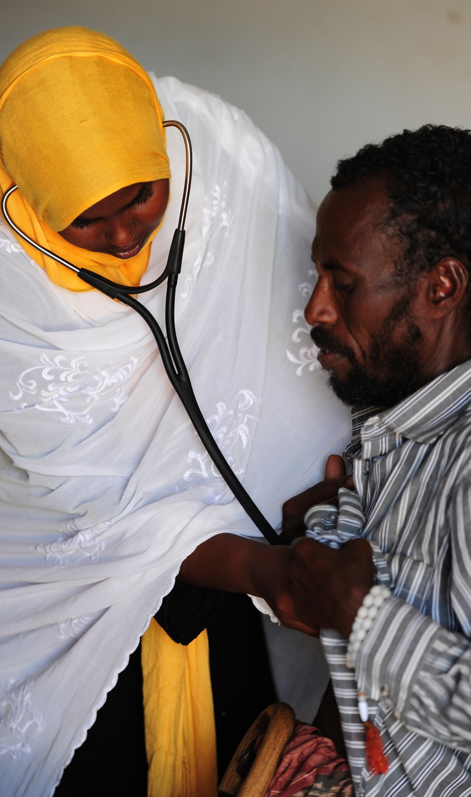
THANK YOU
www.amsp.africa

