Slide 1


Nigeria COVID-19 Vaccine Roll-out
Planning for the COVID-19 vaccination programme roll out in Nigeria
Dr. Bakunawa Garba Bello
NATIONAL PRIMARY HEALTH CARE DEVELOPMENT AGENCY
|

Slide 2

Outline
Background
Planning, coordination and service delivery
Data Management, Surveillance and microplanning Vaccine safety, cold chain and logistics
Risk communication and Demand Generation
2

Slide 3
Background (1/2)
▪
There is a functional multi-sectoral (COVID19 Vaccines Introduction Technical Working Group (TWG) to ensure readiness for timely COVID-19 vaccine introduction in the country
Members of the TWG includes stakeholders involved in COVID-19 response: PTF on COVID-19, FMoH, NPHCDA, NCDC, NAFDAC, NGF, Federal Min of Finance, Budget and National Planning, Federal Ministry of Information, National Orientation Agency (NOA), NTA, CSOs, Professional bodies & Organized private sectors. Other members include development partners and donors
▪
▪
The National Vaccine Deployment Plan (NVDP) for the COVID-19 vaccines introduction has been developed and submitted to the COVAX Facility and African Union (AU)
The main objective of the plan is to introduce COVID19 vaccine in Nigeria to achieve a faster herd immunity to slowdown and interrupt transmission of COVID19 in all parts of the country
The country has commenced phased introduction of the COVID-19 vaccine in the country from the March 8th 2021 using AstraZeneca vaccine for the health workers and other frontline workers.
▪
▪
3

Slide 4


Background (2/2)
•
The Nigeria COVID-19 vaccine introduction technical working group (TWG) has continued to meet daily to track and monitor the status of preparedness towards the successful roll-out of
COVID-19 vaccines in Nigeria
•
The technical working group (TWG) has 4 subgroups – meets
daily
o o o o
Planning, coordination and service delivery Surveillance and micro-planning
Vaccine safety, cold chain and logistics
Risk communication and Demand Generation
•
The technical sub-committees have been up and doing working to ensure that the country is adequately prepared to vaccinate Nigerians with safe and efficacious COVID-19 vaccines
4

Slide 5
Outline
Background
Planning, coordination and service delivery
Data Management, Surveillance and microplanning
Vaccine safety, cold chain and logistics
Risk communication and Demand Generation
5

Slide 6




The Federal Government of Nigeria has received multiple commitments for the delivery of millions of doses of COVID-19 Vaccines to all eligible Nigerians - COVAX facility, African Union Commission, the Government of India and MTN
The Federal Government of Nigeria will be receiving 16,008,000 doses of AstraZeneca AZD1222 vaccines from the Serum Institute through the COVAX facility as early as February. So far a total of 3.924million doses received.
The African Union has approved approximately 41,000,000 doses of AstraZeneca (22.9M doses) and Johnson & Johnson (18.4M doses) of COVID-19 vaccines in the Q2
COVAX Facility
Government of India | MTN Africa
The Government of India has decided to donate 100,000 doses of Covishield (AstraZeneca) vaccines to the FGoN from the Serum Institute of India.
Nigeria is also to receive 1,500,000 doses of AstraZeneca COVID- 19 vaccine from MTN starting with 500,000 doses.
African Union
CEPI: Coalition for Epidemic Preparedness Innovation (CEPI) Gavi: Global Alliance for Vaccines and Immunization
6

Slide 7


The FGoN will be vaccinating all eligible populations (18 years and above) with safe and effective COVID-19 vaccines as it becomes available
Total eligible population of Nigerians is about 108,707,569 (18 and above including pregnant women¹) which makes 51.4% of the total population
Based on the Strategic Advisory Group of Experts on Immunization (SAGE) recommendation, the country for now, will be targeting individuals aged 18 years and above
Nigeria will deploy the TEACH² strategy to vaccinate eligible population towards interrupting the COVID 19 scourge and building a critical mass of immunized Nigerians against the disease
1. TEACH – Traditional, e- self reg, assisted with concomitant H2H
2. Pregnant women will be reviewed by physicians for eligibility
2. 18 and above based on SAGE recommendations
7

Slide 8


TEACH Strategy will combine benefits of several strategies to deploy COVID 19 vaccines in three (3) Pulses in 2021 and pulse 4 in 2022
Characteristics
T.E.A.C.H
Strategy
Traditional Microplanning – Conduct a comprehensive desk review Microplan approach to identify resources needed to vaccinate ~50 – 70% of the total eligible population using trained health workforce and designated vaccination sites. This will leverage already existing structure of HRH, microplanning process and tools
Traditional Microplanning – Conduct a comprehensive desk review Microplan
approach to identify resources needed to vaccinate ~50 – 70% of the total eligible population using trained health workforce and designated vaccination sites. This will leverage already existing structure of HRH, microplanning process and tools
T
Electronic self-Registration of Health Care Workers and other frontline workers using URL shared through health worker platforms. This is done within a specified period and used for vaccination scheduling
Assisted electronic registration of Health Care Workers who are unable to complete self-registration due to lack of android devices, poor network or not tech savvy. LIOs and/or other LGA/Ward personnel assist registration process for Health Care workers
Electronic self-Registration of Health Care Workers and other frontline workers using URL
shared through health worker platforms. This is done within a specified period and used for vaccination scheduling
E
Assisted electronic registration of Health Care Workers who are unable to
complete self-registration due to lack of android devices, poor network or not tech savvy. LIOs and/or other LGA/Ward personnel assist registration process for Health Care workers
A
Concomitant eRegistration of general population especially when the HCWs self- registration has stopped alongside vaccination of eligible population. This will capture any missed beneficiaries while ensuring rollout of vaccination campaigns
Concomitant eRegistration of general population especially when the HCWs self-
registration has stopped alongside vaccination of eligible population. This will capture any missed beneficiaries while ensuring rollout of vaccination campaigns
C
H2H teams deployed specifically to areas where there is poor enrollment or registration of eligible population with low coverage as an added push to register eligible beneficiaries towards target coverage to protect the entire population.
H2H teams deployed specifically to areas where there is poor enrollment or registration
of eligible population with low coverage as an added push to register eligible beneficiaries towards target coverage to protect the entire population.
H
TEACH strategy will combine benefits of traditional microplanning
methods underpinned with appropriate technology
8

Slide 9
Breakdown of *expected allocations of **COVID-19 Vaccines – COVAX and African Union
S/No | Vaccine type | Q1 2021 | Who to target | Q2 2021 | Who to target | Q3 - Q4 2021 | Who to target
1 | AstraZeneca | 5,600,000 | HCWs, frontline workers, ports of entry (air, land and seaports), Military, COVID 19 Rapid Response Team (RRT), lab network, Policemen, petrol station workers, contingency | 15,300,000 | > 50 years, significant co- morbidities, schoolteachers, admin staff who do not fit first two priority groups | 0 | LGAs with highest disease burden, daily case reports and mortality
 |  |  |  | 10,400,000
 |  |  |  | 7,600,000
2 | Johnson & Johnson | 0 |  | 0 |  | 18,400,000
 | Total | 5,600,000 |  | 33,300,000 |  | 18,400,000 | 37,850,000
*These are expected indicative allocation of COVID-19 vaccines at the moment in 2021
** There are additional 1.5M and 100,000 doses of AstraZeneca vaccines expected from MTN and Government of India respectively
9

Slide 10



The TEACH Strategy for COVID 19 vaccination rollout will target the 37.85M eligible Nigerians with 57.3M doses of **COVID-19 vaccines
Pulse
Target Priority Group
Qty of vaccines expected
Population to be covered + Strategy
Pulse 1
2.8m eligible persons
Vaccinated using Fixed post (60%) and
Temporary Fixed Post (40%)
Campaign mode (~10days) in rounds
Priority group 1 & other frontline workers
Some 60-69 years
• 2.8m eligible persons
• Vaccinated using Fixed post (60%) and
Temporary Fixed Post (40%)
• Campaign mode (~10days) in rounds
▪ Priority group 1 & other frontline workers
▪ Some 60-69 years
5.6m doses of AZ
5.6m doses of AZ
2&3: >50 - 59years, 70+, people 18 - 48years with Co- morbidities
33.3m doses (AZ)
16.7m persons
Vaccinated using FP (50%), TFP (30%), MT (20%)
Campaign mode (10days) in rounds
▪ 2&3: >50 - 59years, 70+, people 18 - 48years with Co- morbidities
• 16.7m persons
• Vaccinated using FP (50%), TFP (30%), MT (20%)
• Campaign mode (10days) in rounds
33.3m doses (AZ)
Pulse 3
18.4m doses (J&J)
(18.4m persons)
Vaccinated using FP (70%), TFP (30%)
Routine mode + campaign
Priority Group 4: Focus on states/LGAs with highest disease burden and people who missed first 2 pulses
• (18.4m persons)
• Vaccinated using FP (70%), TFP (30%)
• Routine mode + campaign
Priority Group 4: Focus on
states/LGAs with highest disease burden and people who missed first 2 pulses
18.4m doses (J&J)
16.7m persons
Vaccinated using FP (50%), TFP (30%), MT (20%)
Routine mode
RResestt ofof eleliigigiblblee
populpopulatatiionon aass vvacaccicineness becbecomomee avavaiaillablablee
Based on available vaccines*
•• 116.6.7m7m pperersosonnss
•• VVacaccciinatnateedd ususiingng FFPP ((50%50%)),, TTFFPP
((30%30%)),, MMTT ((20%20%))
•• RRoouuttiinnee mmooddee
Rest of eligible population as vaccines become available
• 16.7m persons
• Vaccinated using FP (50%), TFP (30%), MT (20%)
• Routine mode
Pulse 4
Rest of eligible population
as vaccines become available
Based on available
vaccines*
Fixed Post (FP) - <2km; Temporary Fixed Post (TFP) 2-5km, Mobile Team (MT ) >5km
*As vaccine supply improves
** There are additional 1.5M and 100,000 doses of AstraZeneca vaccines expected from MTN and Government of India respectively
10

Slide 11
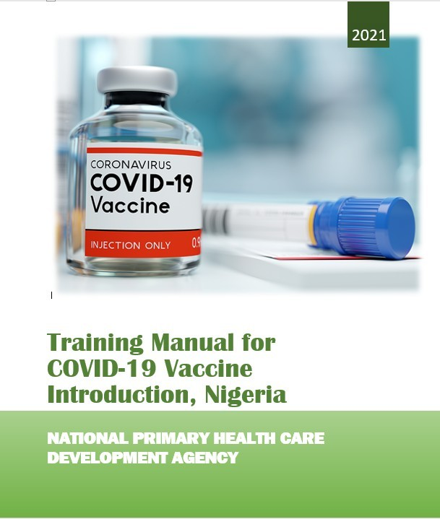

The NPHCDA and partners have developed a comprehensive training plan to guide the overall coordination and implementation of the COVID-19 vaccine introduction
Operational and training manual
Training plans developed
Operational and training manual
Training plans developed
Training materials developed
Training manual
Data tools
Monitoring and supervisory checklists
Training slides developed for use during virtual trainings
National Planning Meeting – Feb 23 - 24 National Training of Trainers – Feb 25 - 27 State/LGA Planning Meeting – Mar 1 – 2 LGA Training of Trainers – Mar 3 - 6 Strategic Politicians Launch – Mar 8 Launch for the General Population – Mar 15
COVID-19 Vaccination Launch – Mar 8

Slide 12
Outline
Background
Planning, coordination and service delivery
Data Management, Surveillance and microplanning
Vaccine safety, cold chain and logistics
Risk communication and Demand Generation

Slide 13
The pre-testing of e-registration and scheduling of health workers for vaccination has been concluded (1st week of February 2021)
A Mini-manual for the e-registration process has been developed for HWs and other users
Pretesting of the e-registration was conducted in Bwari area council from Feb. 2nd – 5th
Prioritized health workers will be scheduled for vaccinations viz:
o o
Share prioritized list of health workers with the states and LGAs
States/LGAs are guided to develop scheduling plan with names of health workers in facilities where they will be vaccinated.
A system generated SMS sent to health workers scheduled for vaccination to notify them of the dates and venues of vaccination
A defaulter tracking system is activated by the state operations room for possible rescheduling where necessary
o
o

Slide 14
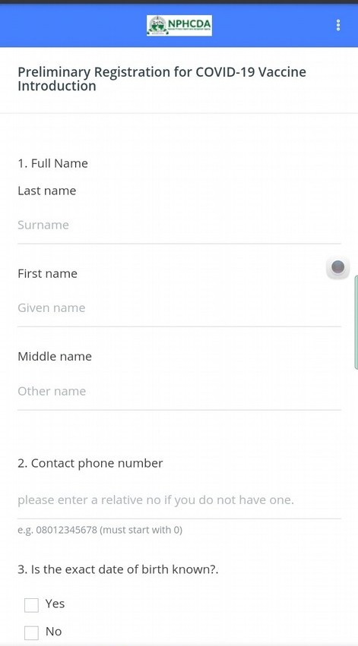
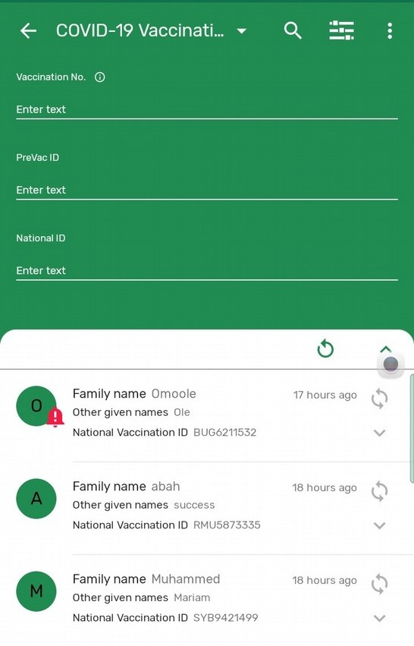
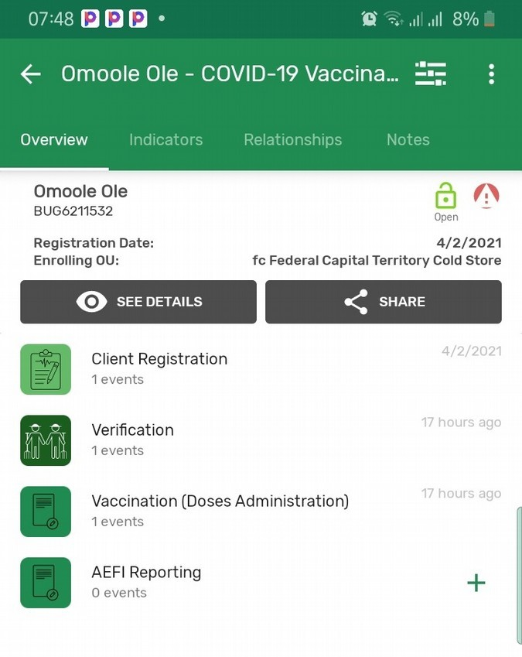
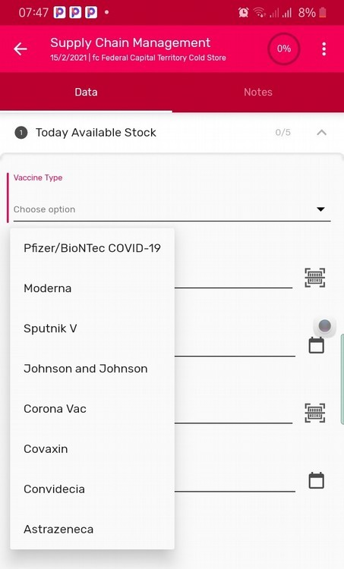
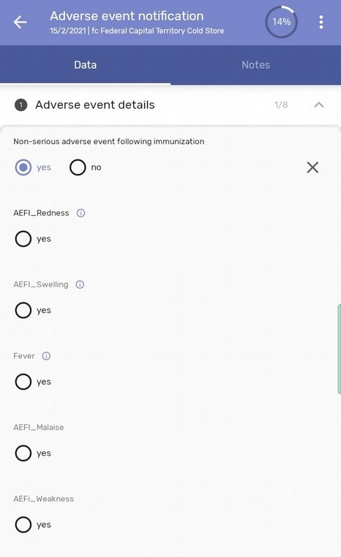
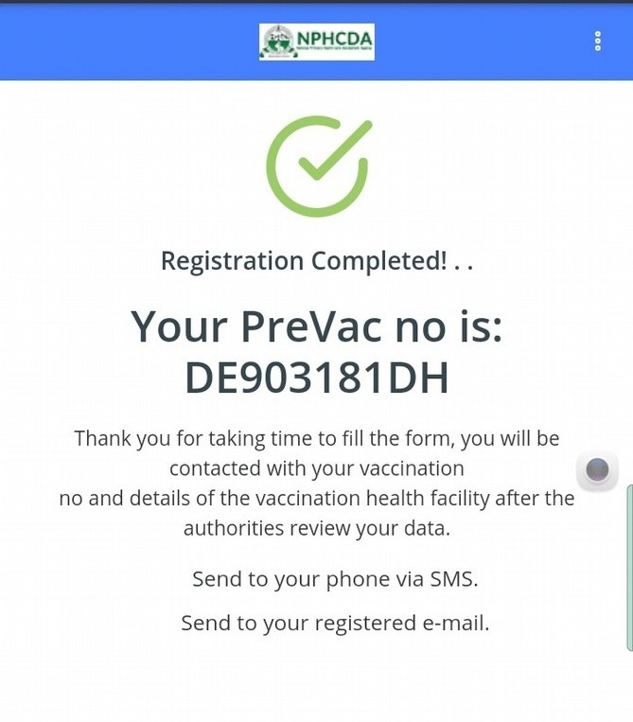
Operationalization…..(1/2) – a simple link for eRegistration
https://nphcdaict.com.ng/publicreg
Use of Mobile phones
Mobile app/ mobile optimized web pages

Slide 15










Operationalization……(2/2)
SMS gateway / service
Clients
Self-Registration for COVID-19 vaccination
NPHCDA server
Health Facilities
COVID-19 Vaccination
Analytics
Assisted registration,
Vaccination
Follow-up documentation
Registration database
Vaccination database
Follow up database
Vaccine and devices database
Optimization and transitioning
SMS gateway / service
Clients
NPHCDA server
National DHIS2 instance
Health Facilities
Routine immunization
(All vaccines in the RI Schedule)
Analytics
Routine immunization at HFs
Registration database
Vaccination database
Follow up database
Vaccine and devices database

Slide 16
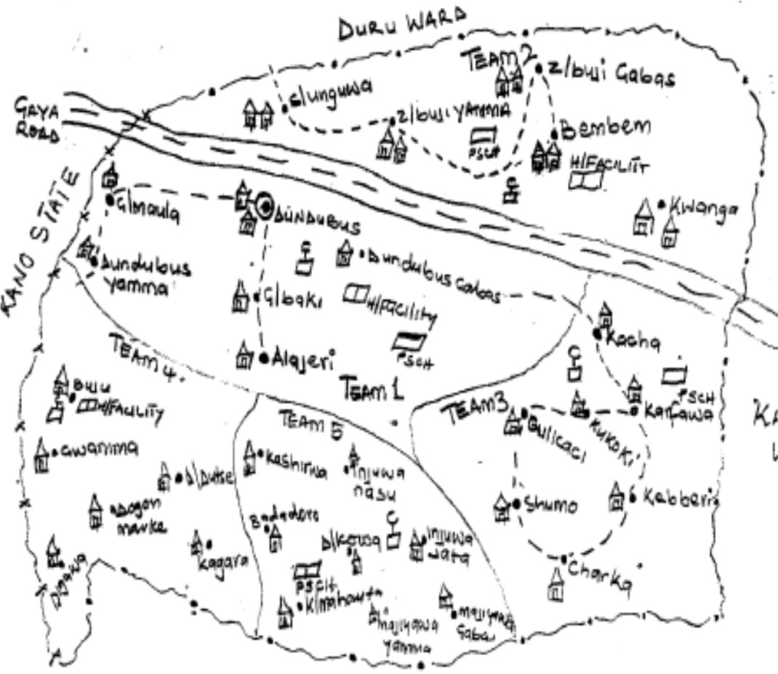
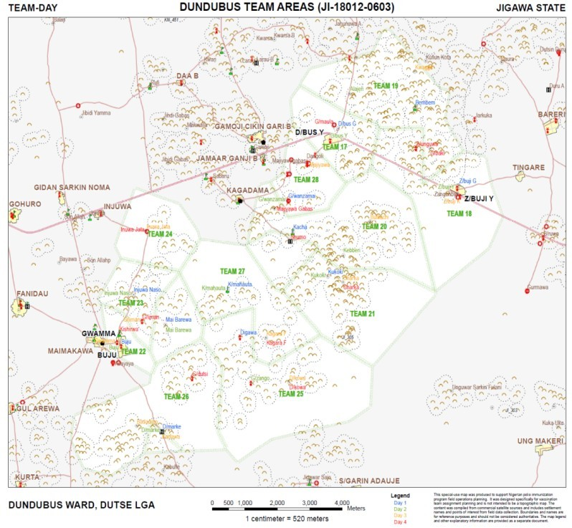
There is a shift from hand-drawn maps to Geographical Information System (GIS) high resolution maps in the conduct of micro planning
1) Original hand drawn map for microplan
2) Revised microplan map based on GIS data with optimized 11 vaccination teams
2
1
4
5
3
Dundubus Ward, Duste LGA of Jigawa State

Slide 17
To improve vaccine coverage and minimize wastage, a micro-planning exercise conducted over a period of 4-5 days is critical for effective planning and delivery of Covid-19 vaccines
Day 1
Day 3
Day 2
Day 4
^{Dundubus Ward, Duste LG}N^{A} P^{of}H^{Jig}C^{aw}D^{a S}A^{tate}– National Primary Health Care Development Agency
17

Slide 18
Outline
Background
Planning, coordination and service delivery
Data Management, Surveillance and microplanning
Vaccine safety, cold chain and logistics
Risk communication and Demand Generation
18

Slide 19
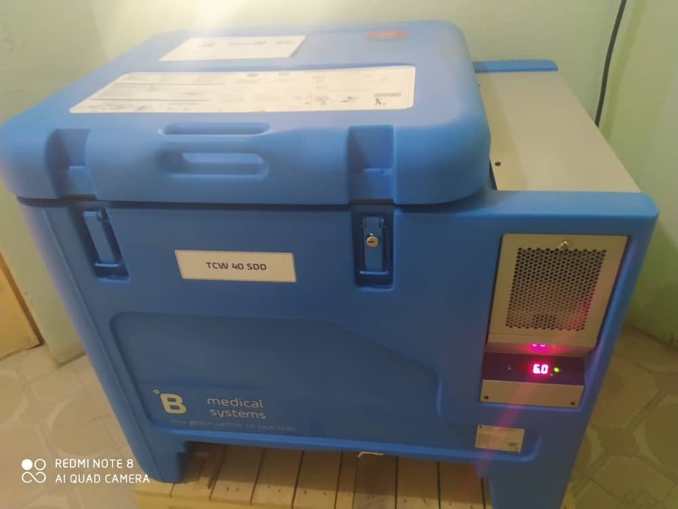
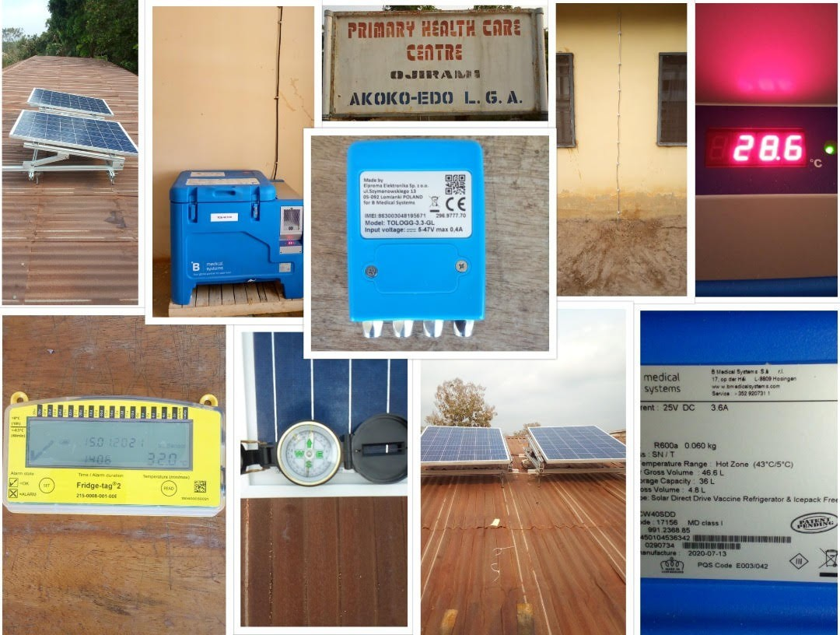
There are sufficient cold chain equipment in the space to accommodate all the expected doses of AstraZeneca & Johnson & Johnson COVID-19 Vaccines at national, zonal and state levels
Solar Direct Drive (SDD) Cold Chain Equipment Stores vaccines at +2 to +8 degree celsius
Solar Direct Drive Refrigerator & it components at Ojirami PHC, Akoko-Edo LGA of Edo State
19

Slide 20
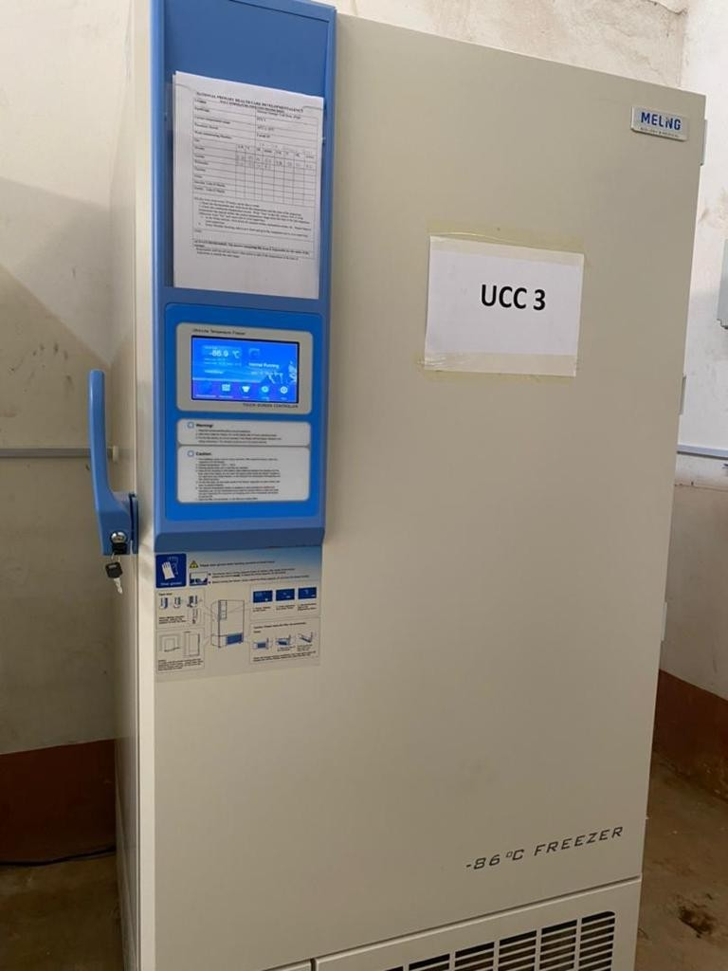
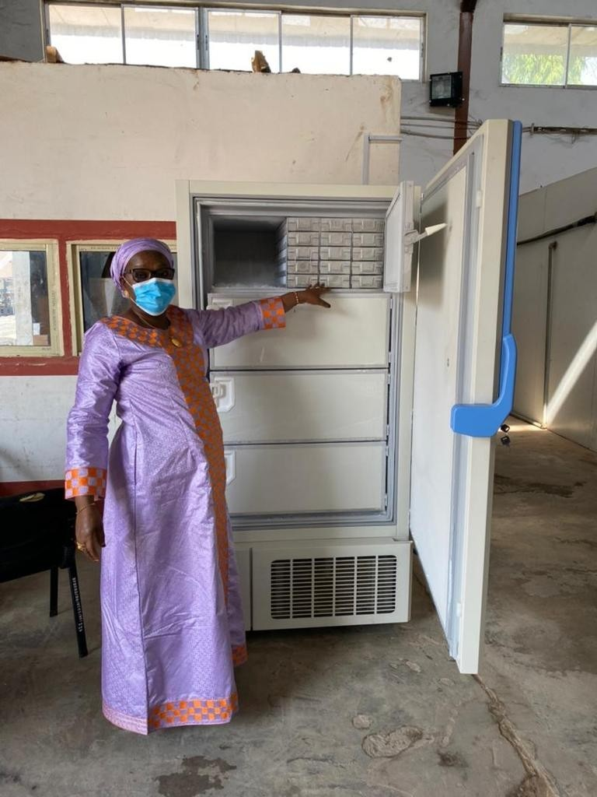
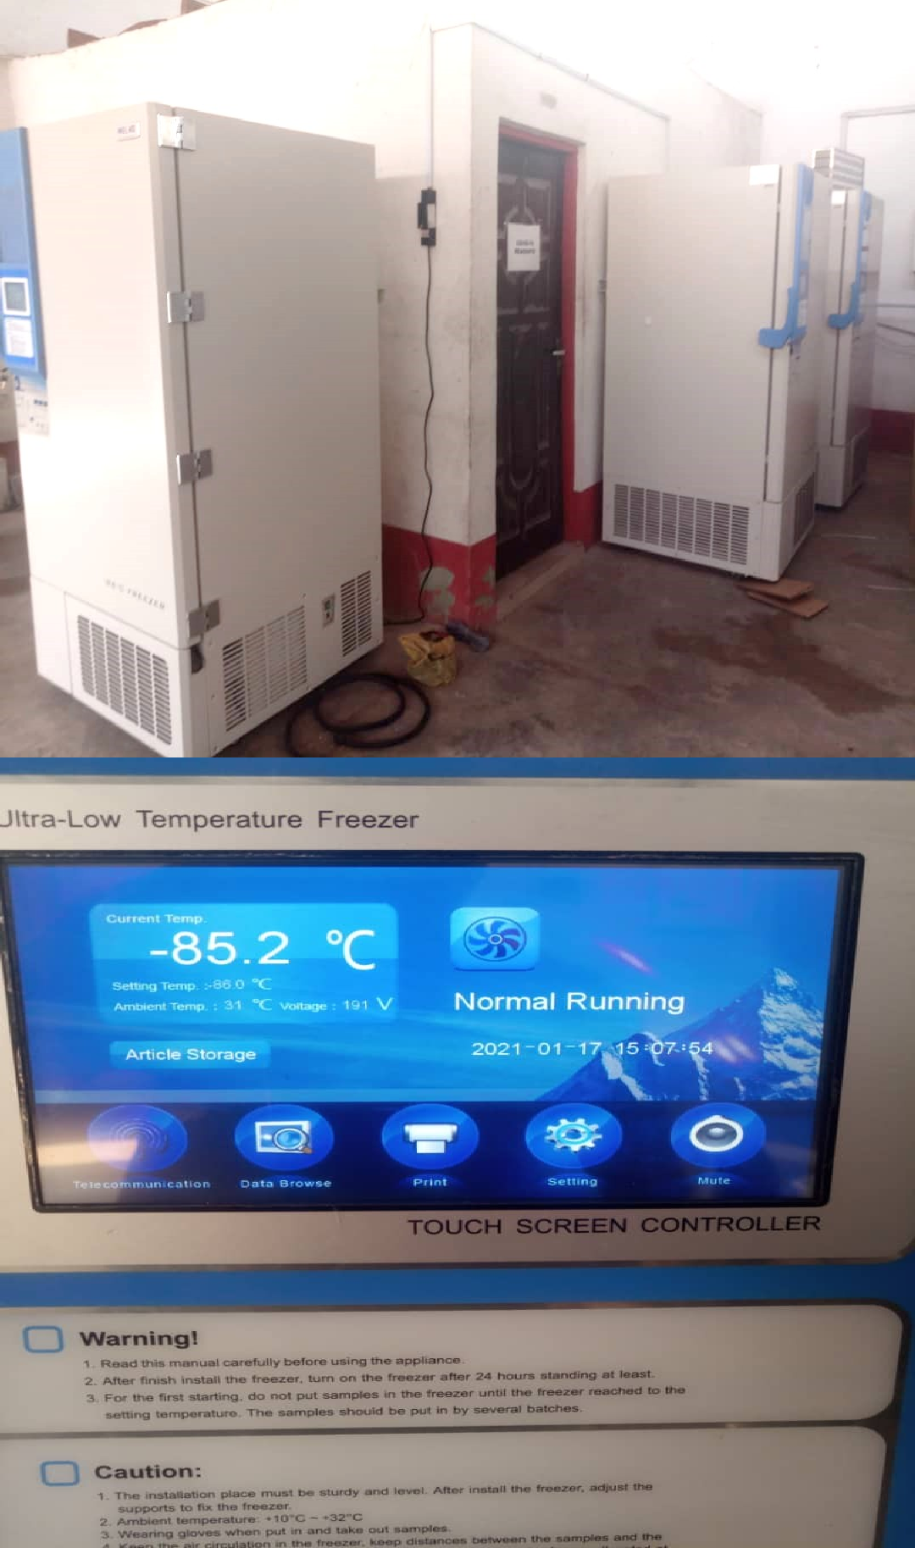


The FGoN currently has 3 units of Ultra-Cold Chain units to store potentially, Pfizer COVID- 19 vaccines and is in the process of procuring additional units for the zonal cold stores
20

Slide 21
COVID-19 Vaccine Arrival
In anticipation of vaccine arrival, an application has already been submitted to NAFDAC for pre- arrival regulatory approvals (Import Permit)
For the COVAX Facility , UNICEF SD will send pre-alerts at least two (2) weeks before arrival of the COVID-19 vaccines and accompanying devices, a clearing agent will immediately be assigned to start airport clearance documentation processes. We have LTAs with clearing agents for vaccines and devices
The COVID-19 vaccine and devices will be airlifted to the Nnamdi Azikiwe International airport,
Abuja
Clearing of the vaccines will be done within 24 hours of arrival, and the vaccines delivered to the
National Strategic Cold Store (NSCS), Abuja, where inspection and necessary store receipt
documentation will be done
NAFDAC will take samples from each batch for analysis to ensure the quality is of global standards and issue batch certificate release
Electronic Vaccine Arrival Report (eVAR) to be sent to UNICEF SD within 72 hrs of arrival
21

Slide 22
Storage of the AstraZeneca Vaccines from COVAX
Storage
The AstraZeneca/Oxford University COVID-19 vaccine can be
months at +2 °C to +8°C and for 30 days at 25°C (Study ongoing)
stored for 9
The AstraZeneca will be stored in Walk In Cold Rooms(WICR) at the National, Zonal and state level.
At the LGA level the vaccines will be stored in vaccine refrigerators.
Health facilities with Solar Cold Chain Equipment will also store the vaccines during implementation.
22

Slide 23
Temperature monitoring to maintain COVID-19 vaccine potency
At the National zonal and state levels remote temperature monitoring devices are used to ensure the vaccines are maintained within the recommended temperature range
At LGA cold stores and Health Facilities 30 D-T-R (30 Day Temperature Recorder) devices are used.
At all levels temperature readings are charted twice a day.
23

Slide 24
Distribution of COVID-19 Vaccines
COVID-19 vaccines and supplies will be distributed through a push system from the national level to the zonal cold stores and from the zonal stores to the thirty-six state cold stores of the federation including Federal Capital Territory (FCT)
Distribution will be funded by the Federal Government through third party logistics firms (3PLs)
The distribution will be based on verified micro plan submitted by states
The bundled vaccines will be distributed to LGA cold stores and during implementation to health facilities with cold chain storage capacity
The Vaccines will be transported in cold boxes using conditioned iced packs as the coolant, each cold box will have a freeze tag because AstraZeneca vaccine is freeze sensitive
24

Slide 25
Vaccine accountability, Traceability and Reverse Logistics
Vaccines will be issued by batch numbers which will be clearly documented at both issuing and receiving stores
Every shipment of vaccines will be accompanied by armed security personnel and validators
NPHCDA will be leveraging on the Polio experience to select the Vaccine Accountability Officers (VAOs) at national, States, LGAs and Ward levels, with clear TORs are to be appointed to support vaccine accountability
The VAOs will keep records of quantities of vaccines and batch numbers and ensure physical count of all returned vials (opened and unopened)
The VAOs will also review data on issuance, receipt and utilization of vaccines on a daily basis
The VAOs will also ensure that records on reverse logistics (usable, punctured vials and filled Safety Boxes) are properly kept

Slide 26
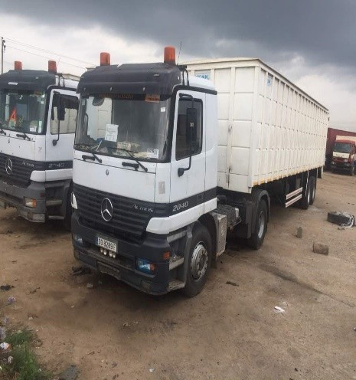
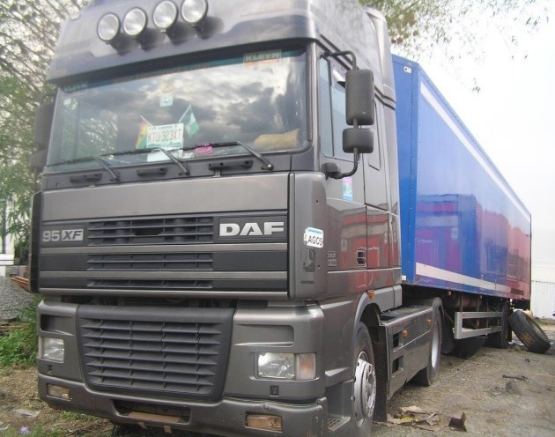
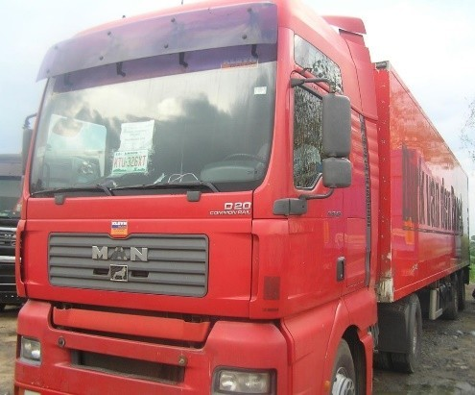
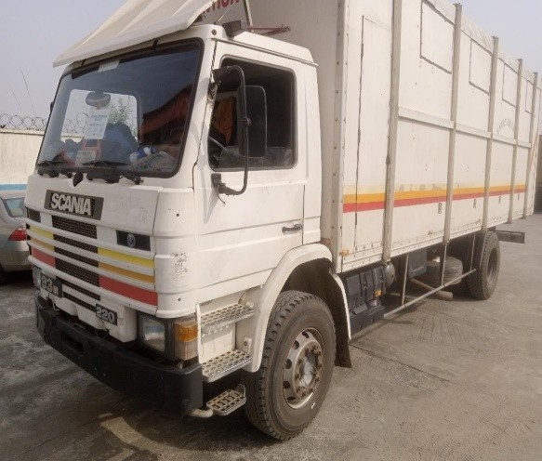
Prepositioned Cold Vaccine delivery Vans from private vendors – more pictures
GENERAL AND HEALTH INTERNATIONAL LIMITED FLEET
Plot 622,Atiku Abubakar Way, Idu Industrial Area, Abuja

Slide 27
Waste Management
Disposal of vaccine vials will be through boil and bury methods. Other wastes will be incinerated
Waste management committees will be reactivated at the State, LGA and Ward levels with clear terms of reference
The WMCs will develop waste management plans, suitable for their areas of responsibility
The committees will be responsible for:
  Identification of collection/holding points for wastes,
  Proper documentation of wastes collected, especially for sharps
  Designing an efficient waste transportation system where required,
  Identification of incineration facilities in the state
  Mobilization of required resources for waste management
  Monitoring of waste management practices

Slide 28
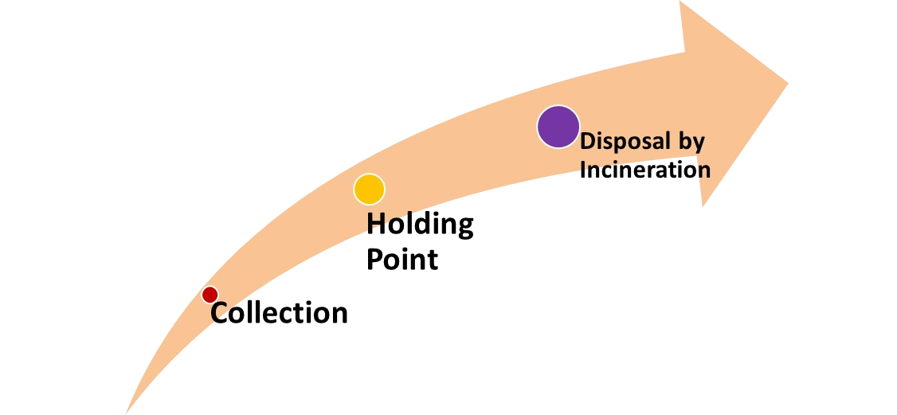


COVID-19 Vaccine: Waste Disposal Management Flow
Waste management is a multi-level
responsibility
The State will be responsible for incinerating the waste at the incineration point.
The LGA and State will work together to move the waste from the holding point to the Incineration point in states with incinerator.
WFP collects from vaccination point and move to LGA holding point
Service delivery point

Slide 29
Outline
Background
Planning, coordination and service delivery
Data Management, Surveillance and microplanning Vaccine safety, cold chain and logistics
Risk communication and Demand Generation

Slide 30



Risk Communication Strategies is being implemented across the different phases of Covid-19 Vaccine Introduction
Phase
Activities Channel
Engage experts (outside govt) to assure Nigerians on vaccine safety
Sensitize stakeholders on what the government is doing
(1)
Pre-arrival (Address Vaccine Safety)
(2)
Arrival and vaccination
Provide evidence of vaccine acceptance
Mobilize communities, create awareness and demand for vaccine
Follow up on vaccinated people to give testimony
Produce evidence of vaccine safety & efficacy and post-vaccination wellness
(3)
Post-vaccination

Slide 31
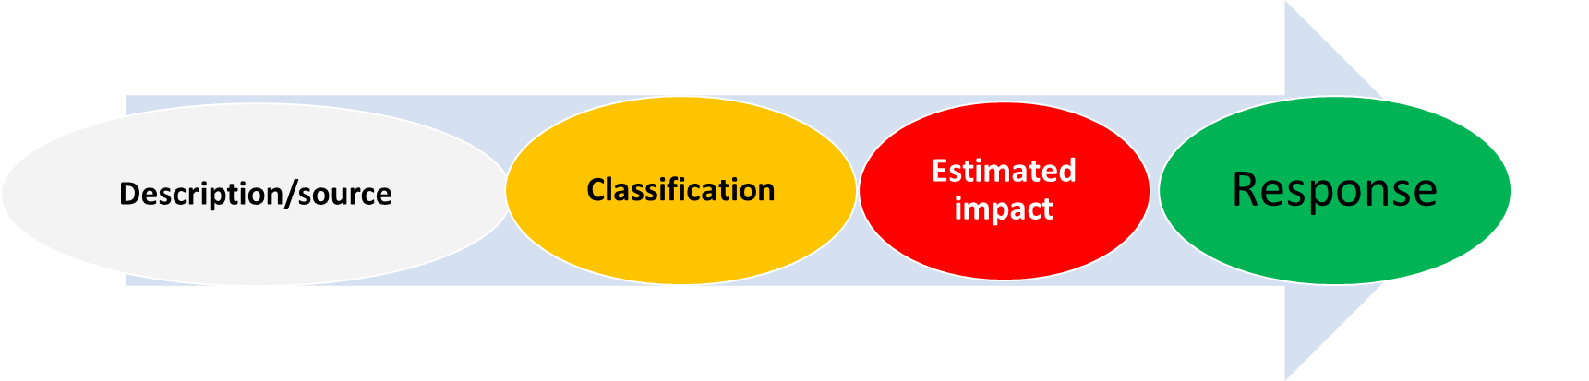
Integrated Rumour management for COVID-19
Requiremen ts
Framework Tools Capacity
Partnership
Web-based –
Connect centre, Media & SM +
scan
Community-based –
Community networks
Integrated Strategy
Key variables

Slide 32
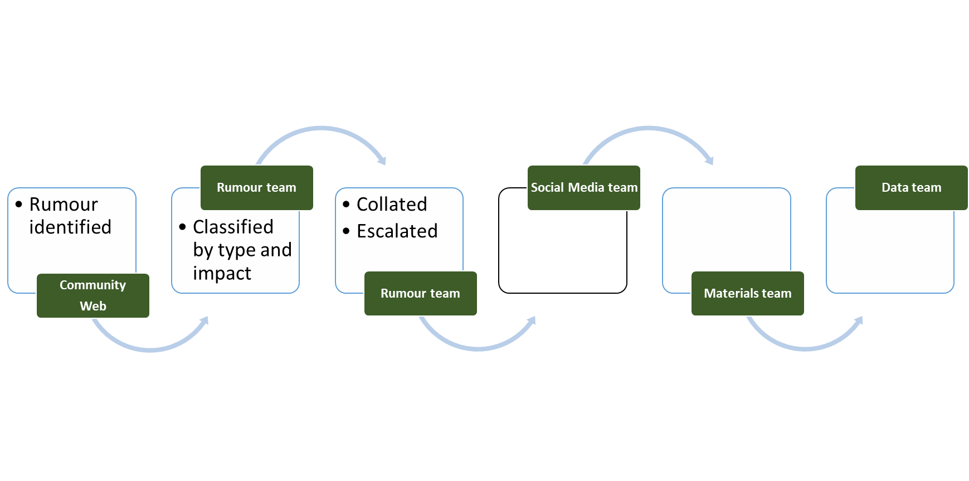
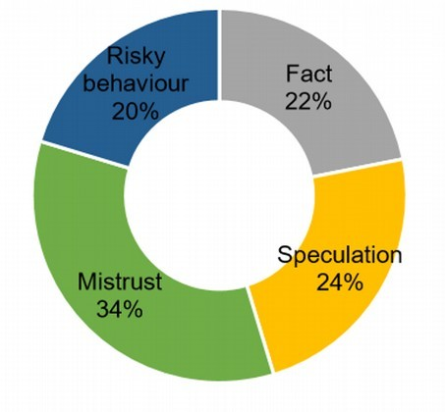
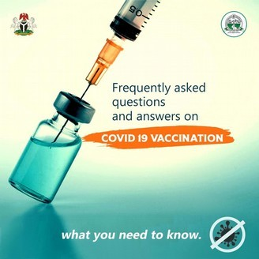
Rumour response process
•
Response drafted
•
Infograph developed
•
Response monitored

Slide 33


