Slide 1
Adenike Oladosu
Urgência da crise climática: percepções da área do Lago Chade

Slide 2
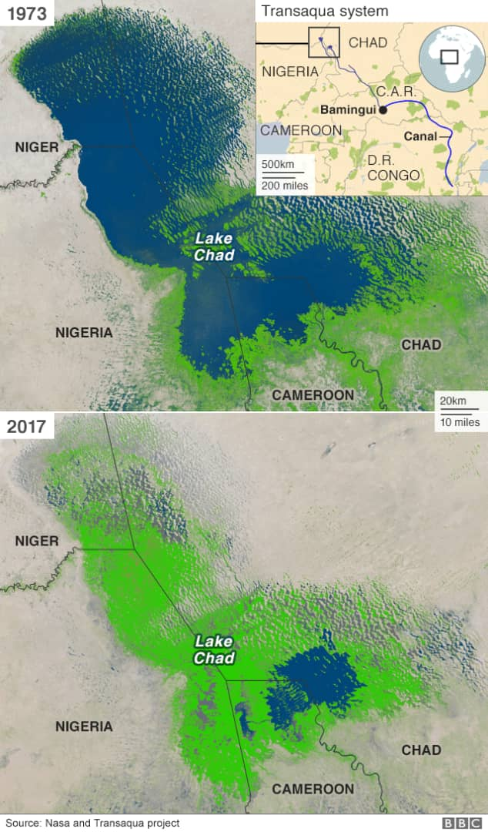

Slide 3
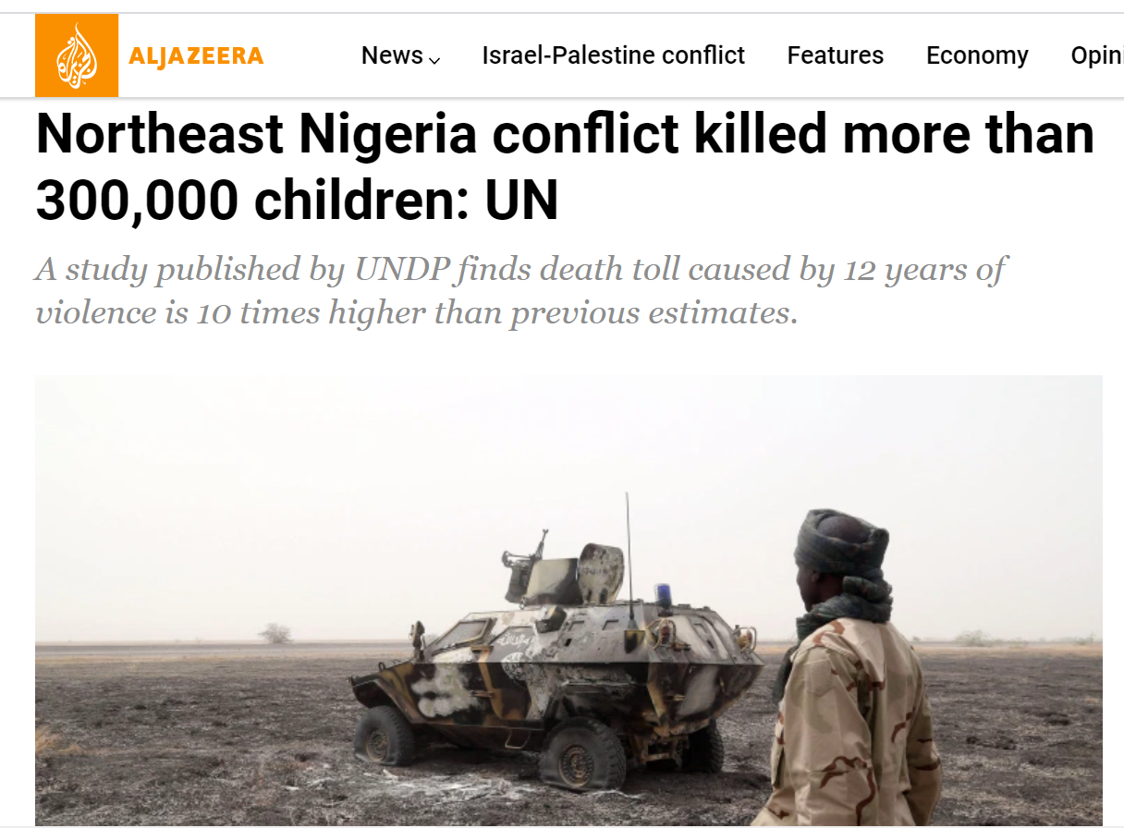
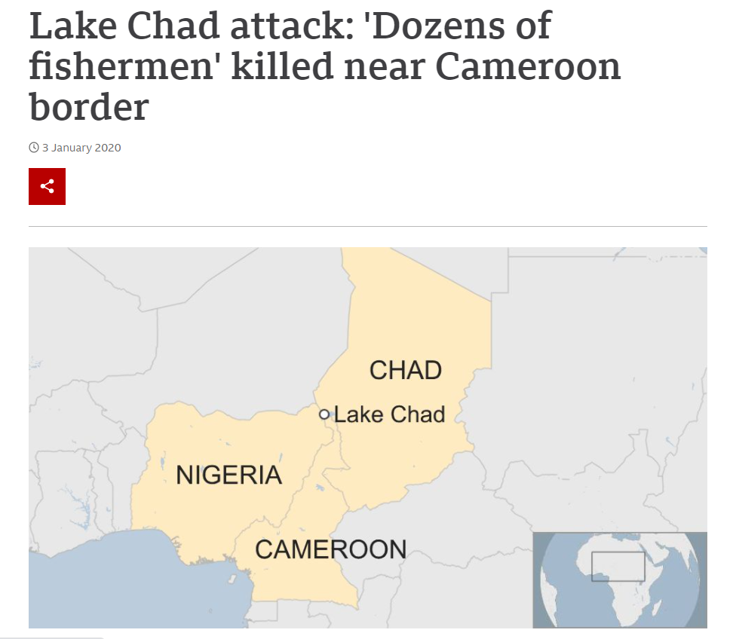
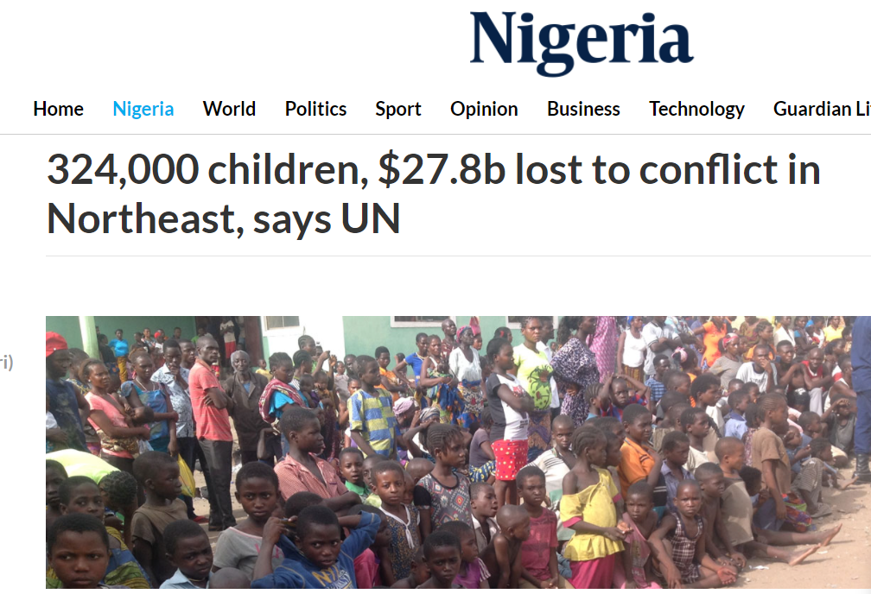
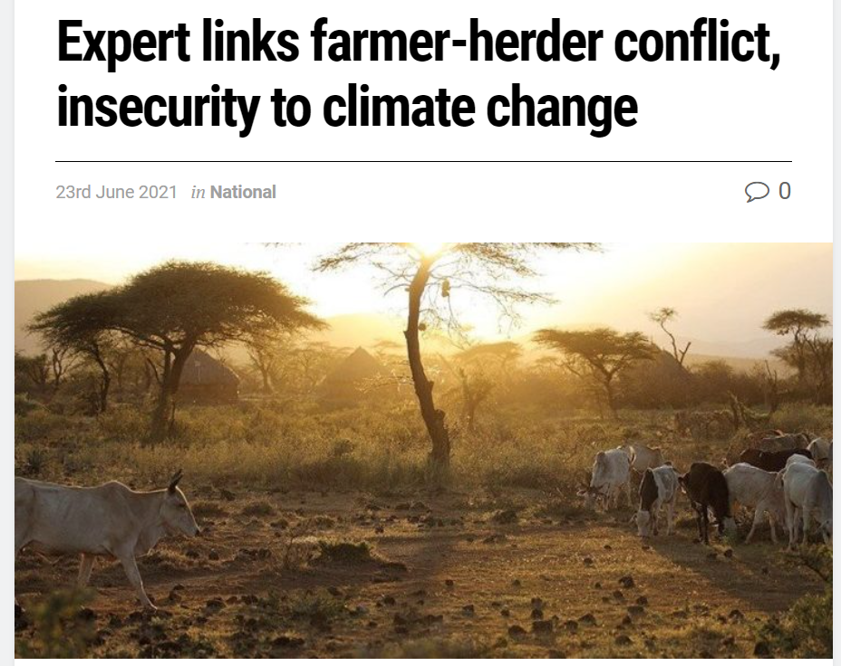
Notes:
https://www.aljazeera.com/news/2021/6/24/northeast-nigeria-conflict-killed-more-than-300000-children-un
https://guardian.ng/news/324000-children-27-8b-lost-to-conflict-in-northeast-says-un/
https://www.sunnewsonline.com/expert-links-farmer-herder-conflict-insecurity-to-climate-change/
https://www.bbc.com/news/world-africa-50987123

Slide 4
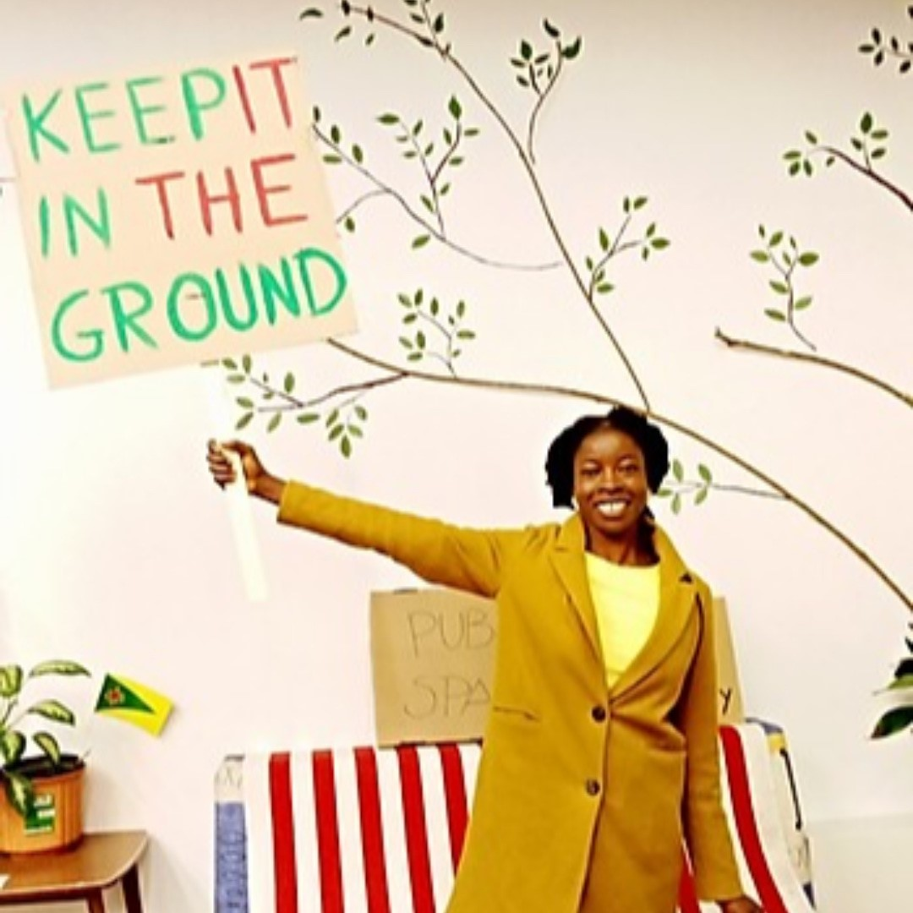

Slide 5
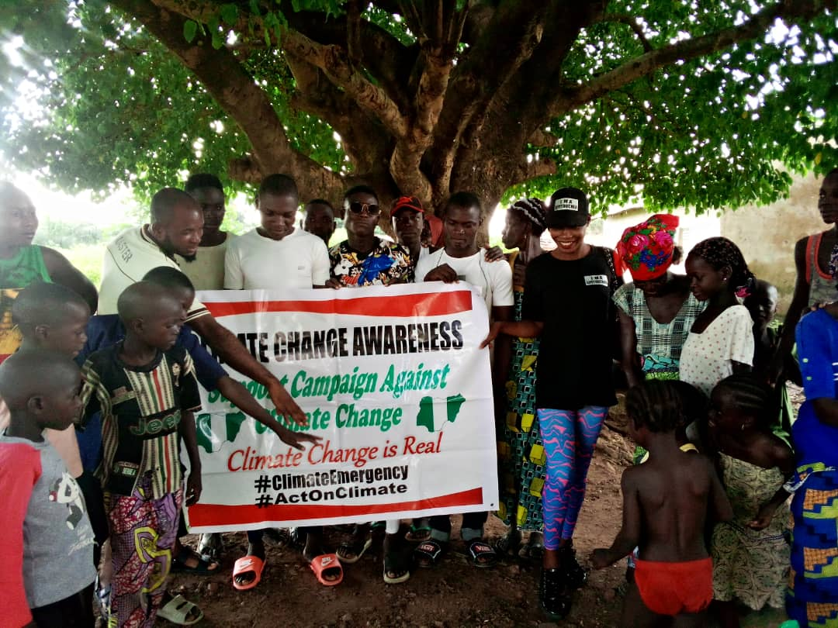

Slide 6
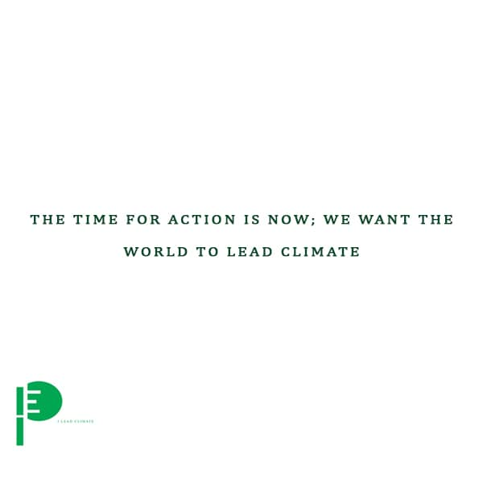
Aqui está o que representamos como Movimento

