Slide 1
Overview of financing options for COVID-19 vaccination programmes
13 April 2021

Slide 2
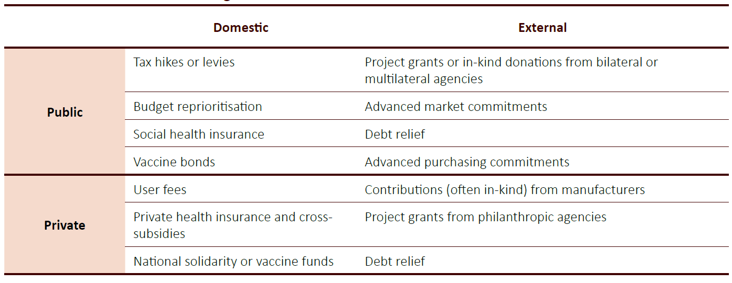
Financing options for COVID-19 vaccination programmes
Notes:
Additional public sector financing gap estimated at US$ 122 billion with tightening of global financial markets, capital flight to safety and the decline in financial inflows—foreign direct investments, remittances and portfolio flows—have led to widening sovereign bond spreads and currency depreciations accompanied by a sudden uptick in inflation in many countries
IMF predicts that African government revenues will fall between 20% and 30%. Many developing countries rely on income from areas that have been all but wiped out by the pandemic, such as remittances, tourism and exports of raw materials.

