Slide 1
JUNE 29, 2021
The International Framework
for Integrating Gender and
Climate Change
TARA DANIEL
PROGRAM MANAGER
WOMEN'S ENVIRONMENT AND DEVELOPMENT ORGANIZATION (WEDO)

Slide 2
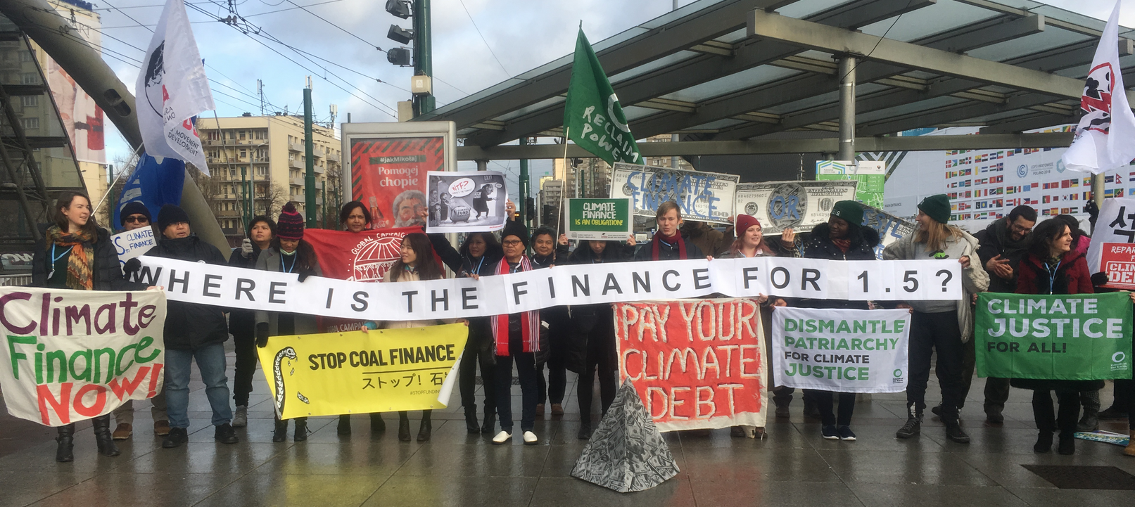
QUESTIONS
How does international policy recognize the importance of gender equality in climate action?
How can climate finance be gender-responsive?
What are current opportunities to advance gender equality with climate finance?

Slide 3
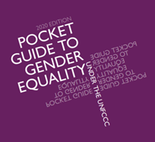
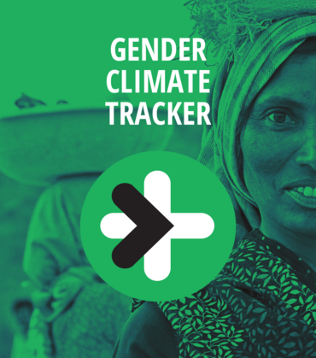
GENDER AND CLIMATE CHANGE UNDER THE UNFCCC
2015: Paris Agreement
Acknowledging that climate change is a common concern of humankind, Parties should, when taking action to address climate change, respect, promote and consider their respective obligations on human rights, the right to health, the rights of indigenous peoples, local communities, migrants, children, persons with disabilities and people in vulnerable situations and the right to development, as well as gender equality, empowerment of women and intergenerational equity
80+ Mandates for Gender within the UNFCCC
across technology, capacity-building, finance
Enhanced Lima Work Programme & Gender Action Plan
adopted at COP25 in 2019

Slide 4
GENDER ACTION PLAN ACTIVITIES
D.1 Share experience and support capacity-building on gender budgeting, including on the integration of gender-responsive budgeting into national budgets to advance gender-responsive climate policies, plans, strategies and action, as appropriate
D.2 Raise awareness of the financial and technical support available for promoting the strengthening of gender integration into climate policies, plans, strategies and action, as appropriate, including good practices to facilitate access to climate finance for grass-roots women’s organizations and indigenous peoples and local communities
Parties, the secretariat, and relevant organizations all have responsibilities and opportunities such as submissions and an expert group meeting.

Slide 5
CLIMATE FUNDS UNDER THE UNFCCC
814 million committed to 118 projects
30+ National Implementing Entities
Least Developed Countries Fund & Special Climate Change Fund: more than $2 billion committed
1,000+ mitigation projects in 160 countries:
$4.2 billion committed
8.4 billion committed to 173 projects, 68 in Africa
~50 Direct Access Entities (National)

Slide 6
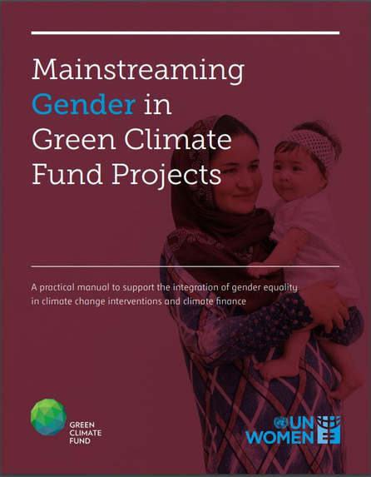
ADAPTATION FUND
GREEN CLIMATE FUND
"The Fund and its implementing partners shall strive to uphold women’s rights as universal human rights and to attain the goal of gender equality, the empowerment of women and girls and the equal treatment of people regardless of gender, including the equal opportunities for access to Fund resources and services, in all Fund operations through a gender mainstreaming approach."
"Gender equality considerations should be mainstreamed into the entire project cycle to enhance the efficacy of climate change mitigation and adaptation interventions, and ensure that gender co-benefits are obtained...Gender main-streaming is fundamental to any project
intervention and does not
necessarily signify
additional costs; in fact,
mainstreaming gender
makes climate
interventions more
effective and efficient."

Slide 7
RESOURCES
NATIONAL GENDER & CLIMATE CHANGE FOCAL POINTS
Benin | Burkina Faso | Burundi | Cameroon | Central African Republic | Chad Comoros | Congo | Côte d’Ivoire | Democratic Republic of the Congo Eswatini Ethiopia | Gabon | Guinea | Liberia | Madagascar | Malawi Mauritania Mozambique | Namibia | Niger | Nigeria | Republic of Ghana Sao Tome and Principe | Senegal | Sierra Leone | South Africa | Sudan Togo | Uganda
Zambia | Zimbabwe
GUIDANCE ON PLANNING AND POLICY DOCUMENTS
WOMEN AND GENDER ORGANIZATIONS

