Slide 1
Lessons from Kingdom of Eswatini
DEPARTMENT OF GENDER AND FAMILY ISSUES – DEPUTY PRIME MINISTER’S OFFICE
BY: Mpendulo Masuku (Mr)
Gender Monitoring and Evaluation Analyst

Slide 2
1. Climate change in the national Gender Strategy
Eswatini recently reviewed her National Gender Policy 2010
Thematic area “12.8 Environment and Natural Resources”, no mention of “Climate Change”
Plan fairly implemented without Costed Action Plan with M&E Framework
2019 process of reviewing policy began, with International and National Technical support (Consultants) – UNDP Eswatini
Currently due for Approval at Cabinet Level – After fist presentation came with comments
Commonwealth Gender and Climate Change Experts also enhanced the Policy , Implementation Strategy and M&E Plan immensely.

Slide 3
2. Eswatini’s new Gender Policy 2020-2030
Embracing Sustainable Development Goals (SDGs – Agenda 2030)
Embracing AU Agenda 2063 “ the Africa We Want”
Embracing all other Gender Equality advancement conventions and protocols i.e. CEDAW, Beijing Declaration and Platform for Action as well as UNFCCC recently

Slide 4
Contents…
Thematic Area - Section/ Chapter 12.8 on “Environment, Natural Resources and Climate Change “
Thematic Policy Statement - “The Government shall ensure that environmental and climate change policies, … programmes and action plans take into consideration issues of gender in terms of access, control, benefits as well as management of the natural resources.”
Education and Training Thematic Area – the need and intention to create curriculum with climate change content to educate children and especially young girls to be climate SMART
Capacity building initiatives to increase the awareness and knowledge around climate change as well as how the intersections between Gender and Climate Change play out in the real world (societal norms and values)

Slide 5
Gender and NDCs?
Women and disadvantaged groups are disproportionately affected by negative climate change effects.
They also face unequal access to economic resources, and climate-related information and decision-making.
NDC is the national climate action plan
Mainstreaming gender equality and supporting more inclusive approaches in climate action offer a pathway to more effective, resilient climate action

Slide 6
Eswatini’s NDC and Gender
Gender Assessment for Eswatini by World Resources Institute (Baseline)
Gender related knowledge products- Video, webinars (in pipeline)
Technical Advisory Group of NDC revision includes Dept. of Gender and Family Issues (DPMO)
Gender and Climate Change Workshop with Gender Experts from government and Civil Society Organisations
Final NDC have measures that promote gender equality/Gender responsive NDC
MRV system and NDC implementation to ensure gender mainstreaming

Slide 7
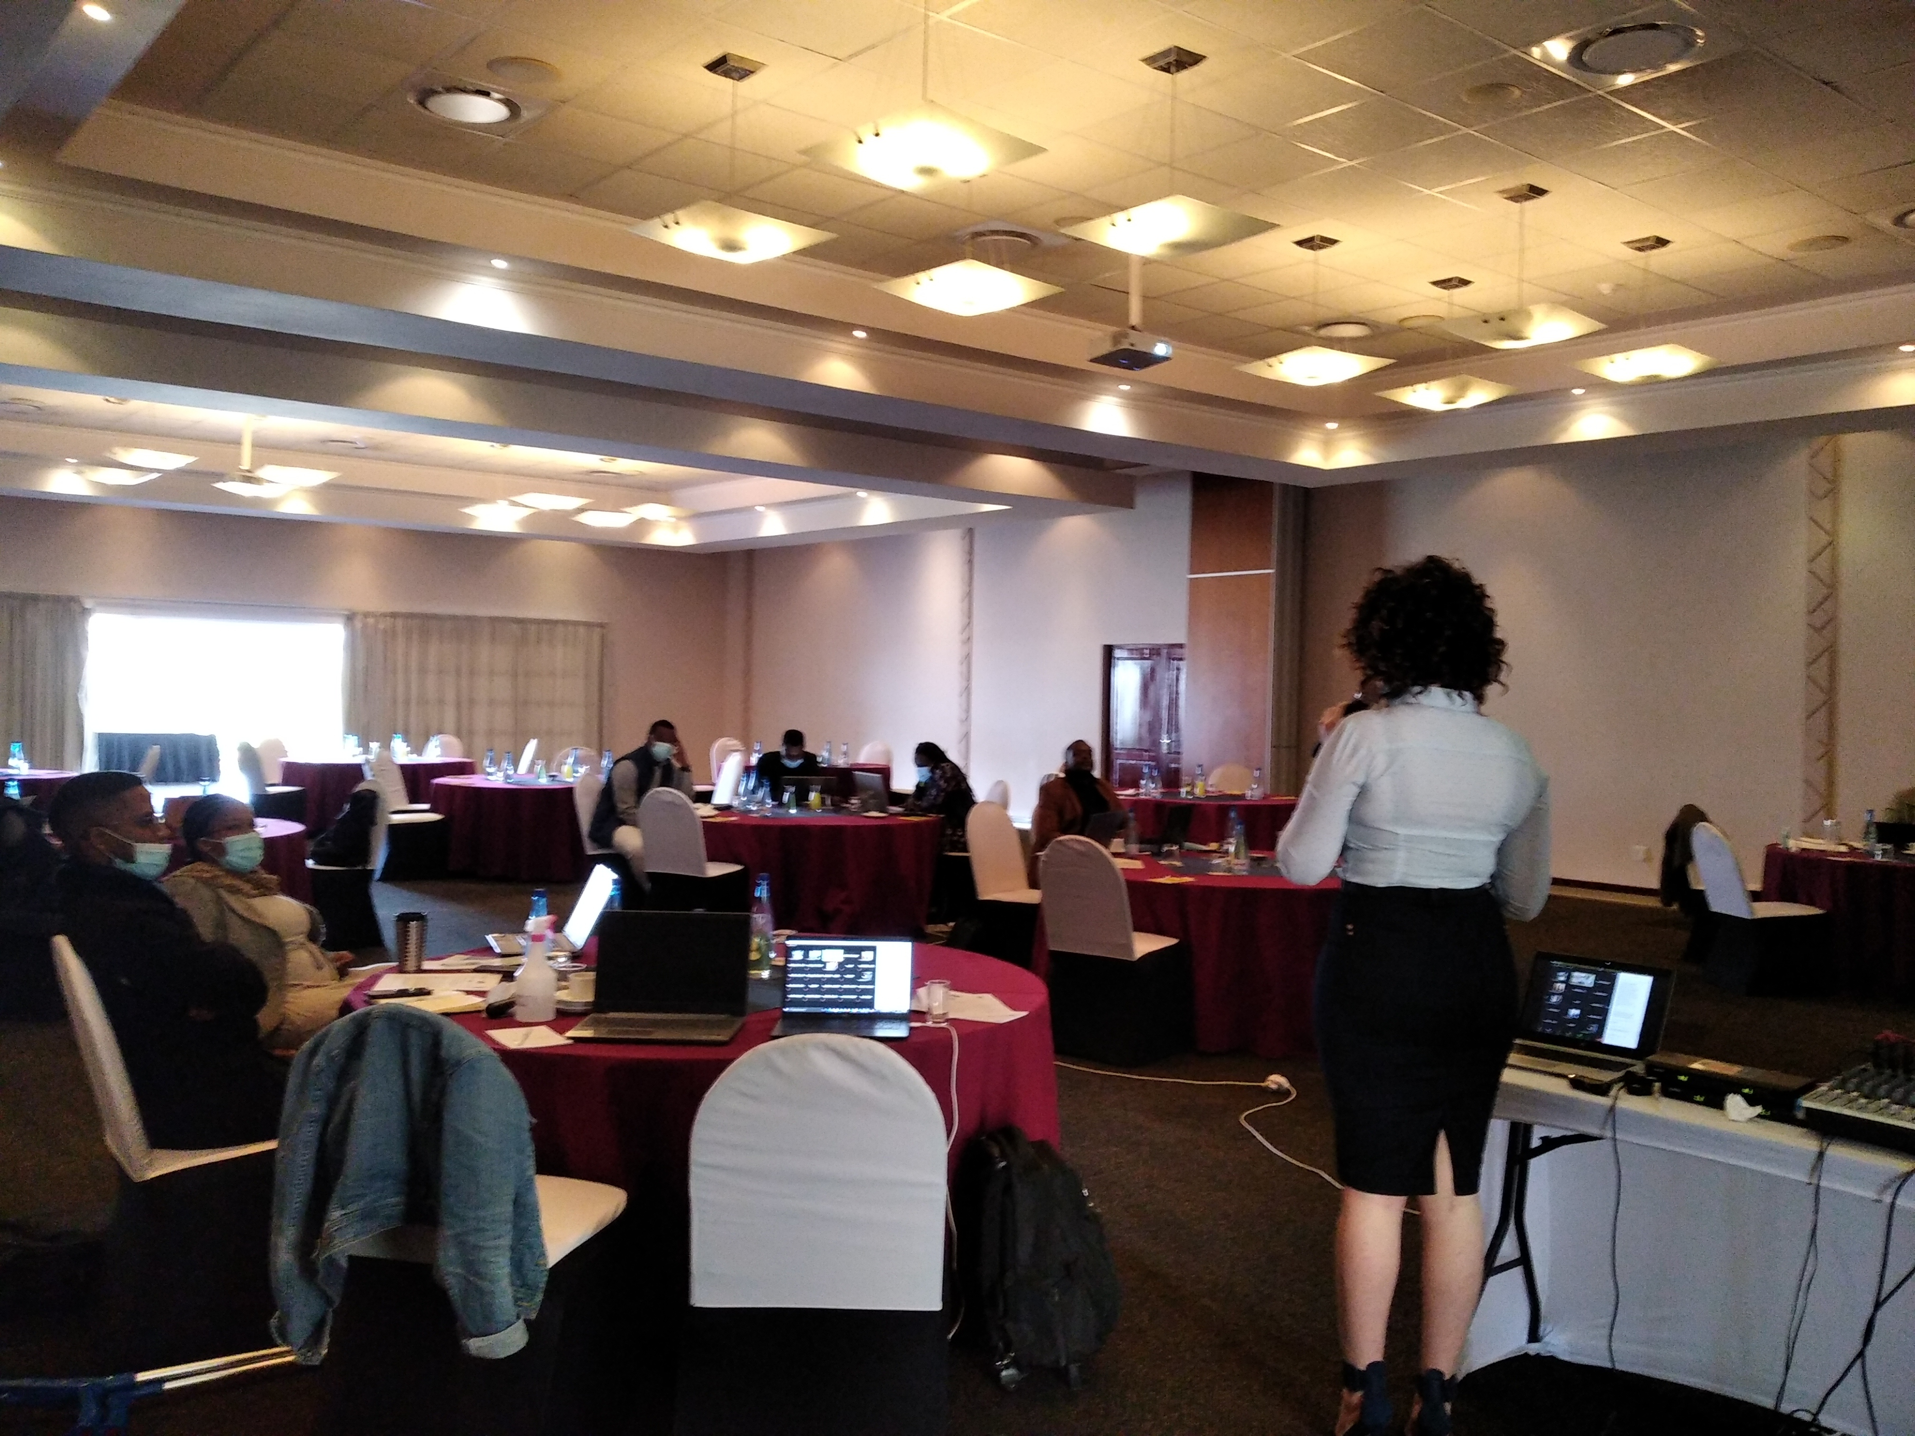
Gender and Climate Change workshop (NDC revision process)
Gender and climate change workshop held on 15 June
15 Participants physically
33 participants virtually
Gender policy presented- ideas on climate change integration into gender policy
NDC measures discussed- how to mainstream gender into NDC processes discussed

Slide 8
Lessons learnt
Working together and synergising can help everyone – eg. Synergising gender and climate change workshop – jointly organizing it with DPMO Gender dept., helped NDC process and also Gender policy review

Slide 9
Thank you Siyabonga

