Slide 1
CABRI : Peer-Learning and Exchange on the Opportunities to Coordinate the Integration of Gender and Climate Change into Budgeting and Financing
Gender-responsive budgeting in Morocco :
Focus on the Gender Budget Report
Mrs. Hajar BEN AMEUR
Head of Budget Performance Monitoring and Gender-responsive Budgeting
Ministry of Finance
Center of Excellence for Gender-Responsive Budgeting
Notes:
A compléter

Slide 2
The reference framework for equality in Morocco
The 2011 Constitution
Conventions, protocols and agendas : BEIJING, CEDAW, SDGs …
Government programme 2017-2021
Royal Incentives
Plans of the Government on Equality «ICRAM 1 » 2012-2016 and « ICRAM2 » 2017-2021
« Morocco-Attamkine » Programme for economic autonomy of women and girls by 2030
National Policy to combat violence against women and girls by 2030
The New development model

Slide 3
GRB in Morocco: 20 years of experience
2020-2021
Close support of Ministerial departments
Methodological and conceptual enhancement for the deployment of GRB
Establishment
Anchoring
2016-2019
Foreshadowing performance-driven GRB
Foreshadowing
3
2015
Organic Law No. 130-13 of the Finance Law making GRB compulsory for all Ministries
Organic Laws No. 111-12, No. 111-13, No. 111-14 making gender-sensitive planning mandatory at local level
Realisation
Legislations
2013
Creation of the Center of Excellence for GRB
2
Agency
2009-2012
Capacity building and training of Ministerial departments on understanding and the challenges of GRB
Training
Launching
2005
Preparation of the first issue of the Gender Report accompanying the 2006 PLF
Enhancement of the National Information system with gender-sensitive data
Tools
2001-2004
Awareness and capacity building
Partnership with UN Women
Study on "The methodological feasibility of gender and child budget accounts": : recommendations for the GRB in Morocco
Awareness
1

Slide 4
GRB in Morocco: a support at the level of the Organic Law relating to the Finance Law
Articles of OFL130-13
Implication for the budget programming of ministerial departments
Content
".... The gender aspect is taken into consideration when setting objectives and indicators ...."
The budget programme of each department must be associated with objectives to reduce inequalities, including the achievement of results measured by indicators
Report accompanying the presentation of the draft Finance Law
Tool to analyse public policies in relation to the principles of gender equality
Article 39
".... Budget reporting based on the results – taking into
account the gender aspect .... "
Article 48

Slide 5
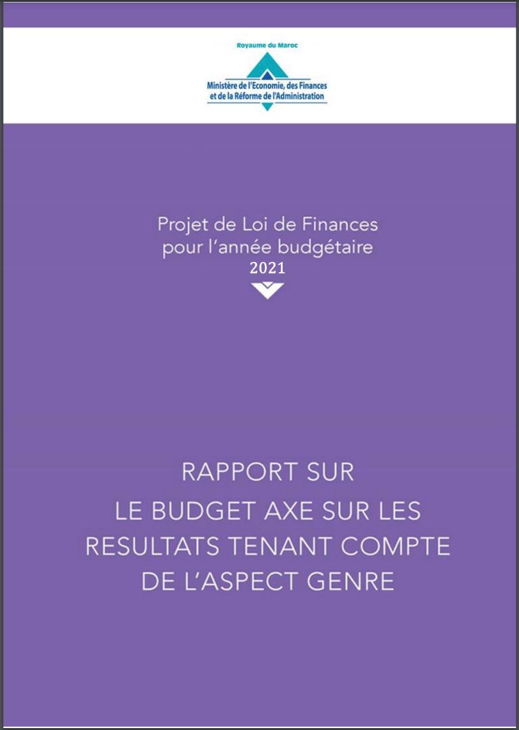
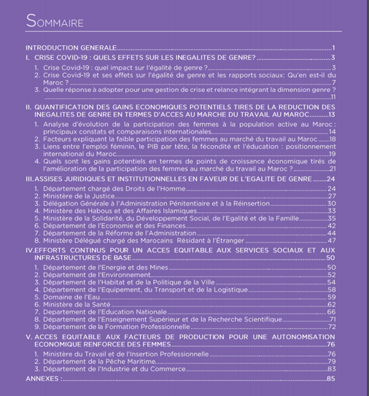
The Results-Based Budget Report which factors in the Gender Aspect (GRB) in Morocco
GRB: Instrument for analysis and evaluation under the gender prism of public policies developed in line with a process
Progressive, reflected in the expansion of the number of ministerial departments it covers ;
Participatory, in the involvement of ministerial departments in its drafting ;
Iterative, produced annually when the Finance Bill is presented in Parliament.

Slide 6
GRB: more than 15 years of practice
Objectives of GRB: Present the efforts made by the ministerial departments within the framework of their programmes and budgets with regard to the promotion of equality and strengthen the accountability of the Government vis-à-vis the parliament and the citizens
2005: 4 Departments
Rigid analytical framework: a gender analysis of the situation, an analysis of public priorities, programmes and projects implemented as well as a gender analysis of budgets
2010: 21 Departments
Integration of a cross-sectional synthesis into the RG and a gender analysis of performance indicators
2018-2019 :
27 Departments
Analytical approach that tries to apply a gender-sensitive performance approach
2020: Redesign of the Report

Slide 7
Main improvements to the GRB
Improving the relevance of gender-sensitive results chains
Gender-sensitive data collection and analysis
Alignment between the GRB and the Government Plan for Equality (PGE II)
Annual analysis of topics related to GRB that benefit the economic prosperity of the country
Strengthening of the coordination between ministerial departments
Alignment between GRB development processes and performance documents

Slide 8
GRB today: organised and coordinated stakeholder engagement
Improving gender-responsive result- chains
Gradual operationalisation of intersectorality
Continuous enrichment of information systems with gender-sensitive data (coordination with the HCP)
Regular use of GRB capacity building
Involvement of Top Management

Slide 9
GRB: a more structured content based on the contribution of the Ministries
Introduction
Purpose of the GRB
Explanation on the new GRB elements and their content
I. Macro-economic importance of gender equality
Findings from studies on the macro-criticality of gender equality as an integral part of promoting stability and economic growth
II. For effective gender equality: Major advances and strengthening tools
Legislative and institutional progress in institutionalising gender equality in public policies and promoting the culture of equality, briefly highlighting particularly significant new achievements in specific sectors in support of gender equality between women and men
III. Towards an application and appropriation of a gender-sensitive performance approach by ministerial departments
Legal and institutional foundations for gender equality
Continued efforts for equitable access to social services and basic infrastructure
Equitable access to factors of production for greater economic empowerment of women
Statistical appendices
Situation of gender inequalities in the organisational structures of the Department
Access of women and men to public service in the sectors of activity for which the relevant Department is responsible

Slide 10
Grb: main persisting challenges
Integration of gender-sensitive aspects at the end of the results-chain (indicators or sub-indicators). Which implies :
- Few gender-targeted programmes
- Limited number of gender targets
- Significant number of gender- sensitive indicators
Concepts related to gender equality in general and GRB in particular, are not yet fully understood in a harmonised way by ministerial departments…
A common understanding of GRB to be strengthened
Use of sectoral gender assessments to be systematised
An adoption of a "top-down and bottom-up" process for the genderisation of the results-chains to be allocated
Gender analysis is an essential prerequisite for any action aimed at promoting gender equality;
The availability and analysis of gender-sensitive data are challenging for some sectors ...

