Slide 1
NATIONAL STRATEGIES AND BUDGET FORMULATION Nigeria: National Action Plan on Gender and Climate Change (NAPGCC)
By Acting director, DEPARTMENT OF climate change
Halima bawa-bwari

Slide 2
History of gender in the climate change process
The concept of “gender” was introduced in the global climate change discussions and the first decision on gender and climate change was at COP 7 in 2001 and it was Decision 36/CP.7.
Focus- Increasing the participation of women delegations and in constituted bodies under the convention and the Kyoto Protocol.

Slide 3
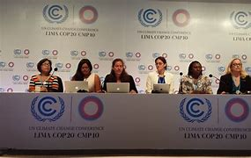
The Lima Work Programme on Gender (LWPG)
The UNFCCC at COP 20 in Lima in 2014, provided opportunity to advance the issue of gender equality in relation to addressing climate change which was called the LWPG.
Focus- Article 17 and 18 requests the UNFCCC Executive Secretary to develop and ensure the implementation of an action plan for the two-year Plan of Action on gender and climate change and invites Parties and relevant organizations to provide the means for implementing gender-related activities within the two-year Work Programme.

Slide 4
Gender and Climate Change in Nigeria
Gender and climate change discussion in Nigeria have been ongoing since its inception at the international conventions.
On the 13th and 14th of July, 2016, a 2-day National Stakeholder’s Consultative workshop on Gender and Climate Change took place in Abuja.
The workshop was organized to develop a common and unique voice on the issues of gender and climate change especially in preparation for entry into force of the Paris Agreement and implementation of Nigeria Intended Nationally Determined Contribution (INDC).
The event was organized by the Federal Ministry of Environment, Department of Climate Change in collaboration with Women Environmental Program (WEP) and United Nations Development Program (UNDP).

Slide 5
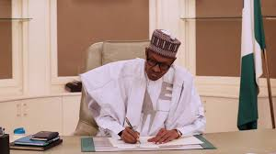
The Paris Agreement
At COP 21 in Paris, on 12th December 2015, Parties to the UNFCCC reached a landmark agreement to combat Climate Change and to accelerate and intensify the actions and investments needed for a sustainable low carbon future.
The Paris Agreement’s central aim is to strengthen the global response to the threat of Climate Change by keeping a global temperature rise to well below 2⁰C above pre-industrial level and to pursue efforts to limit the temperature increase even further to 1.5⁰C
Nigeria ratified the Paris Agreement in 2017.

Slide 6
Gender Action Plan
At COP 23, a Gender Action Plan was adopted and this initiative was in line with implementing the Paris Agreement and the Nationally Determined Contribution (NDC).
The GAP sought to advance women’s full, equal and meaningful participation and promote gender-responsive climate policy.

Slide 7
Capacity building, knowledge sharing and communication
Gender balance, participation and women’s leadership
Coherence.
Gender responsiveness and means of implementation
Monitoring and Reporting.
GAP PRIORITY AREAS - 2018

Slide 8
Nigeria’s National Action Plan on Gender and Climate Change
In a bid to domesticate the International Gender Action Plan, the Federal Ministry of Environment, through the Department of Climate Change developed a National Action Plan on Gender and Climate Change
The action plan focuses on effective strategies for integrating gender into the implementation of national climate change initiatives, including the Paris Agreement, the Nationally Determined Contributions (NDC) and the ERGP in Nigeria.

Slide 9
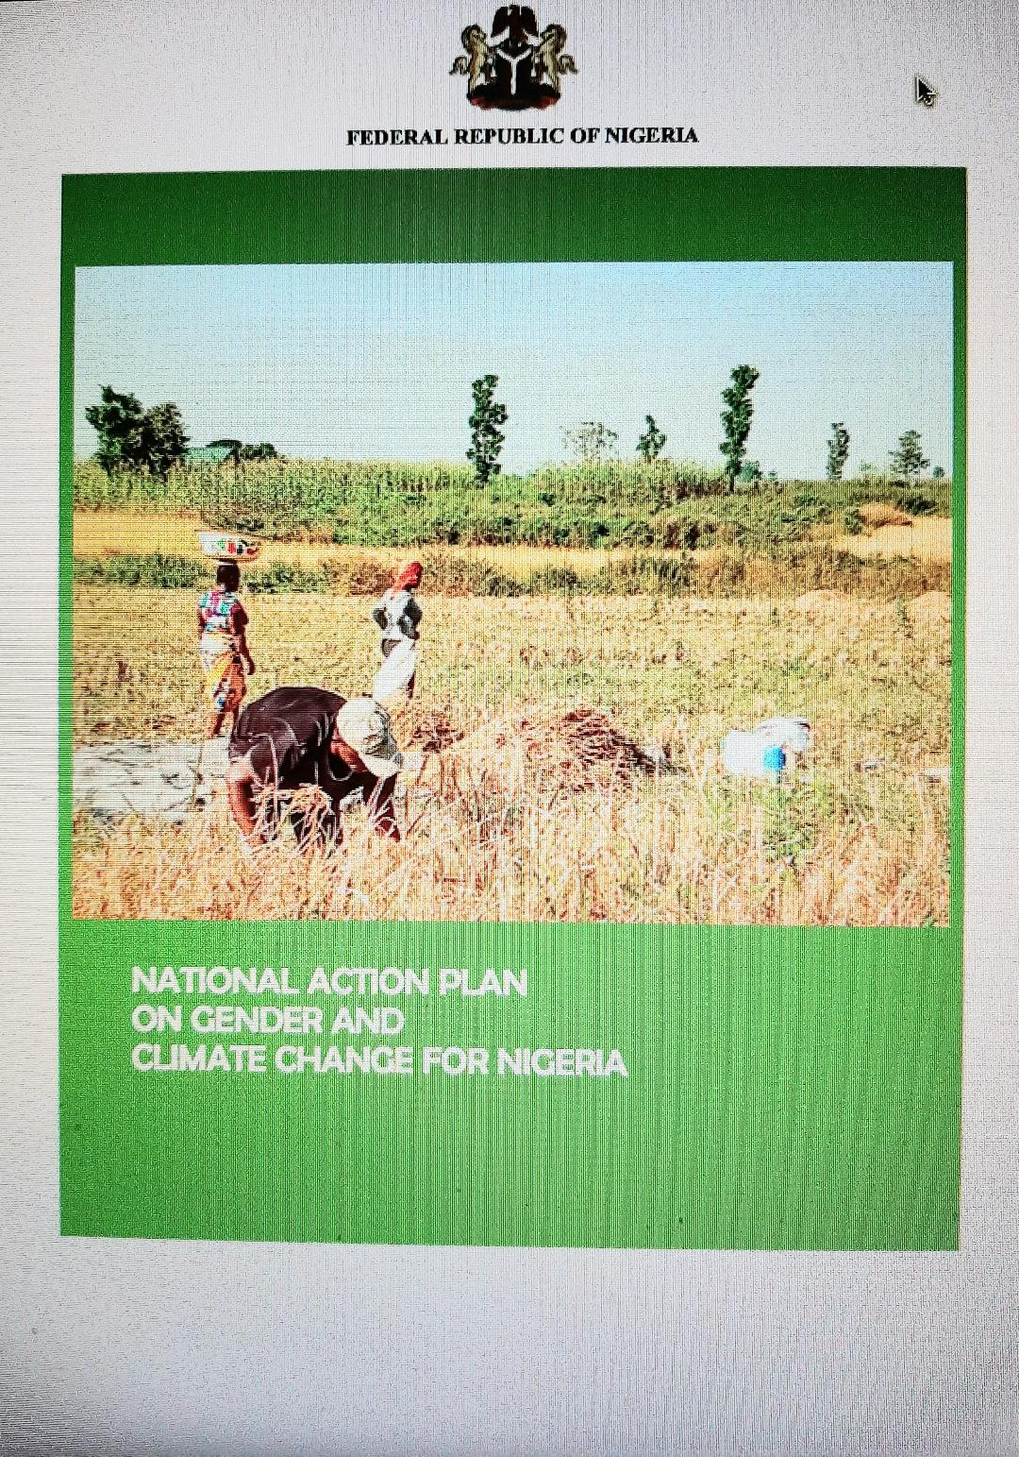
Nigeria’s National Action Plan on Gender and Climate Change
The goal of the Action Plan is to ensure that national climate change processes in Nigeria mainstream gender considerations to guarantee inclusivity of all demographics in the formulation and implementation of climate change initiatives, programs and policies

Slide 10
Priority sectors covered by the Action Plan
Agriculture, Forestry and Land use
Food Security and Health
Energy and Transport
Waste Management
Water and Sanitation

Slide 11
Presently
The document was approved by the Federal Executive Council (FEC) on the 12th of August 2020.
The implementation of the Action Plan will be governed by a participatory approach involving the governments at all levels, academic, and research institutions, CSOs, particularly women groups, private sector and non-state actors as well as development partners.
The development of implementation strategy has been done.

Slide 12
Integration of Gender and Climate Change into Budgeting and Financing
UNFCCC GAP PRIORITY AREA D: Gender-responsive implementation and means of implementation.
Activities:
D.1: specifically targets capacity building and integration of gender -responsive budgetting into National Budgets towards advancing gender responsive climate change policies, plans, strategies, actions, among others.

Slide 13
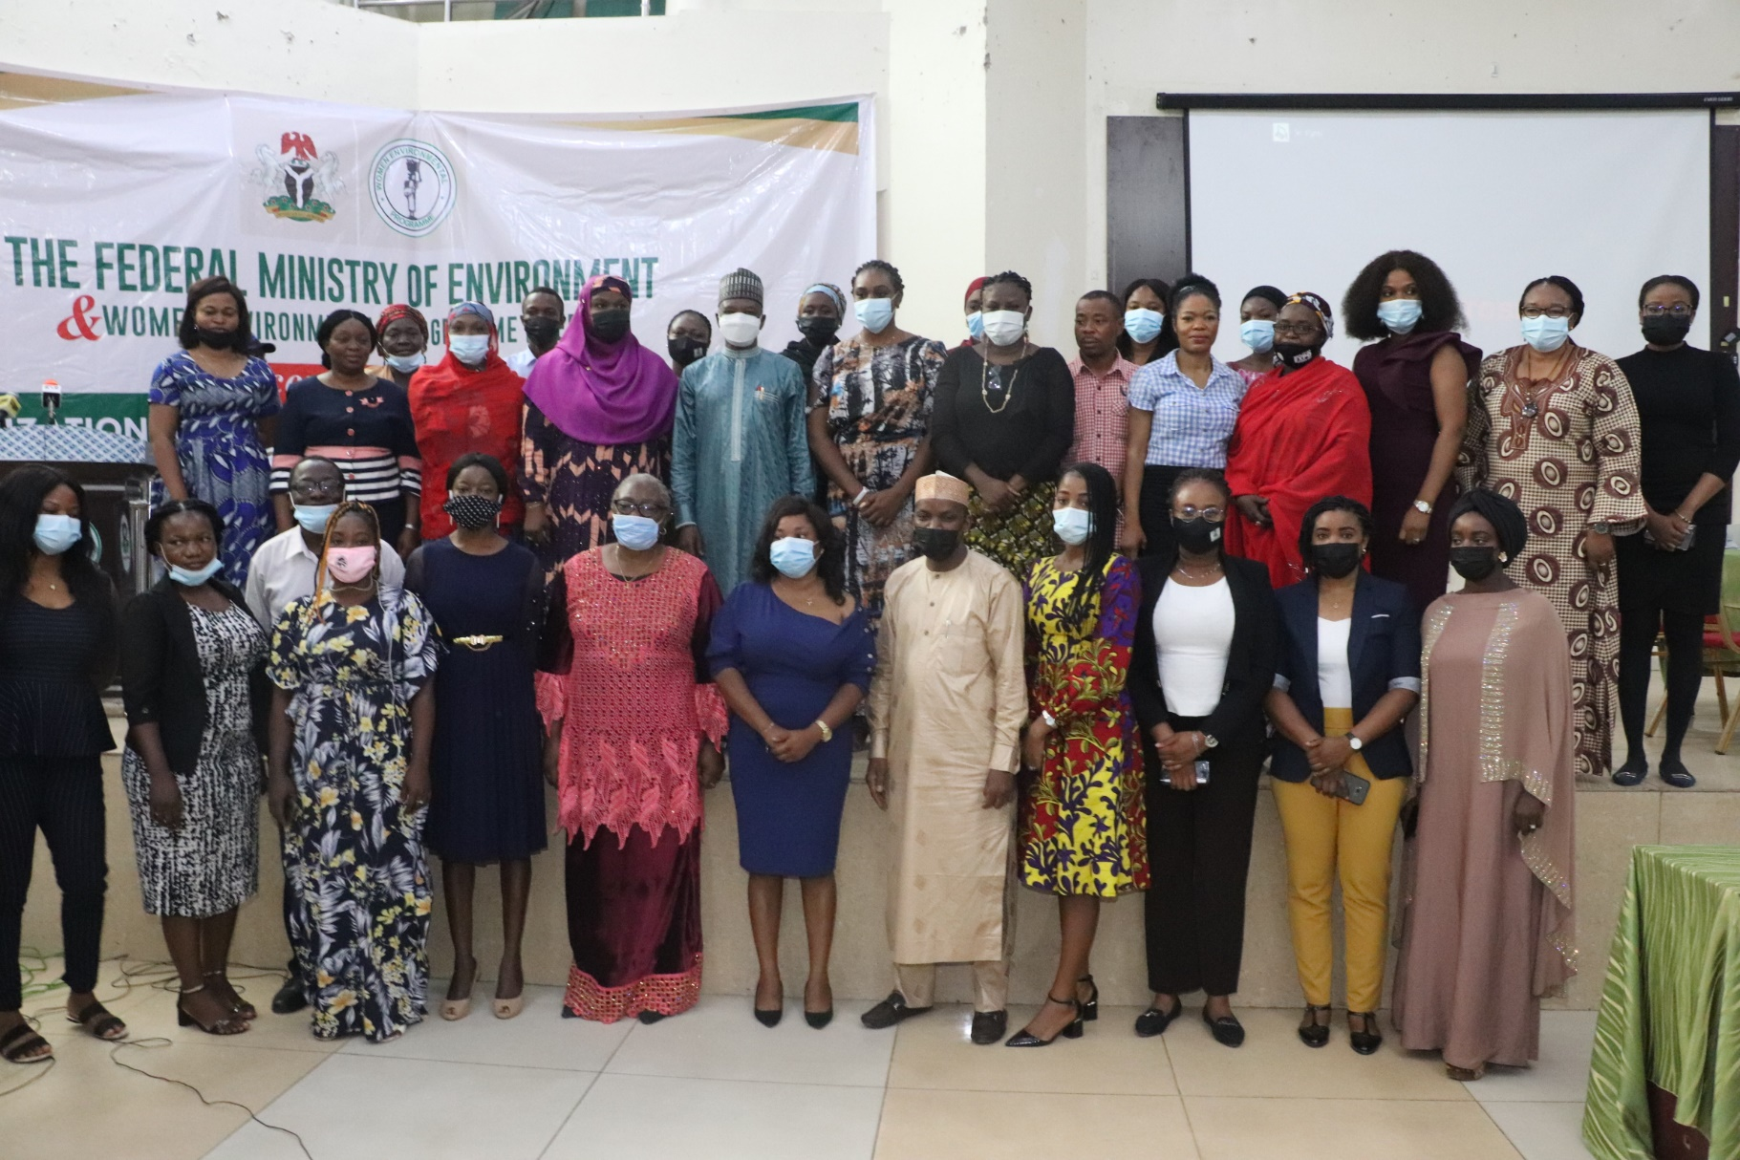
NAPGCCC FORMAL LAUNCH

Slide 14
NAPGCC Implementation Strategy
The Implementation Strategy –
to ensure that the actions identified in the blueprint NAPGCC are integrated into day-to-day operations and decision-making processes of Implementing Entities.
The development of this Implementation Strategy supported by the British High Commission Nigeria, and Women Environmental Programme.

Slide 15
NAPGCC Implementation Strategy - Provisions
Objective 5 - Ensure gender-responsive budgeting
Two Action steps enumerated to cover 2020-2022:
Conduct capacity building for institutions on gender-responsive budgeting – Cost implications - sourced from National budget through projects of the relevant Ministries/Departments and Agencies.
Monitor institutions’ budget for gender-responsive implementation.

Slide 16
CONCLUSION
Department of Climate Change of the Federal Ministry of Environment will coordinate the implementation of the Action Plan and will liaise with relevant MDAs to ensure they incorporate activities and accompanying budgets from the Action Plan in their annual plans, implement and report on the activities.

Slide 17
Thank You. Merci Beaucoup. Obrigado.

