Slide 1
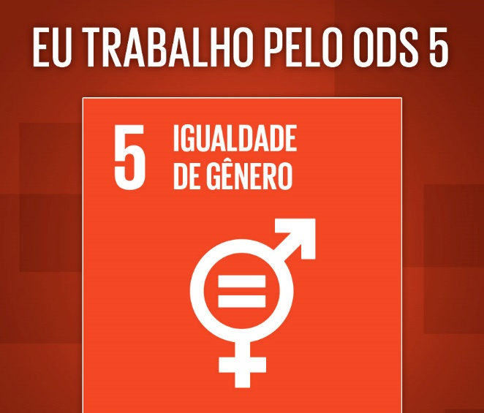
PLANNING AND BUDGETING FROM A GENDER AND CLIMATE CHANGE PERSPECTIVE
I WORK TOWARDS SDG 5
GENDER EQUALITY
Maputo, June 2021

Slide 2

PLANNING AND BUDGETING
GENDER MAINSTREAMING IN PLANNING AND BUDGETING

Slide 3
PLANNING/BUDGETING
Planning from a Gender Perspective
  It means incorporating gender into national plans and programmes, in all its stages, and taking into account the specificities, needs and capabilities of men and women.
  Budgeting from a Gender Perspective
  Also known as GRB – ‘Gender Responsive Budgeting’. It can be understood as a budgeting process that answers or addresses gender issues and entails incorporating the gender dimension in budgeting as well as in the evaluation and preparation of government budgets
  Incorporating a gender perspective in the budgeting process doesn’t mean creating a parallel budget or additional resources for a plan or sector
  There is no Gender budget

Slide 4
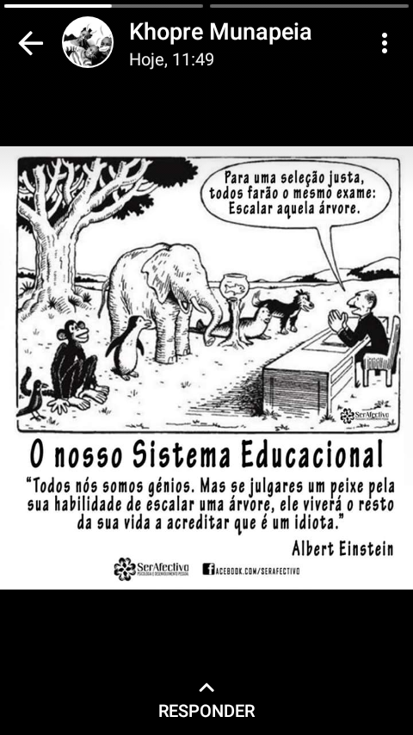
To ensure a fair selection process, the test will be the same for everyone:
Climb that tree!

Slide 5
PLANNING AND BUDGETING
CLIMATE CHANGE MAINSTRAMING IN PLANNING AND BUDGETING

Slide 6
BACKGROUND TO THE GENDER APPROACH IN PLANNING AND BUDGETING
    Gender and Climate Change in planning and budgeting are Cross-Cutting Issues.
Cross-cutting issues are those issues that extend beyond the scope of a single sector and must therefore be considered by all sectors in their planning, budgeting, monitoring and evaluation processes.
The cross-cutting issues considered by government are:
    Gender
    Food and Nutritional Security
    Sustainable Management of Natural Resources and the Environment (PNG)
    Disaster and Climate Change Risk Reduction
    HIV and AIDS
    Rural Development

Slide 7
Aim | Effects of CC | Impact on Women
Access to clean water | Negative impact on water sources, affecting supply for basic, vital household use and production. | Increased workload as they are the ones primarily responsible for water collection and use. Reduced access to clean water: increased levels of malnutrition and risk of diseases
Agriculture | Droughts and/or floods as consequences of temperature changes and changing weather patterns | Food insecurity for cultural reasons Reduced access to means of production (land, cattle, finance, technology) to be able to deal with new realities and continue producing
Natural disasters | Floods, cyclones, extreme drought, heavy rainfall | Greater vulnerability owing to: Difficulties in accessing early warning systems – hence lower disaster response capabilities Lack of survival skills, which are normally taught to boys

Slide 8
PLANNING AND BUDGETING
Climate change affects and impacts women and men differently; generally, the negative impact on women is more severe. Also, their contribution to the fight against climate change is different, although equally necessary and relevant
To mainstream gender, it is crucial to identify existing tools that link different sectors and ensure coordinated progress towards gender-sensitive adaptation policies
National Action Plan for Women's Empowerment;
National Plan for the Prevention and Combatting of Gender-Based Violence
Gender Policy and Implementation Strategy (PGEI)

Slide 9
PLANNING AND BUDGETING
Climate change presents an opportunity and a challenge to rethink gender-focused policies and respond with solutions that encourage sustainable development while reducing gender inequalities.
Land Law - Law No. 19/97 of 1 October - a legal instrument that safeguards the rights of peasant women in the use and enjoyment of land; including, in particular, widows, divorcees and single mothers. Articles 10, 12 and 16 this law enshrine equal rights for women and men related to land use.
Family Law - 22/2019 of 11 December- The principle of male supremacy in relation to women has been replaced by an equal status between spouses, resulting in the effective joint administration of property. The law has also opened up new opportunities for women to manage and transfer property in their own right.

Slide 10
PLANNING AND BUDGETING FROM A GENDER AND CLIMATE CHANGE PERSPECTIVE – ASSUMPTIONS
  AWARENESS OF PLANNING AND BUDGETING TOOLS;
  AWARENESS OF INSTRUMENTS PROMOTING GENDER EQUALITY AND CLIMATE CHANGE (e.g.: National Gender Strategy, National Climate Change Adaptation Strategy, National Adaptation Plan);
  AWARENSS OF THE IMPORTANCE OF GENDER ANALYSIS FOR THE COUNTRY’S DEVELOPMENT;
  A DATABASE (QUALITATIVE AND QUANTITATIVE) AS A BASELINE FOR DEFINING DEVELOPMENT OBJECTIVES, ACTIONS AND GOALS, AND
  BREAKDOWN OF STATISTICAL DATA BY GENDER AND LOCATION.
      THE ACTIONS MUST RESPOND TO THE NEEDS OF MEN AND WOMEN IN ORDER TO INDUCE CHANGE AND RAISE THE STATUS OF WOMEN IN SOCIETY
10

Slide 11
INSTRUMENTS FOR PLANNING AND BUDGETING FROM A GENDER AND CLIMATE CHANGE PERSPECTIVE

Slide 12
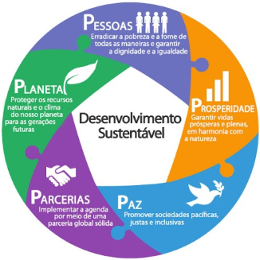
People
Eradicate all forms of poverty and hunger and ensure dignity and equality
GOVERNMENT
PROGRAMME
GENDER POLICY AND IMPLEMENTATION STRATEGY
Planet
Protect our planet’s natural resources and climate for future generations
Prosperity
Ensure a prosperous and full life in harmony with nature
NATIONAL ACTION PLAN FOR WOMENS’ EMPOWERMENT
Sustainable development
NATIONAL CLIMATE CHANGE ADAPTATION STRATEGY
Sectoral
strategies
Partnerships
Implement the agenda through strong global partnerships
Peace
Promote peaceful, just and inclusive societies
PUBLIC SERVICE GENDER STRATEGY
CFMP
(Programmes)
GENDER, ENVIRONMENT AND CLIMATE CHANGE STRATEGY
NATIONAL ADAPTATION PLAN
PESOE

Slide 15


FUNCTIONAL CLASSIFICATION
BUDGET CLASSIFICATION
The purpose is to combine public spending into areas of government action
LEVEL 1 – FUNCTION
        01 - General Public Services
        02 – Defence
        03 – Security and Public Order
        04 – Economic Affairs
        05 – Adaptation to Climate Change
        06 – Housing and Collective Development
        07 – health
        08 – Recreation, Culture and Religion
        09 – education
        10 – Security and Social Action
15

Slide 16
CLASSIFIERS – PROGRAMME-BASED
Vision of the Planning and Budgeting Sub-system (SPO)
Pillars according to the National Strategy …………………….1
Sectoral area ……………………………………………..…02
Programme ……………………………………………….. MCA40
  Outcome Indicator
  Sub-Programme ………………………………………….01
    Output indicator
    Action;
  Projects ………………………….. MCA40-01-TUR-2015-0005
  Activities ………………………………….MAS-2019-OF01
Ex:MCA40-01-MCA-2021-0001

Slide 17

DISCRIMINATION AGAINST WOMEN IN ACCESSING AND MANAGING RESOURCES REDUCES THE PRODUCTIVE POTENTIAL OF FAMILIES, INCREASES THEIR VULNERABILITY AND LIMITS THE POTENTIAL OF ALL INDIVIDUALS, INCLUDING MEN, TO ESCAPE POVERTY!

Slide 18
GREETINGS AND
THANK YOU!

