Slide 1

IMF GRB MISSION:IMPLEMENTATION UPDATE
Director Budget Reform: Prudence Cele

Slide 2
OUTLINE
History
Background
NT response to GRPBMEA framework
Data collected – Gender
Reporting Requirements
IMF Assistance
Purpose of the mission
Lessons learnt

Slide 3
history
Post democratic elections in 1994, the Parliament of South Africa initiated the Women's Budget Initiative with the intention of reorienting the National Budget post-apartheid
It aimed to give cognisance to multiple factors such as gender, single parents, and the informal and rural sectors among others
Included Parliament - GOV-CSO
LESSONS
If not institutionalised – it is not sustainable
Different economic environment
We are able to work together

Slide 4
BACKGROUND
  A Commitment to Equity (CEQ) incidence study was done by Economic Policy
  The Impact of Taxes and Transfers on Poverty and Income Distribution in South Africa
  However, these impressive results are partly due to high levels of pre-fiscal inequality in the country and due to valuing in-kind benefits from free government services in education and health at the average cost of provision – they do not take into account the significant variation in the quality of the services provided
  OAG :Capacity building – conducted a survey and awaiting results
  They will lead in the roll out of training
  To analyse the progressivity of the main tax and social spending programs and quantify their impact on poverty and inequality.
  The analysis by gender shows that the fiscal system is partially responsive to the additional burden of childcare borne by women through social transfers such as the child support grant and public healthcare and education services,
  and partially responsive to inequality of access to labour opportunities through the progressive direct taxation system

Slide 5
NT RESPONSE TO GRPBMEA FRAMEWORK
Since the introduction of the framework in 2019
  Requests have been made through MTEF guidelines for gender budget plans
  The response has not been good in the two calls made in 2019 and 2020
  The data suggests the officials who fill in the data templates do not understand what is required and there is an information gap between the strategic planning, gender focal points and budgets units
  Those who respond already have data by gender e.g Higher Education
  The data collected through the MTEF is not the final allocations and having the numbers in the first submissions does not guarantee allocation
  Timing of the data collection
  Compliance without understanding can be malicious

Slide 6
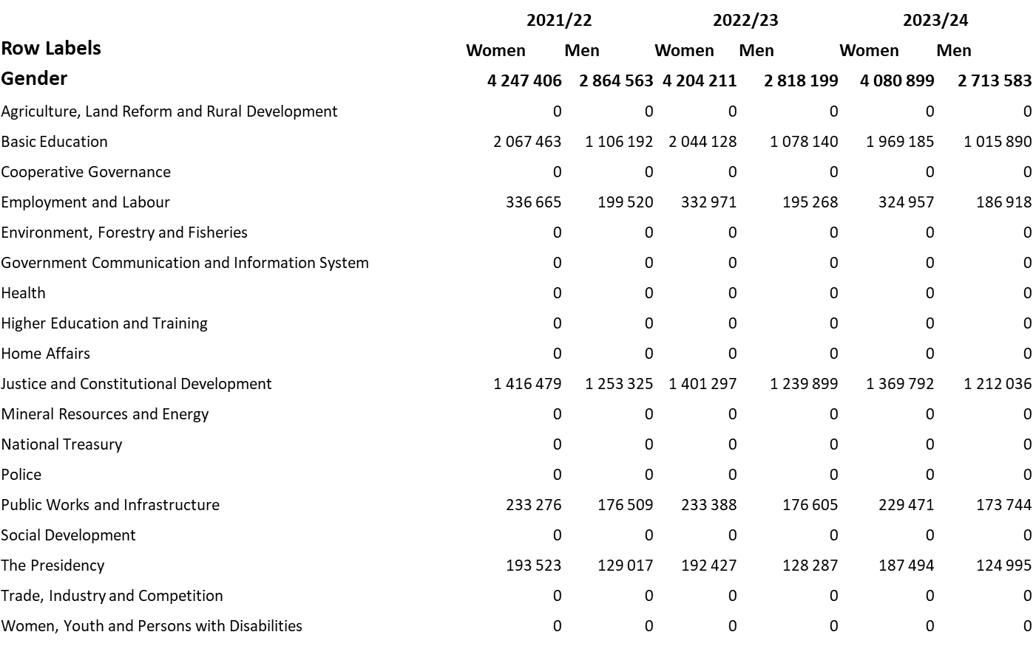
Data collected - Gender

Slide 7
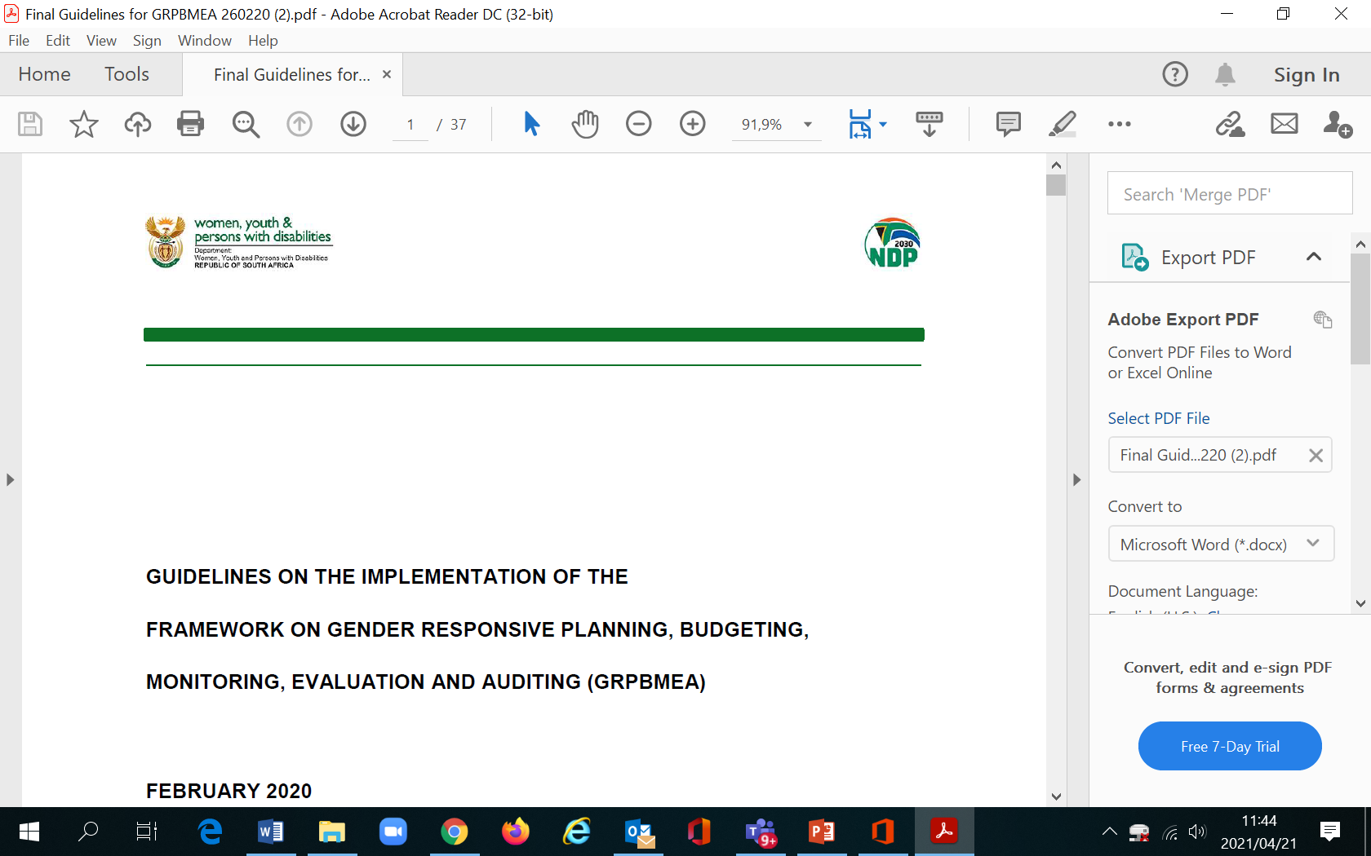
Reporting REQUIREMENTS
The framework also outlines the role of the National Treasury in ensuring gender responsive budgets. Quarterly
Mechanisms identified to achieve this include:
Budget Guidelines issued by National Treasury are expected to include requirements that each institution’s budget is gender responsive
Budget bids to demonstrate allocations for WEGE (NO BIDS)
Estimates of National Expenditure (ENE) and Adjusted Estimate of National Expenditure (AENE) to include sections on Women’s Empowerment and Gender Equity WEGE allocations per vote/ add guidelines on how to break it down (Definitions crucial)
Each budget vote to include gender indicators per programme (mainstreamed and targeted) (If indicator does not exists at sector level-limited indicator)
Allocations to key WEGE interventions to be included in Medium Term Budget Policy Statement (MTBPS) and National Budget Speech (FISCAL consolidation)
Gender to be included in the National Treasury database (what happens after)
Treasury regulations on gender to be issued; and (what would be included and how would it be different to the framework)
Guidelines to be issued to Provincial Treasuries.
Recently added 40 per cent procurement to Women

Slide 8
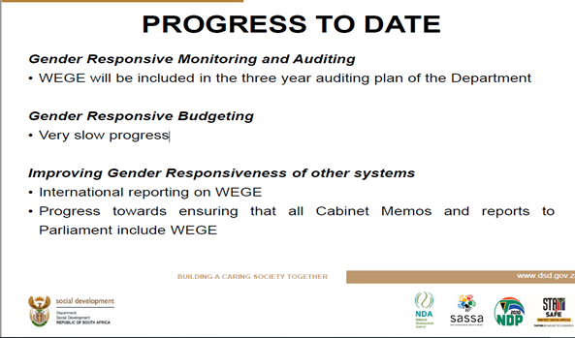
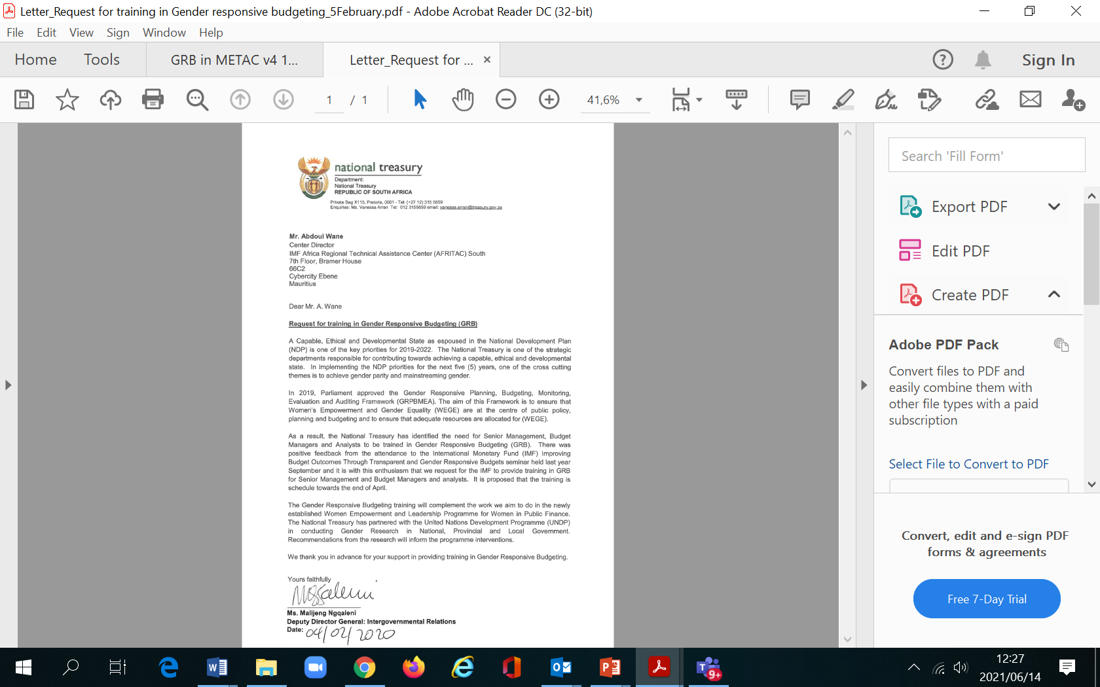
IMF ASSISTANCE
The IMF conducted training in 2019 on GRB
In 2020 the National Treasury made a requested for training for National Treasury colleagues
In January 2021 they conducted another training on the IMF GRB framework
The conversation was then started again about the slow implementation of GRB in SA
The heads of the Budget group agreed there needed to be a workshop with key stakeholder on the Gender Responsive Budgeting reform

Slide 9
PURpose of GRB mission
PURPOSE
The development of a roadmap/plan of action for the roll-out of GRB for the National Treasury
OBJECTIVES
Establish common understanding of the GRB concept
Gather data on progress made to date
Identify gaps that contribute to slow implementation of the GRPBMEA
Assess government wide readiness for the implementation as it pertains to PFM
Learn initiatives that can support implementation of GRPBMEA

Slide 10
LESSONS LEARNT
The guidelines and template can never replace training and buy –in
The people who are preparing budget submissions are not the people being trained
  Some Departments budget structures allow for ease of disaggregation
  Inclusion of the Gender in the guidelines does not guarantee compliance or prioritization of Gender issues
Clear setting of objectives – why GRB?
  Improve Accountability of government institutions for gender responsibilities
  Estimating the national financing gap on gender actions
  Monitoring spending on gender
  Create awareness in government
Understanding reforms take time – Patience
“6 out of 12 countries with some form of gender budgeting, could point to specific examples where the gender-budgeting tool had brought about significant changes in policy design and/or outcomes” (Downes et al, 2017: 3

Slide 11
Questions ?
THANK YOU

