Slide 1
COVID-19 Vaccine Introduction and deployment Costing tool
CVIC tool
COVID-19 Vaccine Financing, Purchasing and Distribution in Africa
CABRI Peer-learning and exchange event, 13-14 April 2021
CVICosting@who.int

Slide 2
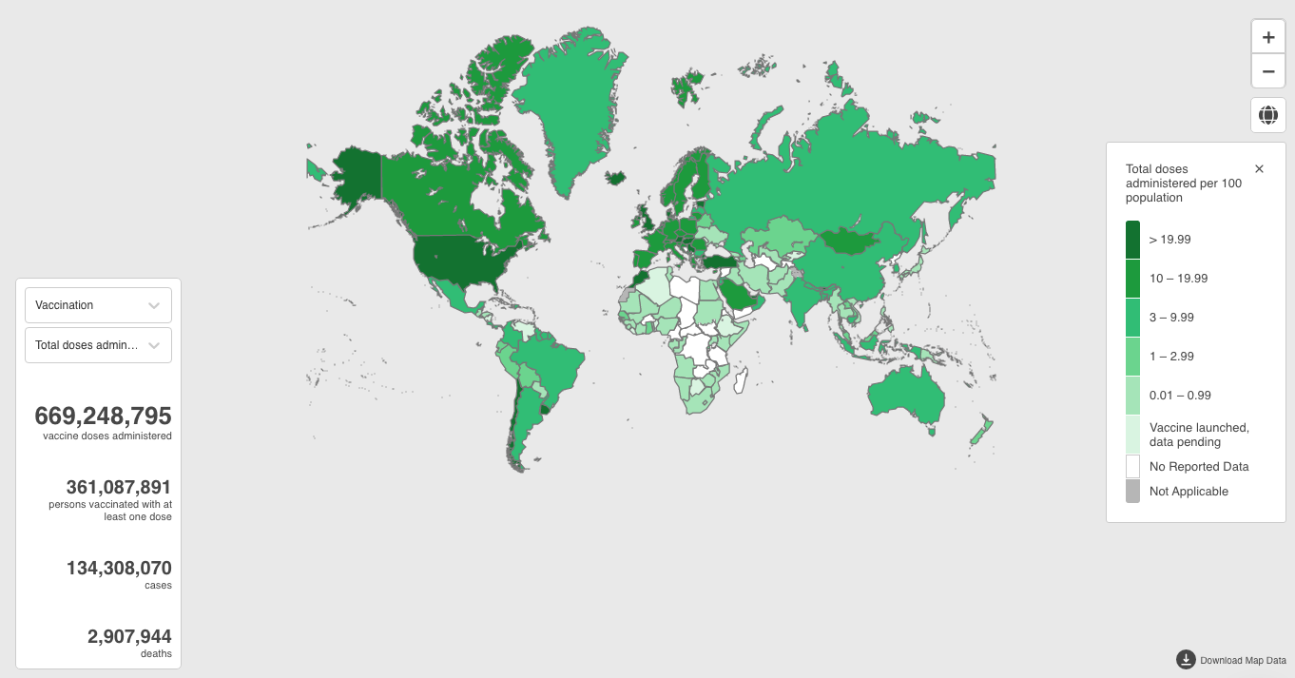
Daily COVID-19 vaccine doses administered (9 April 2021)
Notes:
As of last week one can see from this global map that most COVID-19 vaccine doses are administered in HICs

Slide 3

Estimated cost to vaccinate one person in MENA countries
Anticipated average cost per dose
Two doses needed for most vaccines
Transportation cost currently included in dose price
Service delivery and supply chain in country $1.67 - $2.36 per dose; 5% wastage
Climate sensitive cold chain investment
Cost of fully vaccinated person
$18.21-$19.12 in AMC countries
$27.11-$28.47 in other countries
AMC/
other
$7.00/ $10.55
$14.00/ $21.10
n/a
$1.39-$1.97
+ 20% of supply chain costs
Dose prices vary based on producer and country income classification
COVAX suggests AMC countries assume $7/dose, and $10.55 for self-financing countries. Includes syringes and safety boxes.
Only J&J vaccine is a one dose regimen
Assumption of 5% wastage factored into vaccines and service delivery unit cost; COVAX currently not delivering additional doses to include wastage
COVAX includes transportation cost to country in price/dose
Vaccines purchased via direct agreements may need to account for this (~10%)
Cost estimates for supply chain and service delivery are based on data from routine childhood immunization. Estimates presented above are for Gavi and non-Gavi eligible countries
Cost estimates for climate friendly cold chain are estimated by WBG and ESMAP, and are on a global basis
Costs assume existing system can be leveraged; only includes incremental financial cost; health worker salaries excluded.
1. (20% of service delivery and supply chain cost)
Source: Portnoy A, Vaughan K, Clarke-Deelder E, Suharlim C, Resch SC, Brenzel L, Menzies NA. Producing standardized country-level immunization delivery unit cost estimates. PharmacoEconomics. Sept 2020;38 (9):995-1005.
Courtesy to S. Alkenbrack, World Bank
Notes:
See Section 4.2 in COVAX Costing Note, dated January 25, 2021. Unit costs were derived based on a mix of in-country costing studies, synthesis of global literature review, updates to ICAN estimates and modelling by Harvard. Unit cost estimates were derived for different groups of countries and take into account one-time investments, national and community level start-up costs, and per dose variable costs. Service delivery costs include planning and coordination, training, social mobilization, PPE, hand hygiene, waste management, pharmacovigilance, and per diem for outreach. Supply chain includes cold chain equipment, cold chain recurrent costs, and transportation for outreach. Cost of investing in climate-friendly cold chain is estimated to be 20% of the service delivery and supply chain costs. These costs exclude capital investments and labor as they assume that is already covered. Estimates can be revised in country costing studies.
Out of total cost of deployment, generally 40%.....climate friendly 13-44%

Slide 4
Indicative costs for vaccine and delivery in MENA countries
Countries | AMC | Vaccine cost ($M) |  |  | Service delivery, supply chain, incl. climate-friendly ($M) |  |  | Total Cost of vaccination ($M)
 |  | Coverage: 20% | Coverage: 50% | Coverage: 70% | Coverage: 20% | Coverage: 50% | Coverage: 70% | Coverage: 20% | Coverage: 50% | Coverage: 70%
Algeria | Y | 31 | 209 | 341 | 42 | 107 | 149 | 73 | 316 | 490
Bahrain |  | 6 | 17 | 25 | 2 | 4 | 6 | 7 | 22 | 31
Djibouti | Y | 1 | 5 | 8 | 1 | 2 | 2 | 1 | 6 | 10
Egypt | Y | 73 | 489 | 797 | 98 | 250 | 349 | 171 | 740 | 1146
Iran |  | 280 | 837 | 1214 | 80 | 203 | 284 | 360 | 1040 | 1498
Iraq |  | 136 | 408 | 592 | 39 | 99 | 138 | 174 | 508 | 730
Jordan |  | 34 | 100 | 146 | 10 | 24 | 34 | 44 | 125 | 180
Kuwait |  | 14 | 43 | 62 | 4 | 10 | 14 | 18 | 53 | 76
Lebanon |  | 22 | 66 | 95 | 6 | 16 | 22 | 29 | 82 | 117
Libya |  | 23 | 68 | 99 | 7 | 17 | 23 | 29 | 85 | 122
Morocco | Y | 26 | 174 | 284 | 35 | 89 | 125 | 61 | 264 | 409
Oman |  | 17 | 52 | 75 | 5 | 13 | 17 | 22 | 64 | 92
Qatar |  | 10 | 29 | 42 | 3 | 7 | 10 | 12 | 36 | 52
Saudi Arabia |  | 116 | 348 | 505 | 33 | 85 | 118 | 150 | 433 | 623
Tunisia | Y | 8 | 56 | 91 | 11 | 29 | 40 | 20 | 84 | 131
UAE |  | 33 | 98 | 142 | 9 | 24 | 33 | 42 | 122 | 175
WB&Gaza | Y | 4 | 25 | 40 | 5 | 13 | 18 | 9 | 37 | 58
Yemen | Y | 21 | 143 | 234 | 20 | 52 | 72 | 42 | 195 | 306
Total |  | 855 | 3167 | 4792 | 410 | 1044 | 1456 | 1266 | 4211 | 6248
Courtesy to S. Alkenbrack, World Bank
Notes:
Talking notes:
- Total operational costs without AMC subsidized vaccines for SSA at 20% coverage would be US12 billion
At 70% coverage: projected operational costs for South Sudan share of health budget 455% or share of government expenditure of 10%. For Zimbabwe these numbers would be 153% and 13%.

Slide 5
What CVIC is for?
About the tool
Current version (2.0) available at: www.who.int/publications/i/item
/10665337553
Version 2.1 will be available in mid-April 2021 in all six working UN languages (Arabic, Chinese, English, French, Russian, Spanish) and Portuguese
To provide a structured and comprehensive, estimation of:
incremental operational and selected capital costs of introducing and deploying COVID-19 vaccines
for resource mobilization, budgeting, requests for external funding, strategy refinement

Slide 6
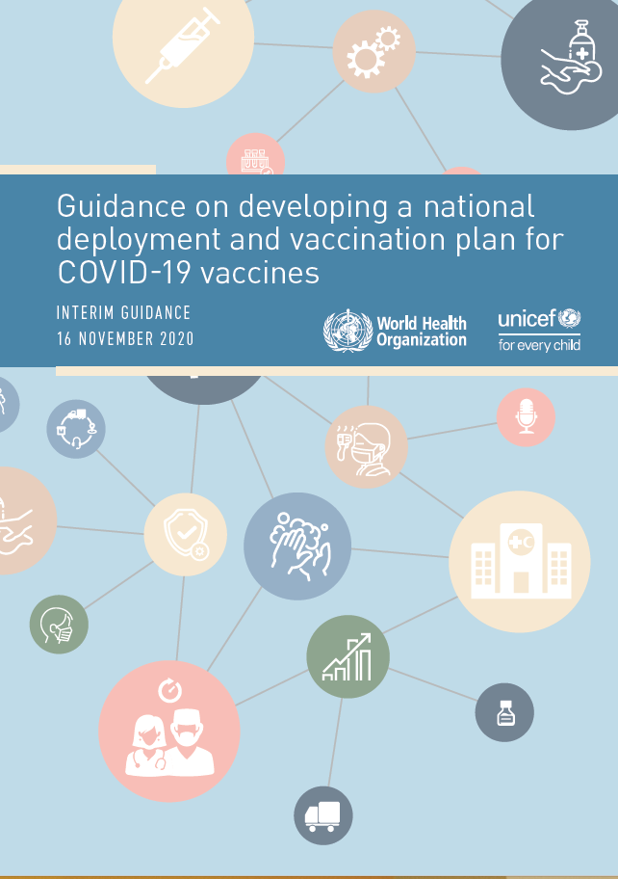
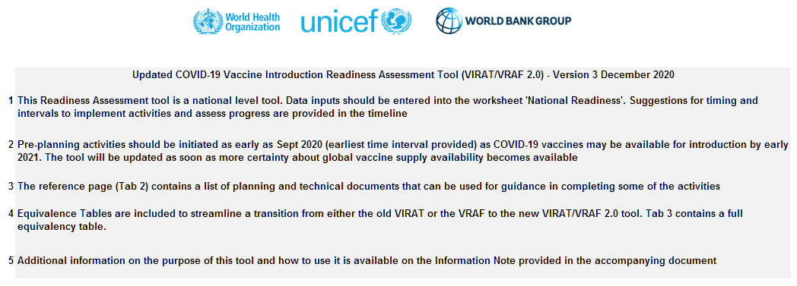
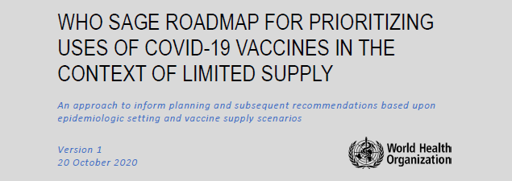

In alignment with…
Guidance on developing a NDVP for COVID-19 vaccines
Guidance for prioritization and allocation: WHO SAGE values framework and prioritization roadmap
Readiness assessment tool (VIRAT-VRAF-2.0)
Gavi COVAX Readiness and Preparation TA Plan
Cost categories for TA and funding resource requests through WHO COVID-19 Partners Platformhttps://covid19partnersplatform.who.int/

Slide 7
Countries using/going to use CVIC (as far as we know)
AFRO
Cameroon
Eswatini
Ethiopia
Ghana
Mozambique
Malawi
Rwanda
South Sudan
Togo
Uganda
Zambia
EMRO
Sudan
Syrian Arab Republic
PAHO
Belize
Bolivia
Costa Rica
Haiti
Nicaragua
WPRO
Cook Islands
Lao PDR
Papua New Guinea
Solomon Islands
Vietnam

Slide 8
Why use the CVIC tool?
Population | Priorities | Vaccines | Distr./Admin. | Output
Convenient & Customized |  | Changeable | Comprehensive | Compatible
Data payload built-in Easy construction and adjustment of SAGE target populations |  | Updateable vaccine specifications and unit prices Explore different vaccine types and scenarios | Every country is different, important to comprehensively consider all the cost drivers; Cost different scenarios – optimize!! | Made with partnerships in mind – linkage with Partners Platform Pillar 10 Resource mapping over 2021-2023.

Slide 9
What data is required to fill in the CVIC?
Population | Priorities | Vaccines | Distr./Admin. | Output
Demographic data optional – only if wish to override UN WPP | NDVP / Sage Target Populations, incl. older adult age cutoff and those with comorbidities Geographic distribution of target population (access to health facilities) Prioritization plans | Vaccine Supply – Covax and non-Covax Vaccine prices and approximate delivery schedule Assumptions on vaccine wastage and expected uptake | Cold storage distribution points: Regional stores, district stores Service points: Fixed sites with cold storage, fixed sites, outreach sites HRH supply Unit prices for HRH compensation, transportation/logistics, data management, demand generation. Optional: Unit prices for commodities Unit prices for central activities | Relevant Country Partners Potential financing interest areas

Slide 10
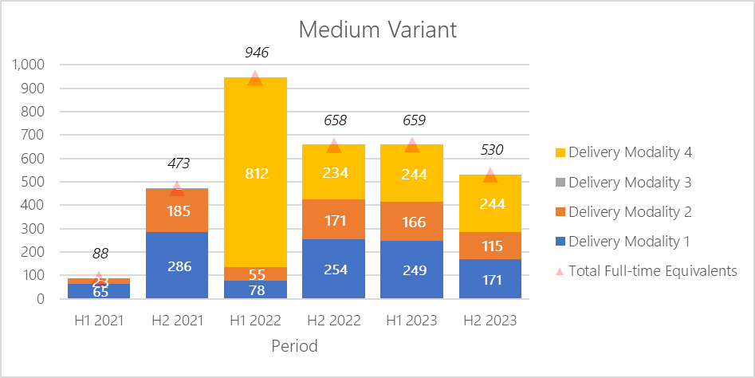
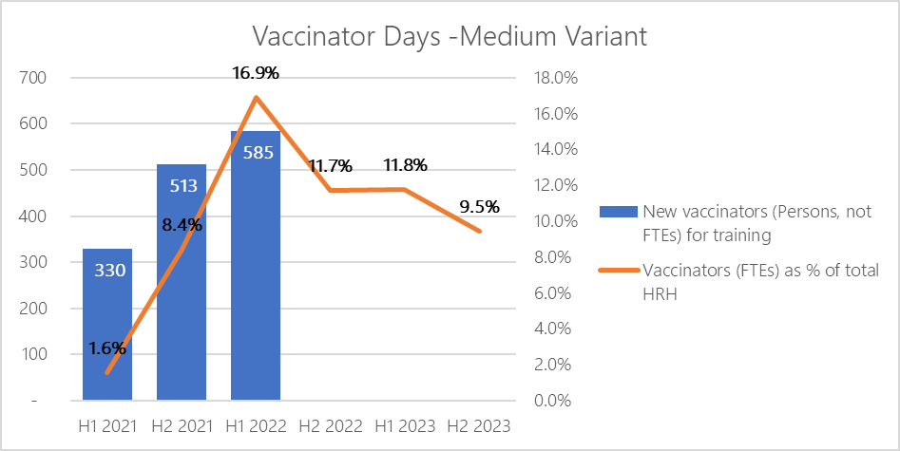
How can CVIC tool be used?
Human Resource Impact Analysis
Health Financing Benchmarking

Slide 11
The 4 Delivery Modalities
Modality | How? | Target Population (as per SAGE)
DM 1 | Fixed Sites with cold storage: e.g. hospitals and (larger) health facilities. | All health workers (but not their households) Some essential workers and related groups Some older adults (option to include households) Some socioeconomic groups ASHRSDD Some groups with co-morbidities or health states ASHRSDD (option to include households) Non-priority groups
DM 2 | Fixed Sites without cold storage: e.g. small health centers, community halls, etc. “campaigns” | Some essential workers and related groups Some older adults (option to include households) Some socioeconomic groups ASHRSDD Some groups with co-morbidities or health states ASHRSDD (option to include households) Non-priority groups
ASHRSDD = at significantly higher risk of severe disease or death

Slide 12
The 4 Delivery Modalities
Modality | How? | Target Population (as per SAGE)
DM 3 | Residential institutions | Some older adults (in residential institutions) and staff Some socioeconomic groups ASHRSDD (in residential institutions) and staff
DM 4 | Outreach | Hard-to-reach: Some older adults (option to include households) Some socioeconomic groups ASHRSDD Some groups with co-morbidities or health states ASHRSDD (option to include households) Hard-to-reach but no other priority criteria
ASHRSDD = at significantly higher risk of severe disease or death

Slide 13

Built-in calculator to match supply and demand
Vaccine Supply
Vaccine Demand
Covax and non-Covax procurement
Target population (who and how many)
Prioritization (when)
Vaccine wastage
Expected uptake

Slide 14
Types and access of support
Nudges from WHO ROs
Global trainings
Regional/ sub-regional trainings
Nudges from partners
A communal e-mail address
Country-level trainings + remote support

Slide 15
Overview of TA provided for CVIC tool
Country | Partner | Focal point | Support provided
‘Light’ support: Transfer of data, answering standalone questions via email etc.
Uganda/AFRO | ThinkWell | Directly with a local consultant, partners or govt not involved | Transferring data from v1.0 into v2.0 plus review
Ethiopia/AFRO | - | - | Used CVIC and requested for orientation Being asked to join the global training to start
Ghana/AFRO | HSPH | University of Ghana, MoH, WCO, UNICEF | Session on NDPV presentation and CVIC orientation Updated analysis in v2.0, working on HRH costs and Central cost to finalize Justice N. leading filling of tool. Providing review and light tech support regarding how tool works, assumptions, calculations.

Slide 16
Overview of TA provided for CVIC tool (cont.)
Country | Partner | Focal point | Support provided
Medium intensity support: 1-2 general walk throughs or calls
Rwanda/AFRO | Tool developer | WCO EPI | A walkthrough call to review filled CVIC tool CVIC subsequently used in NDVP submission
Zambia/AFRO | ThinkWell | Directly with the logistics manager, no costing/financing person involved and none of the partners involved | Transferring data from v1.0 into v2.0 plus review Intro/walkthrough calls to fill in the tabs
Sudan/EMRO | HSPH/WB | local consultant | Transferring data from v1.0 into v2.0 plus review Collaboration with local WB consultant,medium effort, ~1-2 meet/week to fill tool together
Cameroon/AFRO | CHAI | Directly with MoH | Supporting the use of CVIC

Slide 17
Overview of TA provided for CVIC tool (cont.)
Country | Partner | Focal point | Support provided
Significant support: Numerous calls and discussions
Eswatini/AFRO | ThinkWell | Group consisted of WHO, CHAI, UNICEF and others | Transferring data from v1.0 into v2.0 plus review Required support to better understand how calculations were carried out and resolve queries regarding the outputs
Mozambique/AFRO | ThinkWell | Directly with a local consultant | Transferring data from v1.0 into v2.0 plus review Finding workaround as tool originally did not accommodate for strategy (short campaign)
South Sudan/AFRO | ThinkWell | Group consisted of WHO, UNICEF and other partners | Transferring data from v1.0 into v2.0 plus review Protracted troubleshooting due to Excel version issues, multiple versions of the v2.0 prototype tested with the team
Togo/AFRO | HSPH | WCO EPI | Transferring data from v1.0 into v2.0 plus review Intro/walkthrough calls to fill in the tabs

Slide 18
Concluding remarks
CVIC tool is an overarching strategic planning and costing exercise to optimize and ensure the feasibility of vaccine deployment plans, an alternative to existing broad or high-level costing/budgeting approaches
Support for costing exercises go beyond support for usage of the CVIC tool per se - including vaccination financing, human resource planning, vaccination delivery strategies, etc.
Ensure that strategic planning and credible costing is a requirement for receiving subsequent, large shipments of doses to scale-up of vaccinations - to ensure that adequate resources are available for service delivery without impacting essential health services

Slide 19
Technical support available
HQ: CVICosting@who.int
AFRO
Dr PETU, Amos (petua@who.int)
Mr SATOULOU-MALEYO, Alexis (satouloua@who.int)
EMRO
Dr ELFAKKI, Eltayeb (eltayebel@who.int)
Dr HASAN, Quamrul (hasanq@who.int)
Core team:
WHO-HQ and ROs
UNICEF
Word Bank
Bill & Melinda Gates Foundation
ThinkWell
Harvard School of Public Health

Slide 20
Global Delivery Cost Estimates for Advocacy
Cross-organizational working group* supporting planning, budgeting, fundraising and financing of COVID-19 vaccine delivery for AMC92 economies
COVAX delivery costing in 92 AMC countries
  Total US$1.7 22 billion
  US$1.41/doses and US$3.15/FVP
* Cross-organization working group with representatives from WHO, UNICEF, World Bank, Gavi, BMGF, ThinkWell and HSPH

