Slide 1
Welcome Address
Philipp Krause, Head – Technical Team
CABRI

Slide 2
Structure of the event
Over the next 2 days, countries will present on their experience with gender responsive budgeting (GRB) and gender responsive climate budgeting (GRCB)
The discussions will consider how GRCB can be strengthened for improved economic and social outcomes
Knowledge products:
Keynote paper: Opportunities to Coordinate the Integration of Gender and Climate Change into Budgeting and Finance
Policy brief: The Integration of Climate Change into Budgeting and Finance
All knowledge products are available on the website
www.cabri-sbo.org
Notes:
The keynote paper draws on the gender audit that was developed for Benin, Ghana, Mozambique and Uganda.
The policy brief summarises the key discussions from the last IBFCCA peer learning and exchange

Slide 3
Experience with GRCB
Gender and climate change are two cross-sectoral priorities which are central to achieving the Sustainable Development Goals (SDGs)
Many African countries have some experience with GRB and CRB, however the two have largely been implemented separately
There is increasing recognition of the linkages between gender equality and climate change adaptation and mitigation
  Women could disproportionately be affected by climate change (increasing existing gender inequality) given their social and political status in society
  Women are active change agents and central to building community resilience
Recent calls for the join integration or ‘double-mainstreaming’ of gender and climate change into budgeting and finance
Notes:
The SDGs. SDG 5 on ‘gender equality’
SDG 13 on ‘climate action’. However, gender equality and climate change adaptation and mitigation are central to achieving the other SDGs.
Climate change has been described by the UNFCCC as, ‘a threat multiplier with the potential to worsen some of humanity’s greatest challenges, including health, poverty and hunger.’

Slide 4
Objectives of ‘Double-Mainstreaming’ Gender and Climate Change
Wider objectives
  Reduce the impact of climate change on gender inequality
  Mobilise the capacity of women to implement adaptation/mitigation
Immediate objectives
  Improve programme design and influence budget prioritisation
Outcomes
  Build more rigorous and credible methods for double-mainstreaming (or GRCB) by exchanging lessons from GRB and CRB
  Integrate gender into CRB initiatives
    - conduct future CRB and GRB initiatives jointly
    - add gender to ongoing/planned CRB
    - retrofit gender into existing CRB (?)
  Raise awareness of benefits from double-mainstreaming

Slide 5
GRCB Reforms
Reforms to systems and practices across the budget cycle that take into account gender concerns and opportunities when planning and delivering climate change mitigation and adaptation
Examples
  Include gender in climate change strategies and ensuring cross-sectoral gender/climate bodies collaborate
  Budget submissions by line ministries which demonstrate both gender and climate related benefits
  Tag/score budget programmes according to their contribution to gender equality and to climate mitigation/adaptation
  Monitor/review/evaluate trends and patterns in tagged programmes
  Accountability actors (parliament, civils society, media) follow and comment on gender and climate programmes
Budget formulation
Budget approval
Budget execution
Budget evaluation
Notes:
We can add the budget cycle figure if you want. It is given in slide 12 which is not part of the main presentation.

Slide 6
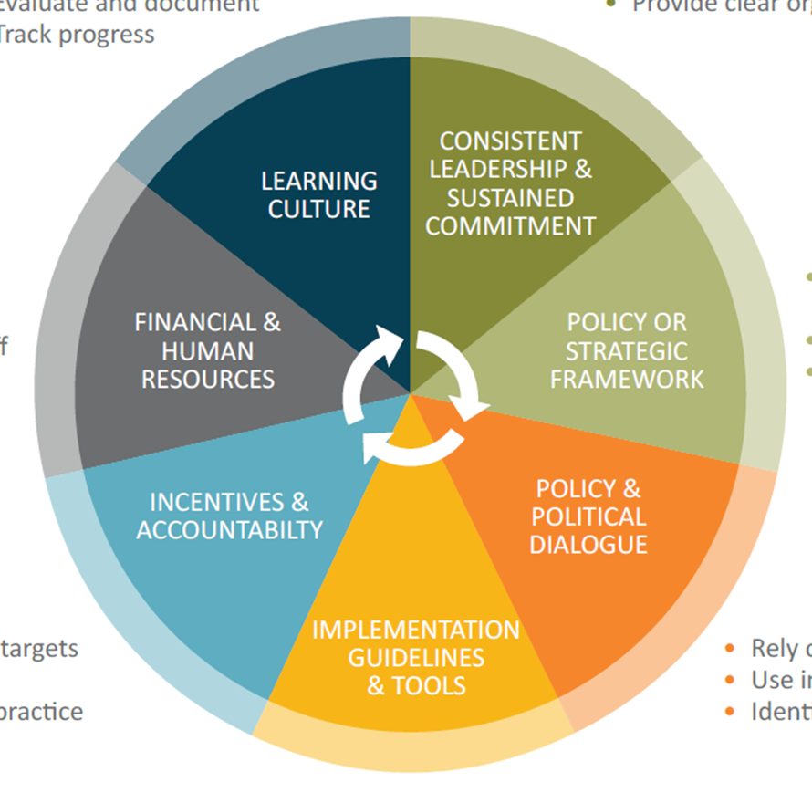
Enabling Conditions for CRCB
Lessons from past experiences with cross-cutting theme mainstreaming highlights key enabling conditions
Source: OECD, 2014
Notes:
African experience:
Policy or strategic framework
- A limited number of gender strategies refer to the way in which climate change affects programmes, policies and priorities, and GRB does not yet recognise the importance of climate change for gender-related planning and budgeting.
Some climate change strategies and policies are beginning to recognise the importance of gender, but this has mainly happened at a programme level, influenced by the demands of dedicated international climate funds

Slide 7
Challenges with GRCB
Competition amongst many cross-sectoral priorities (eg 17 SDGs) may dilute prioritisation of gender and climate
Basic classification methods are well-established and applied to both gender and climate but there is no consensus on scoring the degree of contribution to gender and mitigation/adaptation in a way that can be guaranteed to avoid suspicions about greenwashing or genderwashing
Programme budget reforms are already challenging without adding GRCB
Some international funders are increasingly mainstreaming climate into their development programmes, so GCRB needs to go beyond climate funds
Governments are happy with GRCB when trends/patterns are positive, but less keen when the trend is negative
‘Capacity’, although this may relate more to unclear institutional roles and methods than a lack of staff knowledge/skills

Slide 8
Concluding remarks
Coordinating the integration of gender and climate change may strengthen the effectiveness of public expenditure and reprioritisation to reflect increased benefits
While limited, there are some countries in Africa that have begun to implement gender responsive climate budgeting
The most appropriate measures in each country will depend on their strategic objectives and the particularities of their PFM systems.
There are substantial challenges (both technical and political) and experience with GRB suggests that GRCB will need support for a prolonged period of time (at least 10 years)
Successful reforms will need to engage multiple stakeholders, including civil society organisations who can be important allies

Slide 9
Thank you

