Slide 1
ARC Outbreak & Epidemic Risk Management November 2015

Slide 2
Overview
A. What is ARC?
B. Background on ARC and O&E
C. Insurance and O&E

Slide 3
A. What is ARC?

Slide 4
African Risk Capacity (ARC)
The African Risk Capacity is a continental sovereign risk insurance pool and early response mechanism designed to provide cost-effective contingency funding to African governments to execute pre-approved contingency plans in the event of severe natural disasters
A Specialised Agency of the African Union, ARC was established in 2012, is governed by a board of African ministers and experts and currently counts 26 AU countries as members
The ARC Agency’s first financial affiliate, ARC Insurance Company Limited, was established in early 2014
ARC aims to insure nearly 30 countries with USD 1.5b in coverage against droughts, floods and cyclones by 2020

Slide 5
How Does ARC Work?
ARC provides the financial tools and infrastructure to help countries manage natural disasters – including weather and, soon, outbreak and epidemic risk – more effectively by:
Providing quick-disbursing funds immediately after a severe weather event through insurance, enabling a more timely response to those affected
Offering insurance at the low rates, by pooling risk across the diverse weather systems in Africa through ARC Ltd
Linking payouts to pre-prepared national response plans to reduce the impact of severe weather events and the overall cost to governments
In order to:
Transfer more resources and decision-making to African governments
Reduce their reliance on traditional appeals for assistance for predictable disasters
Shift risk away from vulnerable populations and their governments to the ARC which is better equipped to handle it

Slide 6
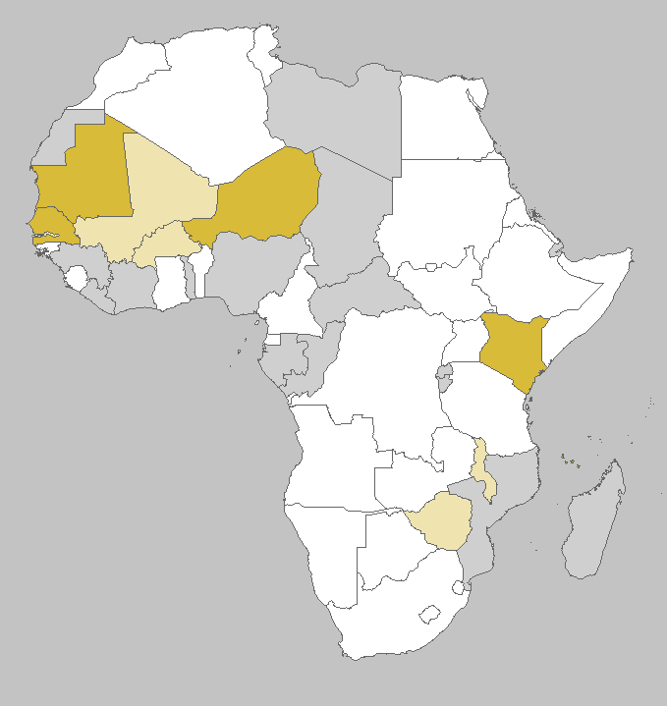
Current ARC Member States
Original Signatories (23 November 2012)
Burkina Faso
Burundi
Central African Republic
Chad
Republic of Congo
Djibouti
Gambia
Guinea
Liberia
Libya
Malawi
Mozambique
Niger
Rwanda
Sahrawi Arab Democratic Republic
Senegal
Togo
Zimbabwe
ARC Signatories (26 countries)
ARC Risk Pool 1 (4 countries)
ARC Risk Pool 2 (5 countries + Pool 1)
Additional Signatories (date signed) 19.Kenya (28 January 2013) 23.Gabon (30 January 2014)
20.Mauritania (28 January 2013) 24.Madagascar (31 January 2014)
21.Côte d'Ivoire (6 February 2013) 25. Nigeria (4 December 2014)
22.Comoros (15 February 2013) 26. Mali (27 May 2015)

Slide 7
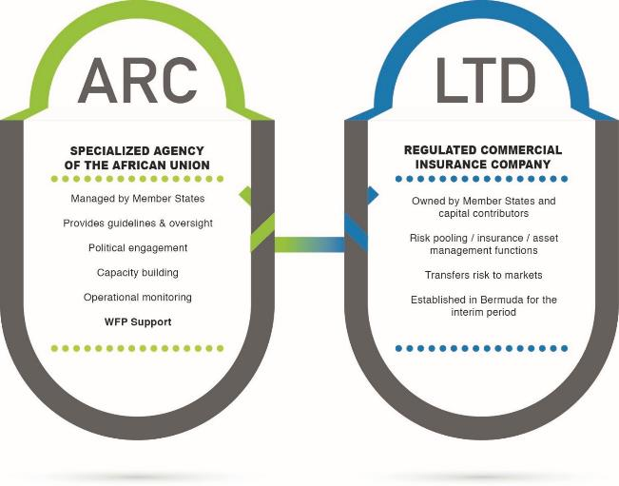
ARC’s Institutional Structure
Governed by Member States

Slide 8
B. Background on ARC and O&E

Slide 9
ARC and Ebola
Slow, unpredictable funding for emerging infectious diseases amplifies both the risk and impact of outbreaks.
African Ministers of Finance requested in March 2015 that theARC Secretariat develop a product to address countries’ financing needs to contain outbreaks of viruses and diseases common
In the case of Ebola, financing was only mobilized (depending on the affected country) 4-9 months after the first cases were reported.
According to ARC and partners’ analysis, beginning the Ebola response two months earlier could have reduced deaths by 80% in Liberia and Sierra Leone.
In that view ARC would like to offer AU Member States a product by 2017.

Slide 10
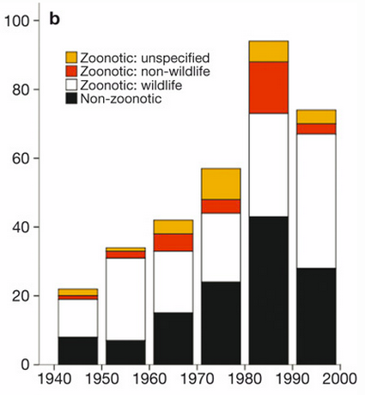
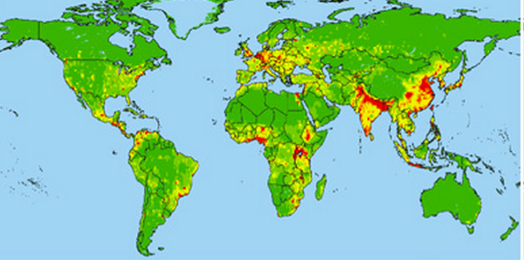
Increasing Threat to Health & Development
Number of EID events increasing globally…
…and relative risk of EID events highest in Africa and SE Asia¹
1. Map shows relative risk (RR) of EID event from zoonotic pathogen from wildlife. RR of EID event from vector-borne diseases has similar global distribution. RR of EID event from zoonotic pathogen from non-wildlife and from drug-resistant pathogens is much lower in Africa.
Note: Zoonotic pathogens refer to those transferred from animals or animal reservoirs. Ebola is considered a zoonotic pathogen with wildlife origins.
Source: Jones et al., “Global Trends in Emerging Infectious Diseases.” (2008)

Slide 11
Slow, Unpredictable Funding Amplifies Impact
Projected Ebola cases (Liberia & Sierra Leone), based on hypothetical start date of intervention¹
Hypothetical scenarios
Actual number of cases in Liberia and Sierra Leone is 20,766 as of March 4th
Dec. 2013
Mar. 2014
May 2014
June 2014
July
2014
Aug. 2014
Sep. 2014
Oct. 2014
Nov. 2014
Dec. 2014
Likely first case
37 potential cases reported in Guinea & Liberia
Cases reported in Sierra Leone
Major international response commences
WHO declares the epidemic a Public Health Emergency²
World Bank makes first major assistance pledge of $200M
UK disburses £117M to Sierra Leone (only 50% of total planned contribution)
$5.4B from US Congress approved
Beginning Ebola response two months earlier could have reduced total number of deaths by 80%
1. Total number of potential deaths by January 2015 for Liberia and Sierra Leone. Values listed are averages of low and high estimates. 2. Public Health Emergency of International Concern (PHEIC)
Source: NYTimes “How the Speed of Response Defined the Ebola Crisis.”; CDC “Estimating the Future Number of Cases in the Ebola Epidemic — Liberia and Sierra Leone, 2014–2015”; UN; WHO; The Guardian; BCG research & analysis

Slide 12
O&E Workstreams of ARC
Continental O&E Contingency Planning Standards & Guidelines to be adopted by ARC Treaty Signatories
Development of a parametric insurance product for outbreaks and epidemics
Incorporation into Africa RiskView software of useful outputs from the epidemic modelling methodology that can be used for decision-making and understanding of the potential progression of an outbreak
Insurance incentivizes contingency planning and accurate reporting

Slide 13
Global O&E Environment post- Ebola
Mechanisms for faster or more predictable response to epidemic
Mechanisms to promote African ownership by regions and countries
World Bank Group President called for New Global Pandemic Emergency Facility, which would rapidly deploy aid to countries affected by O&E
USAID launched “Grand Challenge for Development” to fight Ebola, which is funding three high-potential projects
UN set precedent by creating UN Mission for Ebola Emergency Response (UNMEER) and making first-ever Security Council resolution related to public health
AU has established the African CDC, the Africa Against Ebola, and the Africa Health Standby Force
WHO planning to improve operational responsiveness to outbreaks at the regional and local levels
Ebola Private Sector Mobilization Group (EPSMG), with representation from companies doing business in West Africa, forming in collaboration with UN Global Compact
A sovereign risk pool to insure against outbreaks would complement these efforts – It would create an African-owned mechanism that provides faster / more predictable funding

Slide 14
C. Insurance and O&E

Slide 15
ARC O&E would address many of the current challenges inherent in O&E response
Current challenges
ARC solution
Prohibitively slow and unpredictable
Establish a pool of rapidly deployable capital
ARC would issue insurance payout rapidly after epidemiologic trigger
Preparedness through contingency plans will allow for rapid deployment of O&E response activities
Countries hesitant to declare an outbreak
Tie declaration of specific epidemiologic events to immediate financial payout
Creates incentives for countries to acknowledge outbreaks / confirmed cases by tying discrete epidemiologic events to ARC payout
Diverts resources from other critical activities
Facilitate health systems strengthening and preparedness
Planning for O&E through contingency planning exercise has its own preparedness benefits for health systems (e.g. improved surveillance, IPC¹)
Preparedness through contingency plans will allow for rapid deployment of O&E response activities
Increases dependency on foreign aid
Promote Pan-African solidarity
Original ARC mechanism implemented through treaty
Extending treaty to other natural disasters which pose great threat to the continent maintains momentum around African solidarity
1. Infection prevention and control.

Slide 16
How would a sovereign risk pool for O&E work?
1
2
1
2
3
4
Countries develop O&E contingency plans w/ ARC support
ARC insures countries with certified O&E contingency plans
1
Epidemiologic event(s) triggers insurance payout
Country executes contingency plan with ARC oversight
Established frameworks and best practices for responding to O&E exist
ARC will work with countries to develop contingency plans and ensure prior to taking out insurance that adequate in-country surveillance mechanisms exist
Accurate and effective in-country surveillance critical for monitoring epidemiological triggers for insurance payout
Developing risk profiles of specific countries and building risk models for estimating early response cost needs for epidemic events is feasible
country level risk profiles, risk models to enable structuring and pricing of sovereign level insurance
ARC insurance linked to specific certified contingency plans, with products priced based on risk profile
Epidemiological events that satisfy event criteria will determine timing and extent of payout
Ongoing, objective, in-country monitoring will determine if event criteria have been met
Payouts fund contingency plans, which support rapid scale-up of O&E response and control activities
ARC monitors execution of contingency plan, consistent with approach used for ARC drought mechanism
Mobilization around contingency plan serves as mechanism for coordinating all stakeholders in a response
ARC payout also acts as financing for core early response, thereby catalyzing scale-up as necessary

Slide 17
Key Areas of Contingency Planning
1
1
Contingency planning
Reduce overall mortality and morbidity from outbreak through early and rapid response, while preserving basic health infrastructure
Preliminary
Surveillance
Mechanisms to rapidly detect an outbreak
Infection prevention and control
Procedures and capacity in health systems to prevent spread of cases
Diagnosis, case and contact management
Capacity to rapidly isolate and treat identified cases and conduct full follow up on contacts
Community engagement
Strategy to communicate efficiently and effectively with the communities on public health issues
Response enablers
Logistics/Ops
Communication infrastructure
Health information systems
Technical assistance & training
Response coordination
Governance – national and local
Regional coordination
Financing
M&E
Source: Adapted from Sphere Handbook (Humanitarian Charter and Minimum Standards in Humanitarian Response) and BCG experience in Ebola response

Slide 18
Risk Profiling and Pricing
2
Determine risk profile of the country
Create deterministic event set
Price insurance products accordingly
Land use practices
Develop scenarios for O&E based on exposure and vulnerability
Assign probabilities to deterministic event set at national, regional and continental level to create individual country risk profiles and country-to-country correlation
Structure risk transfer based on risk profile and existing risk financing capacity
Price insurance products based on expected loss costs
Historical time-series mechanism cannot be used because epidemics are infrequent
O&E most similar to “sudden-onset” risk events (e.g. cyclones, earthquakes) rather than current ARC drought coverage
Will utilize established industry techniques to ensure market comfort with index and probabilistic risk analysis
Agricultural practices
Probability of disease emergence
Sanitation
Urbanization
Climate factors
Public health Infrastructure
Disease detection infrastructure
Probability of disease spread
Transportation and trade
Political scenery
Demographics
Various factors that contribute to disease emergence and disease spread will be taken into consideration when profiling countries and pricing products
Source: ARC and partners

Slide 19
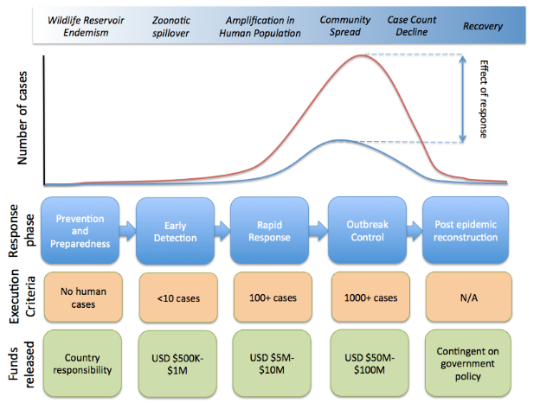
Payment Schedule
3
Source: ARC and partners

Slide 20
Contigency Planning and Monitoring
4
1
Current ARC Standard Operating Procedures
Objective Trigger Met
Country develops & submits Final Implementation plan (FIP)
ARC Agency reviews and approves FIP
ARC makes insurance payout
Country executes FIP and M&E¹ w/ ARC audits
ARC O&E will build on lessons learnt from previous payouts to ensure effective deployment and use of capital

Slide 21
Sovereign Risk Pooling
ARC results from 2014
Predictive capabilities accurately targeted country need
ARC paid out $25 million to mitigate the effects of severe drought before the UN appeal process to secure additional required funding had been launched
ARC payouts able to address immediate funding needs while additional support from other stakeholders could be deployed
Source: ARC internal documents

Slide 22
Challenges
Moral hazard and crowding out
Regional nature of epidemics
Peer review challenges
Data quality for surveillance and prediction

