Slide 1
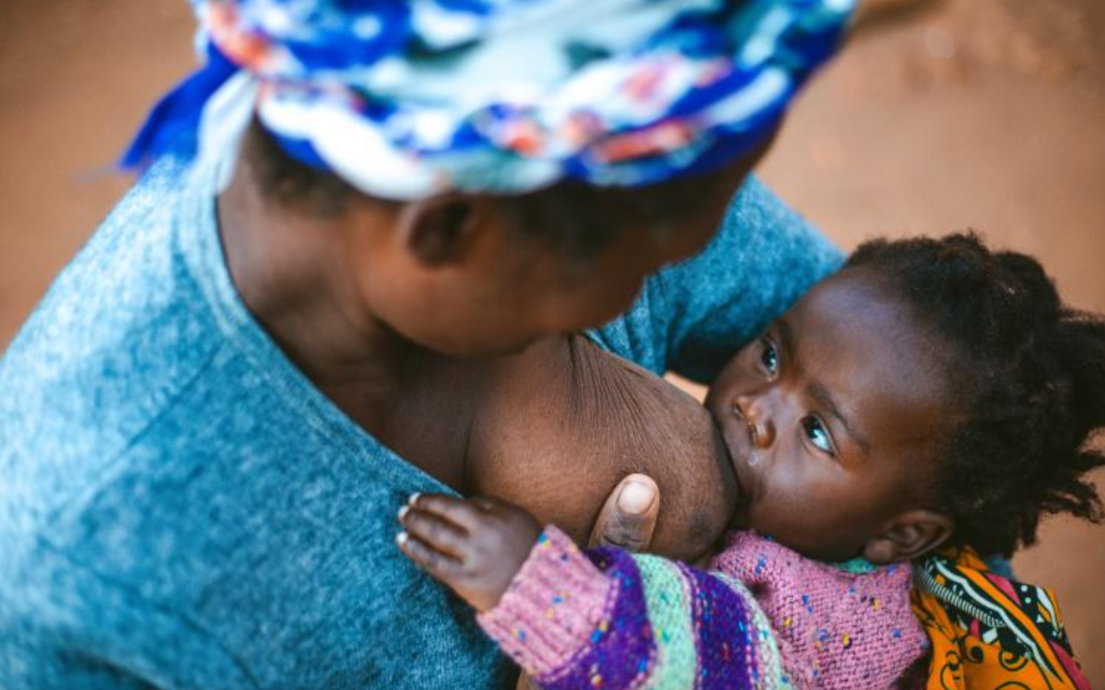

Improving Financing Arrangements for Primary Healthcare Malawi
UNICEF Mongolia
Presentation by Government of Malawi at the CABRI PRW
8-9th November 2023, Cape Town
Date 23rd March 2021
Notes:
Presentation Title Slide with UNICEF logo and new signature and mother and child image. (change slide image relevant to presentation.)
Possible use: at start of presentation when introducing presenter and subject
UNICEF Malawi/2021/HD Plus

Slide 2
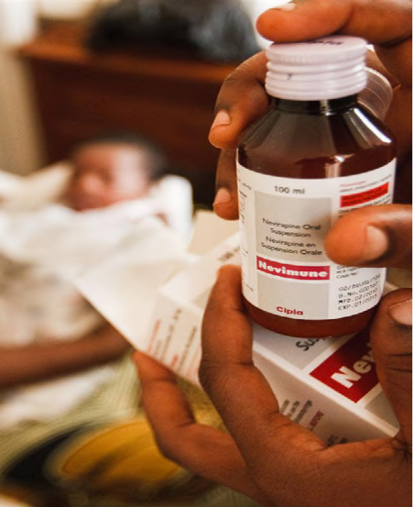
Statement of Problem
Inequitable and limited financial resources trickling down to primary healthcare facilities (1).
Primary healthcare facilities (2) do not receive funds (3) directly from the district or central level, instead receive resources in-kind from districts, upon placing an order with the district level.
The current arrangement limits the autonomy of facilities to plan and forecast their needs, budget, execute funding, and monitor expenditures.
The relevance and significance of the problem was validated through engagements held by the team with 3 District Health Officers (DHOs). There is no proper documentation or record keeping at the district or facility level on the size of in-kind or cash support given to facilities
The facilities of primary focus are health centers
This assignment primarily focuses on other recurrent transactions (ORT) funds to districts and does not include funding for drugs and personnel emoluments (PE)
Notes:
Other Assumptions:
Inflationary pressures would be contained, helped by re-anchoring expectations in line with the tightening of the monetary and fiscal policy stance

Slide 3
Why does this matter? PHC financing is critical to promote equitable access to high quality integrated services while minimizing financial hardships
It limits the effective functionality of facilities – due to the unpredictability of funding for basic operations and maintenance of facilities
Some facilities are left with very low allocations, which is not based on any clearly defined parameters, due to excessive discretion given to the District Health Office (DHO) with regards to the definition of the different allocations
The current arrangement has the potential to lead to hospital-based acquired infections and consequently child and maternal mortality, as primary healthcare facilities are not able to respond rapidly and efficiently to provide quality needed health services to most of the population who reside in rural areas and who have higher poverty rates
Limited community engagement in planning, budgeting and implementation – communities served by government facilities do not receive timely and transparent information about budgetary allocations and execution, which limits their capacity to hold facility managers accountable.
Lack of materials demoralize health workers, which result in poor service delivery.
Notes:
Other Assumptions:
Inflationary pressures would be contained, helped by re-anchoring expectations in line with the tightening of the monetary and fiscal policy stance

Slide 4
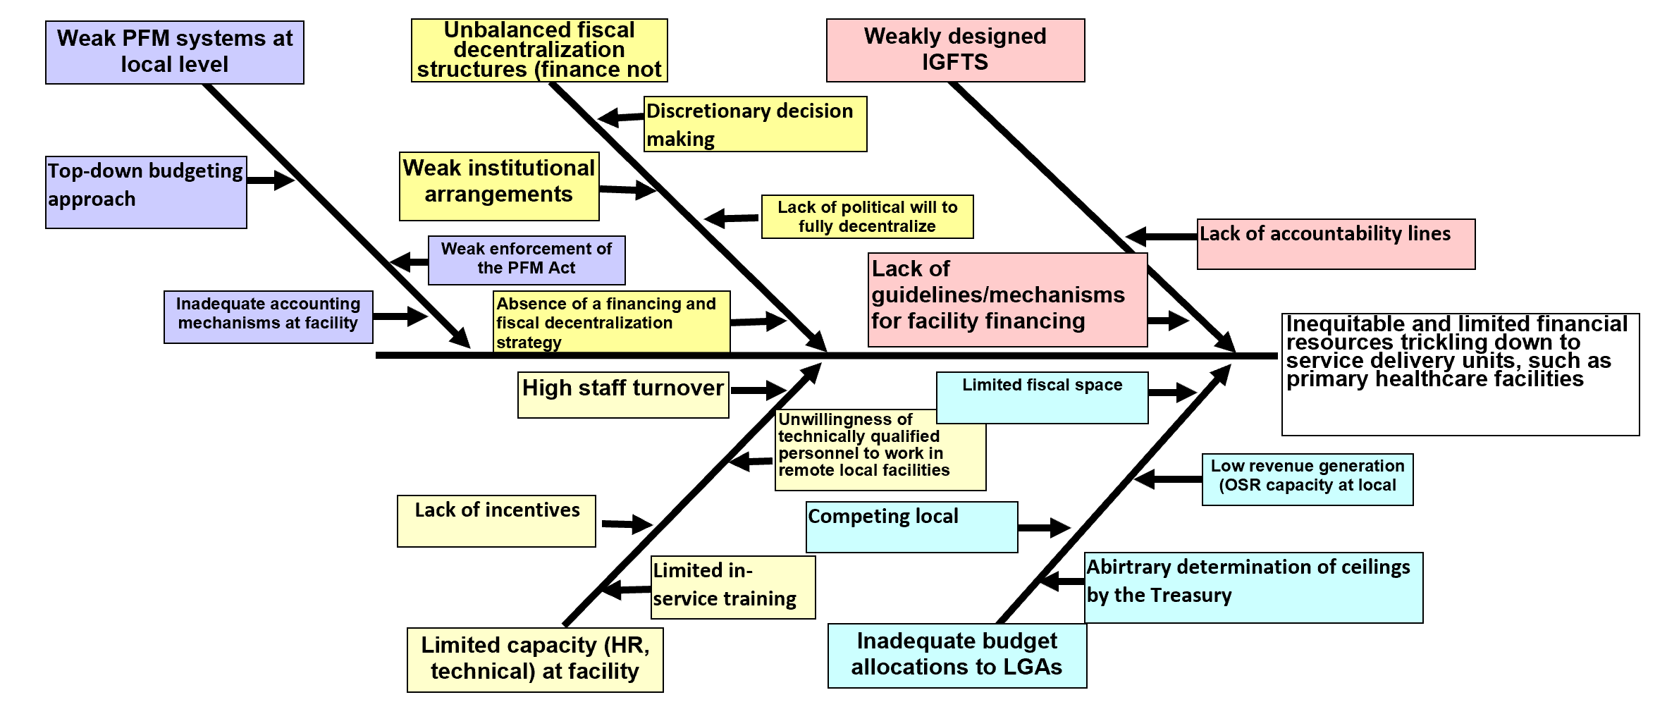
Causes and Sub-Causes (Fishbone)
The team mostly focused on this part of the fishbone, a key contributing factor to the problem
Notes:
Other Assumptions:
Inflationary pressures would be contained, helped by re-anchoring expectations in line with the tightening of the monetary and fiscal policy stance

Slide 5
Entry Points and Ideas for Action
 |  | Authority | Ability | Acceptance | Ideas for Action
#1 | Weakly designed IGFTS
----> | Lack of guidelines/mechanisms for facility financing | High | High | High | Influence the MoH to develop and implement guidelines for health facility financing Support the MoH to develop and implement guidelines for health facility financing
----> | Lack of accountability lines | Medium | High | Medium
#2 | Inadequate budget allocations to LGAs
----> | Limited fiscal space | Low | Low | Medium
----> | Low revenue generation (OSR capacity at local level) | High | Medium | High
----> | Competing local priorities | Low | Low | High
----> | Arbitrary determination of budgetary ceilings by Treasury | High | High | High | Advocate with the Treasury, based on identified costed needs
Notes:
Other Assumptions:
Inflationary pressures would be contained, helped by re-anchoring expectations in line with the tightening of the monetary and fiscal policy stance

Slide 6
Problem Statement and Ideas for Action: key insights and lessons learned
Factors affecting implementation of direct facility funding in the health sector
The presented Fish bone was largely agreed upon, but the following issues/bottlenecks were raised for consideration as the Government pursues efforts to reform PHC financing:
Fear of financial mismanagement at the facility level and how it will be managed
Skepticism on the availability and adequacy of backstopping services from the center – both finance and medical.
Several unknowns, with the following key questions emerged
  “where to start from?”
  “what if it doesn’t work well”
  If it fails, how significant will the human cost be?
The argument around creation of cost centers for health facilities vs the requirements for a facility to attain cost center status from Treasury
Fears about the ability of Malawi’s currently constrained revenue generation capacity to sustainably raise the required funds to support predictable direct funding to facilities.
Notes:
Other Assumptions:
Inflationary pressures would be contained, helped by re-anchoring expectations in line with the tightening of the monetary and fiscal policy stance

Slide 7
Leveraging on ongoing PFM work and sector platforms
Overall, there is strong willingness both from the center and the local level to explore the direct facility funding initiative, leveraging on ongoing work and technical platforms. For example:
  Availability of a Task Force on Direct Facility Funding
  Study tour by Task force members to Tanzania On DFF
  Ongoing DFF pilot in one Local Council, Rumphi
  CABRI member (from MoH) Chairing the DFF Task force

Slide 8
Key lessons learnt for the implementation of DHFF in Tanzania
Health facility autonomy brings efficiency; create space where health facilities can perform independently
Availability of enablers e.g. standard operating procedures and guidelines (cost sharing, digitization etc.) brings consistency, predictability and order in management of DHFF
Digitalization is key and avoids inefficiency in the system all levels
Better Planning and community involvement in the process yields better results
DFF Implementation is a process that gets refined along the way; learn in course of implementation.
Community empowerment across the Public Finance management cycle is key in enhancing transparency and accountability.

Slide 9
Experience from the implementation of Primary School Improvement Grant (PSIG) in improving autonomy and budget implementation
In Malawi, public schools (primary) access funds through the Local Councils, with each school having its own bank account;
Once funding is made at Council level, resources are remitted to the schools’ bank accounts based on cashflow provided;
Once schools have received the funds, they start spending in line with what is in their school improvement plan (SIP);
One of the school officials is assigned to manage the school funds with guidance from the Head Teacher (HT) and school management committee (SMC);
The schools work hand in hand with oversight bodies such as the SMCs for transparency and accountability purposes;
Schools can not spend without the consent of the SMCs;
To ensure that the schools are implementing what is stipulated in the SIP, requests for payments are submitted to the District Education Office for approval. Similarly, the DE office conduct regular monitoring visits to schools.
This approach has improved autonomy and ensured consistent execution of allocated budgets in the education sector

Slide 10
Lessons from the Education Sector
The implementation of DFF need not be conditioned on the “cost center argument” – for it is possible to implement DFF without making facilities cost centers, as is the current case with several primary schools which are receiving PSIG although they are not cost centers
With capacity building, e.g., basic training on accounting, facility staff (such as teachers) and communities can effectively manage and account for public funds
There are already existing capacities from District Officers (such as District Education Managers Office) to provide the necessary backstopping services for devolved facilities
Ongoing financial developments in Malawi support facilities to open bank accounts within their respective district centers
The implementation of DFF needs to be accompanied by supporting frameworks such as resource allocation formulae to be used to objectively and transparently allocate resources across facilities.

Slide 11



For the Health Sector: direct health facility financing (DHFF) is one of the “game-changer” reforms of the Health Sector Strategic Plan III and the National Health Financing Strategy
The HSSP III defines a prioritized package of critical health services as part of the Health Benefits Package (HBP)
Implementing DFF and provider payment reforms are potential avenues for efficiency. The HSSP III and the Health Financing Strategy mention both Health Center Improvement Grants and DFF as policy options.
Considering the limited fiscal space for expansion of both government and donor budgets, continued efficiency gains are critical for Malawi to deliver the HBP and achieve its UHC goals.
Health expenditures are currently estimated at $39.8 per capita, far below the WHO recommendation of $86 per capita for low-income countries.

Slide 12
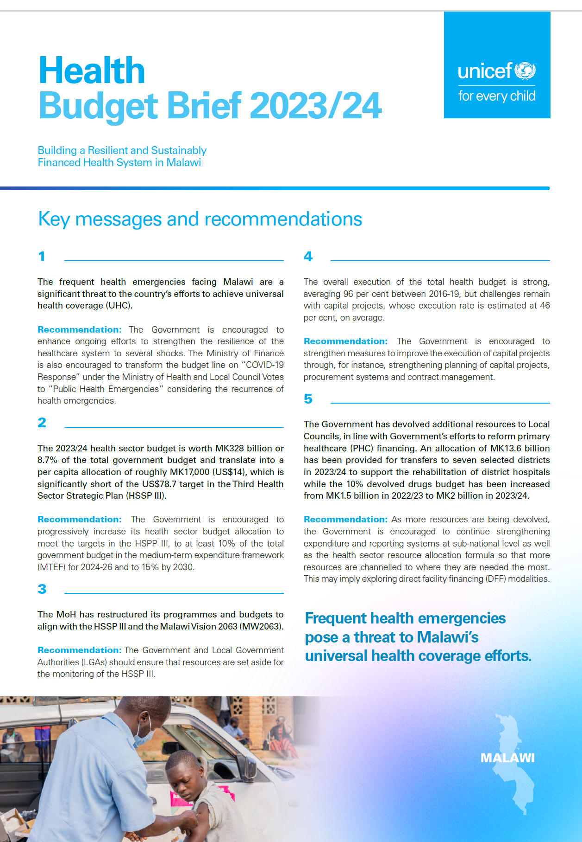
Aims of DFF in the
HSSP III & HFS
  To empower facilities to lead in the health improvement of their catchment areas
  To facilitate a One Plan, One Budget and one M&E mechanisms at facility level where local partners support a health facility plan
  To strengthen community oversight of health facilities and community participation in the provision of client-centred care
  To catalyze health financing reform i.e. voluntary community/corporate financial/in-kind contributions to health facilities

Slide 13
General pre-requisites for DFF implementation
Prerequisites for facility enrollment into DFF
  At least one trained health staff
  Functional Health Facility Governing Committee
  Facility Health Plan
  Service performance data (HMIS)
  Active Facility Bank Account
  Revenue Accounting person
  Functional Communication Channel

Slide 14
Additional Ideas for Action from the Stakeholders Meeting
Advocate for more budgetary allocation to implement DFF.
Strengthen the intergovernmental fiscal transfer system and ensure design and implementation of resource allocation formula to support PHC financing reforms
Engage and support the Ministry of Health to establish a clear evidence-based policy direction with regards to PHC financing. Two policy options could be considered:
  Support process of primary health facilities to be declared fit to be cost centers
  Pilot the implementation of DFF using Government resources in selected health centres in a selected Local Council and provide basic accounting training and backstopping services to healthcare staff
Notes:
Other Assumptions:
Inflationary pressures would be contained, helped by re-anchoring expectations in line with the tightening of the monetary and fiscal policy stance

Slide 15
Challenges faced in implementing ideas and how the team addressed these
The question of whether to make health facilities cost centers
The question of availability of qualified personnel to work in such facilities as accounts staff
The question of whether there would be enough workload at the facility to require such staff
The overall size of the resource basket that may need to be increased.
The matters are still being discussed at the wider level where options are being examined to come up with the best fit.
Lessons learnt from the Education Sector implementation of school improvement grants and Direct Health Facility Financing in Tanzania are currently under consideration.
Notes:
Other Assumptions:
Inflationary pressures would be contained, helped by re-anchoring expectations in line with the tightening of the monetary and fiscal policy stance

Slide 16
Measures of Success
Entry Point | Measures of progress or success
Develop and implement guidelines for Direct Health Facility Financing | Taskforce of relevant stakeholders on DFF is in place and functional
 | Number of consultative meetings conducted.
 | A formula for disbursing Government transfers direct to facilities is formulated at Council level.
 | Facilities in three district councils start receiving direct transfers on a pilot basis within the first year of implementation.
 | Communities under the service of the facilities are participating in decision making through the health facility management committees.
 | Systems are put in place for proper record keeping and accounting at facility level
 | Guidelines are disseminated to all District Health Offices
Advocate with the Treasury based on identified costed needs | A transparent mechanism is put in place for determination of ceilings for facilities
 | An upward adjustment on the resource allocations for the sector based on the costing models that were formulated.
 | A comparative study with the Education sector which is currently implementing a direct transfer system for primary school resources.
 | Comparative learning from other countries within the region on how health facilities are funded –relative levels and systems.
 | Periodic reviews reports.

Slide 17
Working in new ways and building capabilities
The participation to the DFF Taskforce and engagement has helped in reaching out to the authorities that do matter in this process. It has opened a lot of opportunities on how the CABRI work can be scaled up.
The engagements through the district visits and the stakeholders meeting we had has revealed the complexity of the matter considering the current financial management system in Malawi
The authorizing environment is complex being a government set up. There are many stakeholders and processes to be undertaken before a significant change can be applied to the current system.
Gathering all team members as and when need arises prove to be difficult due to other work pressures in our various fields. However, team work still proves to be an efficient and effective way of tackling the problem at hand. We have been able to divide ourselves to attend different tasks then share the experiences later.
The complexity of the reform clearly shows that the reform it will be resolved and implemented beyond the 12 months BPFCC program. There is still need for more consultations and consensus on various reform modalities
Notes:
Other Assumptions:
Inflationary pressures would be contained, helped by re-anchoring expectations in line with the tightening of the monetary and fiscal policy stance

Slide 18
Next Steps – Nov ‘23 – April 2024
Roadmap for Development and Implementation of the DHFF
  Develop an intra-resource allocation formula
  Consultations with DHOs on the intra-resource allocation formula
  Presentation to Health Financing TWG and SMT
  Engagement of Treasury on the Formula
  Finalization of the Formula
  Pilot of the DHFF in Selected Districts, beginning April 2024 (start of FY2024/25)
Notes:
Other Assumptions:
Inflationary pressures would be contained, helped by re-anchoring expectations in line with the tightening of the monetary and fiscal policy stance

Slide 19

Conclusions and recommendations
From 2024/25 HFs will access DFF funds from a pool of donor funds under the Health Services Joint Fund through the District Councils
From 2024/25 the Government will introduce Health Funds which will disburse funds to DFF account. HFs will receive funds directly from the Treasury
Going forward, MOH to work toward the pooling of donor and government funds to be directly disbursed to the health facilities
For cost-effectiveness MOH is advocating online training and not face-to-face. However, training of downstream structures will continue through physical contact

Slide 20


Thank you.
Reflections.
© UNICEF/UN01234567/Photographer

Slide 21

Progress since the Framing Workshop
2. Framing Workshop
4. Regional PHC Financing Forum
Refined our problem statement and identified ideas for action
Greater awareness of the Malawi Team of the PDIA
2 of the Team Members attended a Regional PHC Financing Forum which discussed Malawi’s PFM challenge
Learning Points from Regional Peers (Uganda and Tanzania)
Helped to contextualize the identified PFM challenge and suggested ideas in the framework of PHC Financing Reforms being pursued by Malawi
6. Implementation of Action Plan
February 2023
27-28 March 2023
July 2023+ 🡪
Weekly Technical Meetings
Weekly Technical Meetings
Weekly Technical Meetings
November 2022
1. Kick-Off of CABRI Work
Key Next Steps
Presentation and Discussion of PFM challenge and proposed action plan at Health Financing TWG
Field Visits to 6 selected Districts to gather more evidence and ensure inputs from diverse Local Councils are accurately captured and used to inform the reform process
Engagement of MoH Management to review the proposed action plan and support its implementation
UNICEF to continue supporting the reform process
Opportunities for Learning
  Ongoing DFF Pilot, supported by UNICEF through FCDO Funds
  Learning from the Education Sector Primary School Improvement Grant (PSIG) Financing Arrangement
Mid-March 2023
9th June 2023
3. Scoping Mission to Lilongwe DHO
5. National Stakeholders’ Consultation Meeting
Conducted a scoping mission to Lilongwe District Health Officer, to gather more information and evidence to substantiate the relevance of the problem statement and its importance
Presented the problem statement and proposed solutions to key stakeholders (MoF, LGAs, DPs – UNICEF, FCDO, CHAI; CSOs)
PFM challenge validated, problem and its relevance strengthened
Feedback used to strengthen ideas for action and refine key next steps

