Slide 1


Team Zambia: BPFCC Progress
Program Review Workshop
Cape Town
November 2023
© UNICEF/UN0286458/Sang Mooh

Slide 2
OUTLINE
Problem statement
Overview of the program Katete is implementing
Status or progress
Outputs achieved
Lessons learnt
Challenges faced in the implementation
Way forward
Next step

Slide 3
Situating the BPFCC Project in Zambia
UNICEF Support
Government Priorities
Support to Budget Reforms (OBB)
Vision 2030 and 8NDP
Decentralization Policy and Implementation Plan
Debt Management Act
The BPFCC is situated in the broader decentralization support to the government
Support the IFA
Budget Analysis
Decentralisation Pilot

Slide 4
Pillars of the Decentralization Pilot
CDF Uptake
Social accountability
Financing
Local Authority success in implementing devolved social services
Citizens will be empowered to monitor performance of the CDF
Support access to, and coordination of, Constituency Development Fund (CDF) components
Support to strengthening of local level planning, resource mobilization and budgeting (financing)

Slide 5
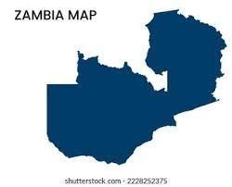
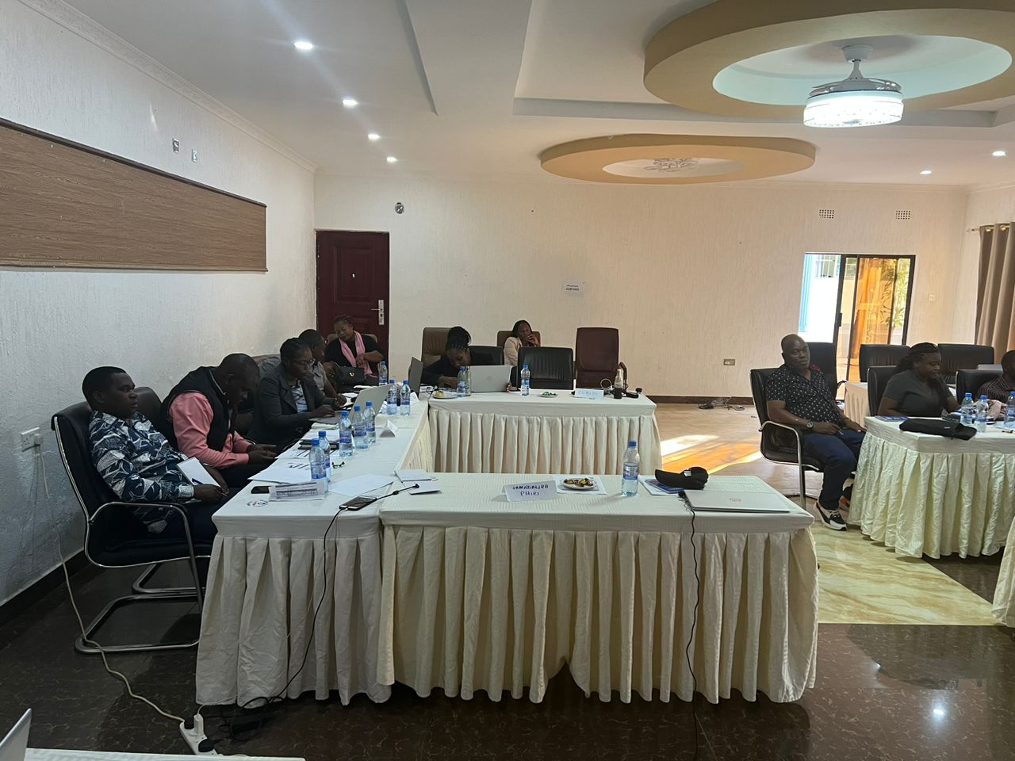
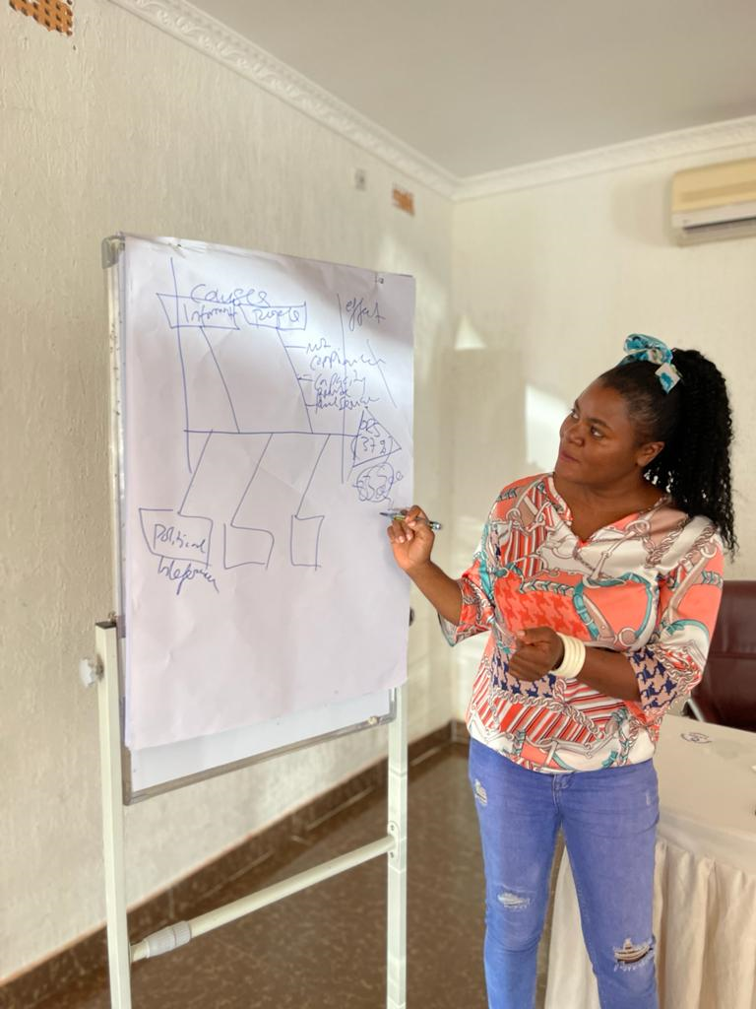
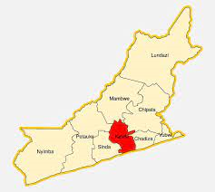
Process Mapping
Identification of the district
Workshop with LAs
Revision of the fishbone
Identification, adoption and costing of best practices
Implementation
Review and replanning
Documentation and scale up

Slide 6

Problem Statement
Low Own Source Revenue(OSR) in Local Authorities has resulted into inadequate provision of social services in Zambia, ultimately perpetuating poverty situation.
Average collection efficiency (37%).
Failure to collect has been highlighted in the AG Report.
Some LA have C.E of 3%
Rural/Urban comparison
Trend analysis of selected LA
Key sectoral analysis(health, WASH)
Tax base/progressivity
LA unable to deliver mandated services to communities
Communities not accessing required services

Slide 7
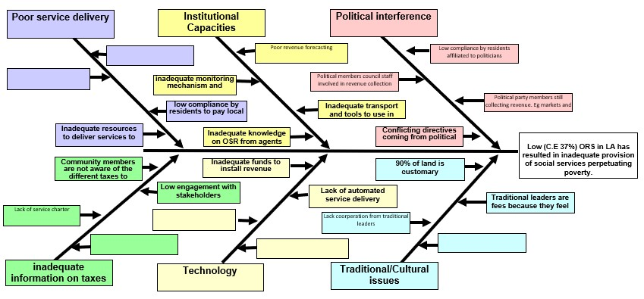
FISHBONE – KATETE

Slide 8
Action Matrix Causes and Sub Causes
What is the identified issue from the fishbone | How will the issue be addressed | Cost | What is the deadline to implement | Who is responsible for leading the work | What could success look like with this idea
Institutional capacity Limited capacity and skills from the revenue collector | This issue will be addressed by providing capacity building to revenue collectors through trainings Updating the revenue database by engaging agents to collect data | - K50,000 | By 31st December, 2023 | - Planning and Finance | Improve public relations Increased compliance from tax payers High revenue collection
Low collection from property rates - Lack of willingness to pay | - Regular Sensitization of property developers through radio programs, PA system, role plays and stakeholder meetings | - K100,000 | By 31st December, 2023 | - Planning and Finance | Increased compliance High revenue collection
Information - Lack of awareness on taxes what need to be paid | Stakeholder sensitization through regular engagements by community meetings, radio programmes and PA System | - K80,000 | By 30th November, 2023 | Planning and Finance | Improved awareness from tax payers Increased access to information Increased compliance from tax payers

Slide 9


What is the progress so far?
Improved public relations from revenue collectors and agents
Increase in compliance
Increase in revenue collection
Improved awareness
Reduction in revenue loss
Training of revenue collectors and agents done
Engagement of data collectors to update the revenue database is done
Updating the database is at 80% completion
Courtesy call to the chiefs has been done
Radio programmes have been held and it is ongoing

Slide 10
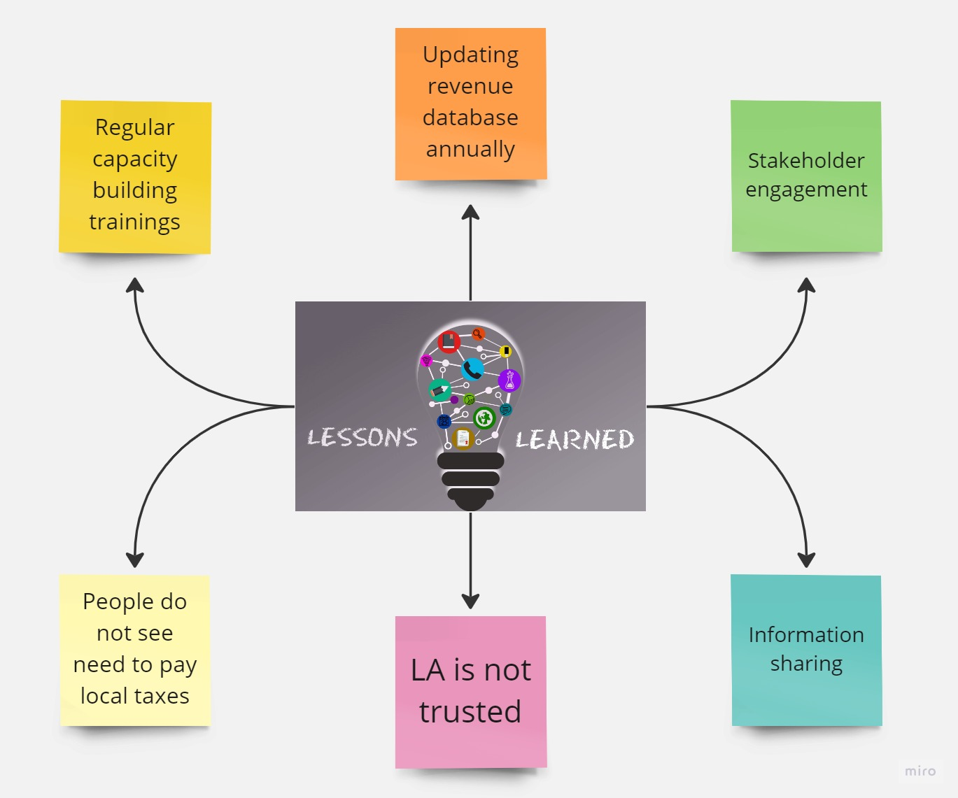
Lessons learnt

Slide 11

Challenges faced to implement the project
The LA is still using manual revenue collection (pilferage/leakage)
The LA can not rate properties under customary land (that’s where infrastructure growth is taking place)
The LA has no OSR strategy
The LA has no service charter
Lack of trust from the tax payers
Lack of revenue vehicle and poor road network
Inconsistence in the data collected
Data collection consumes a lot time

Slide 12

Way forward
The LA must develop an OSR strategy
The LA must develop a service charter
The LA must look at ways of introducing e-levy payments
Engage Traditional Leaders on properties that are on customary land
The LA to continue engaging stakeholders using various platforms

Slide 13

Stakeholder sensitization through community meetings and PA System (In the outskirts of the district)
Development of a program with UNICEF to address some identified challenges

