Slide 1


Slide 2

Underutilization of non-wage budget for Primary and Secondary Education 2018 - 2022

Slide 3
Problem Statement
United nations sustainable development goal number 4 gives the provision of quality education to the citizens of each nation. The national constitution of Zimbabwe gives the provision of affording each school going age child an opportunity to access free basic education. The nation has a shortfall of close to 3,000 schools around the country and in the 8 rural provinces have a great number of satellite schools remain unregistered due to lack of the required infrastructure. For the registered schools, there is deteriorating infrastructure and equipment that do not match the competence based curriculum. Teaching and learning materials remain a perennial issue in the provision of improving pass rate. An estimated number adding to 2,000,000 school going age children are out of school. Beside the budget being allocated the budget utilisation remain low.

Slide 4
Why the problem matters?
More Than 2,000,000 School Going Age Children Out Of School (Due To Lack Of Social Support)
Building Of New Schools And Additional Classrooms For Expansion {Shortfall Of Schools (3000)}
Improvement Of Existing Infrastructure
1,960 Satellite Schools Remain Unregistered
Inadequate Teaching And Learning Materials

Slide 5
A meeting was held to discuss challenges and come up with solutions. The Ministry of Finance pledged its continued support to the Ministry and promised timeous release of requested resources. It was commended that the Budget Execution committee chaired by the Deputy Minister of Finance continue to sit.
PROJECT TIMELINE
Our Journey So far
February-Framing Workshop
Attended Framing Workshop,, Johannesburg, South Africa
April-Development of Accounting Procedures Manual
Held a national consultative and draft of the Accounting procedure manual in Mutare Zimbabwe, where all provincial accountants and administrators were represented. The workshop produced a draft Accounting Procedures Manual.
2023
A workshop was held to collect data and train key stakeholders within the Ministry on PBB. This workshop proved to be fruitful as there was expression of much appreciation from the participants. We discovered that most people where not aware of what PBB was all about.
June-Held workshops on Program Based Budgeting.
Serious discussions were held between three departments. Challenges were discussed and solutions were proffered. The meeting came out with a pact that would ensure transparency and smooth flow of documents and information between the three departments.
July-Finance, Procurement and Administration Departments
August-Meeting between Finance and MOPSE

Slide 6

2018- 2022 BUDGET REVIEW

Slide 8
Causes

Slide 9
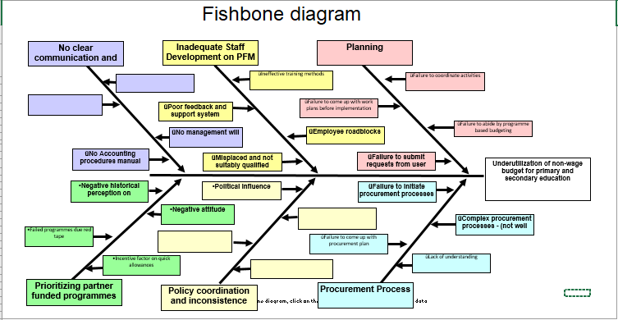

Slide 10
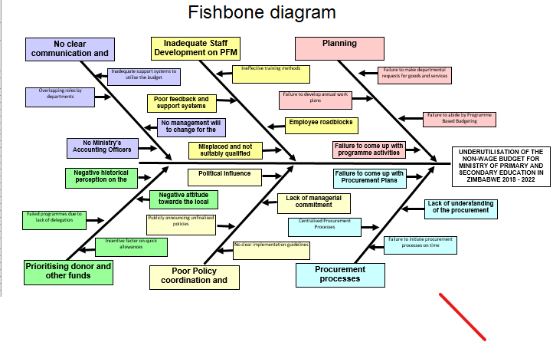

Slide 11
Entry points and ideas for action

Slide 12

Planning
Held capacity development workshops to strengthen planning
Held workshops on Programme Based Budgeting
Highlighted and taught the importance of having Annual Work Plans and how they help to track progress
Emphasized on departmental request for goods and services

Slide 13
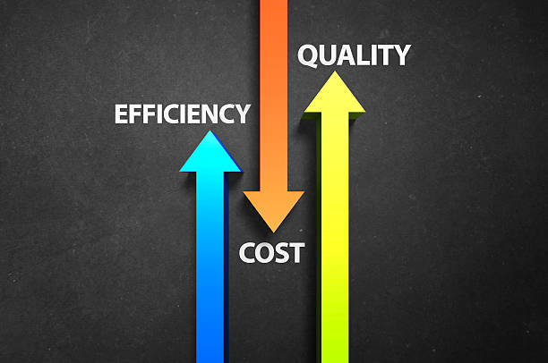
Procurement Process
Departments to initiate the process by requesting for the purchase of goods and services
Procurement Management Unit to train staff on the processes
Procurement Management Unit to assist departments in the preparation of the Annual and Individual Procurement Plans
Procurement Management Unit to be decentralised

Slide 14
Inadequate Staff Development on PFM
Have competent suitably qualified personnel placed in key departments
Allow employees to give feedback in whatever is affecting the operations
Sharing information after attending trainings and workshops
Having competent staff to facilitate at the training workshops
Availing the required resources to enable effective training sessions

Slide 15

Policy coordination and inconsistence
Advocating for consultations to take place before political announcements
Having clear guidelines to support and strengthen the agreed policies
Having support from management on willingness of policies

Slide 16

No clear communication and defined roles
Having consultations for the preparation of the Accounting Officers Procedures Manual
Setting up a steering committee to spearhead the preparation of the manual
Consulting all stakeholders and departments on the day to day operations
Coming up with a tailor made Accounting Officer’s Procedures Manual which is not generic but the one that speaks to the daily operations of the Ministry guided by the relevant statutes

Slide 17
Prioritizing partner funded programmes at the expense of appropriation funded
Expediting expenditure processes
Advocating for adequate cash support for the operations
Strengthening documents processing from the user to the final payment stage by ensuring that no one holds the documents in their offices
Prioritizing the use of Appropriation funds even if we have other funds from various partners
Prioritising the job factor rather than incentives

Slide 18
Lack of managerial commitment
Delegating responsibilities and roles
Having clearly defined work plans that encompasses every sub department
Taking the Integrated Result Based Management Performance Appraisal System seriously

Slide 19

Measure of Success

Slide 20
Success
Non-wage budget shot up to 88.48%
Training of staff on Programme Based Budgeting
Training of staff on procurement processes
Increased request for goods and services
Started consultations on the preparation of the Accounting Officers Procedures Manual

Slide 22
Working in new ways and building capacities

Slide 23


Slide 24
New ways and building capacities
Continuous training of staff on Programme Based Budgeting
Continuous training of staff on procurement processes
Increased advocacy for request for goods and services
Continue consultations on the preparation of the Accounting Officers Procedures Manual

Slide 25


Slide 26

Next Steps
Continuous training of staff on Programme Based Budgeting
Continuous training of staff on procurement processes
Increased advocacy for request for goods and services
Continue consultations on the preparation of the Accounting Officers Procedures Manual

Slide 27


Q & A time
?

Slide 28

SIYABONGA
TATENDA

